Slide 1
Unit 2 Applied computing Delivering the outcomes
2020–2024

Slide 2
Copyright
© Victorian Curriculum and Assessment Authority (VCAA) 2019.
VCAA presentations may be reproduced in accordance with the VCAA’s Copyright and Intellectual Property Policy, and as permitted under the Copyright Act 1968.
VCE is a registered trademark of the VCAA.

Slide 3
Unit 2 Applied computing

Slide 4
Overview
O1
Innovative solutions
O2
Network security
Unit 2
Applied computing

Slide 5
Delivering Unit 2 Outcome 1 Innovative solutions

Slide 6
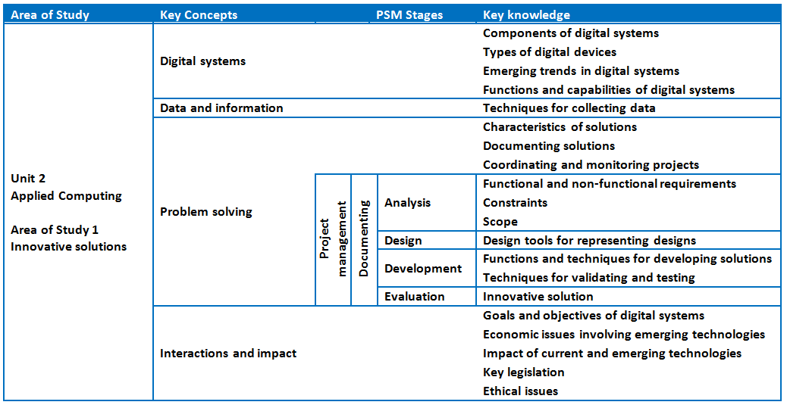
Unit 2 Outcome 1 – Background

Slide 7
Unit 2 Outcome 1 – Background
Students need to be able to:
investigate a problem, need or opportunity
analyse solution requirements
design an innovative solution
develop and document the innovative solution as a proof-of-concept, prototype or product
evaluate the innovative solution
develop project plans (collaborative project).
Students can learn through:
theory and explanation of key knowledge
case studies
exercises
class activities (including from Advice for teachers).

Slide 8
Unit 2 Outcome 1 – Innovative solutions
The innovative solution may take the form of a proof of concept, prototype or product. Students choose one of the following topics to explore in greater detail:
artificial intelligence, machine learning or neural networks
assistive and wearable technologies or Internet of Things (IoT)
creating with digital systems such as drones, microcontrollers, nanosatellites and robotic devices
games development, multimedia programming or web authoring
mixed realities such as augmented and virtual reality
investigation/research project on innovative uses for emerging technologies such as blockchain
any other innovative digital solution.

Slide 9
Unit 2 Outcome 1 – Planning questions
Some questions to consider when planning for Unit 2 Outcome 1:
How will you prepare your students for this outcome?
How will your students identify a need or opportunity?
What do your students know about planning and collaborating in a project?
How will your students select an appropriate topic and research it?
How will you approve and manage student projects?
How will you ensure the chosen projects will take the form of a proof-of-concept, prototype or product? How will students plan for this?
How long will you need to teach and assess this task? Keep in mind you could have a part of Term 2, the whole of Term 3 and even part of Term 4 for this.
How will your students complete a project that will meet the requirements of the outcome?
How could you showcase student projects at school?

Slide 10
Unit 2 Outcome 1 – Suitable tasks
Some suitable assessment tasks could be:
Presentation of an innovative solution
a presentation to the class using video or PowerPoint to present findings to the class
Written report
a report that presents the development of an innovative solution
Annotated visual report
a PowerPoint presentation with images and notes/explanations on the development of an innovative solution.

Slide 11
Unit 2 Outcome 1 – Innovative solutions
The process for developing an innovative solution is:
Proof-of
-concept
Prototype
Product

Slide 12
Unit 2 Outcome 1 – Proof-of-concept
The term proof-of-concept has a range of different interpretations in a range of areas.
For the purposes of Unit 2 Outcome 1 the following are useful to consider:
an idea or a method that demonstrates some feasibility
determining whether an idea can be turned into a reality
practical demonstration of a concept
involves research and review
explores the potential of an idea to be developed
identify the features of a product before the development of it
can be a partial solution in software development
identify issues that could affect success
does not have to be complete.

Slide 13
Unit 2 Outcome 1 – Prototype
The terms proof-of-concept and prototype are often used interchangeably. However, they are different processes for different purposes.
For the purposes of Unit 2 Outcome 1 the following are useful to consider:
a prototype turns the idea (proof-of-concept) into a basic version of an end product
can be a basic working model or an attempt at making a working model
acts as a sample for users and clients to provide feedback
it is not expected to have all the features and functions of an end product
visualises how the product will function
shows how the product will be developed
helps to provide specifications for the product
a prototype can be tested and evaluated

Slide 14
Unit 2 Outcome 1 – Product
A product is an item or a service.
developed to meet a need or opportunity
can be physical or virtual
has to be functional.

Slide 15
Unit 2 Outcome 1 – Some examples
Artificial intelligence:
using a programming language to create a chatbot using Python, Java and Ruby
you could create something to support students/improve student outcomes
Blockchain:
using in a school for the issuing of results and certificates
using for making financial payments in a school
IoT:
used for physical security in buildings such as the unlocking of doors, etc.
Drones:
for imaging crops, farms and coastal areas using different wavelengths of light
App:
creating an app on a smartphone to communicate with a watch worn by a user who is aged or has a disability to prompt them (to eat, go to class, wake up)
Augmented reality:
a camera screen in front of the driver used as a head-up display that assists the driver in navigation or steering

Slide 16
Unit 2 Outcome 1 – Sample task idea
A sample task idea could be:
Innovative solution
Innovative solution using digital systems that includes: proof-of-concept prototype product Collaborative project
Written report
Written report that includes: a project plan an analysis of need or opportunity evidence of data collection documentation of solution requirements solution designs documentation of development process including how the group collaborated potential legal and ethical issues detailed testing table evaluation of the efficiency and effectiveness of the innovative solution
Presentation
A class presentation that includes: an identification of the need or opportunity details of solution requirements and designs a demonstration of the proof-of-concept, prototype or product legal and ethical issues testing evaluation

Slide 17
Delivering Unit 2 Outcome 2 Network security

Slide 18
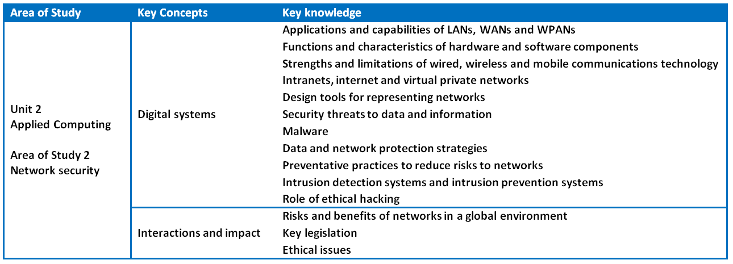
Unit 2 Outcome 2 – Background

Slide 19
Unit 2 Outcome 2 – Background
Students need to be able to:
identify and describe different networks
examine the impact of network vulnerabilities
design a network solution
identify and evaluate threats
propose and justify strategies
identify and discuss legal and ethical issues.
Students can learn through:
theory and explanation of key knowledge
case studies
exercises
class activities (including from Advice for teachers).

Slide 20
Unit 2 Outcome 2 – Planning questions
Some questions to consider when planning for Unit 2 Outcome 2:
How will you prepare your students for this outcome?
What do your students need to know about networks and network security?
How will you develop a case study? How will this task look?
How long will you need to teach and assess this task? It will be in Term 4 and depend on the length of time spent on Outcome 1.
Are you able to have your school’s IT Support staff assist you with this outcome? Explanation of the network or even facilitating some hands-on opportunities.
How will you bring the key knowledge and key skills together to develop an assessment task that will meet requirements?

Slide 21
Unit 2 Outcome 2 – Suitable tasks
Some suitable assessment tasks could be:
Case study with structured questions
a number of structured questions that address a case study
Written report
a report that addresses a case study, maybe with a word limit
Annotated visual report
a PowerPoint presentation with images/notes/explanations addressing a case study
a poster with images and explanations addressing the case study
Design of a wireless network or working model of a wireless network
a network design as part of a case study
development of a wireless network using mobile phones.

Slide 22
Unit 2 Outcome 2 – Sample task idea
A sample task idea could be:
Developing the case study
Development of a case study regarding an organisation and its setting that includes details of: the network and its capabilities vulnerabilities to the network threats to data and information
Developing the questions
Development of questions to respond to the case study that enables students to: identify and describe that applications and capabilities of the network examine the impact of the network vulnerabilities design a network solution for the organisation identify and evaluate the threats to the security of the organisation’s data and information propose and justify strategies to protect the security of the organisation’s data and information identify and discuss possible legal and ethical issues from ineffective data and information security practices

Slide 23
Phil Feain Curriculum Manager, Digital Technologies Victorian Curriculum and Assessment Authority
Ph: (03) 9032 1724 feain.philip.a@edumail.vic.gov.au

