Slide 1
Unit 2 Applied computing Introduction
2020–2024

Slide 2
Copyright
© Victorian Curriculum and Assessment Authority (VCAA) 2019.
VCAA presentations may be reproduced in accordance with the VCAA’s Copyright and Intellectual Property Policy, and as permitted under the Copyright Act 1968.
VCE is a registered trademark of the VCAA.

Slide 3
Unit 2 Applied computing

Slide 4
Unit 2 Applied computing Overview
O1
Innovative solutions
O2
Network security
Unit 2
Applied computing

Slide 5
Unit 2 Outcome 1 Innovative solutions

Slide 6
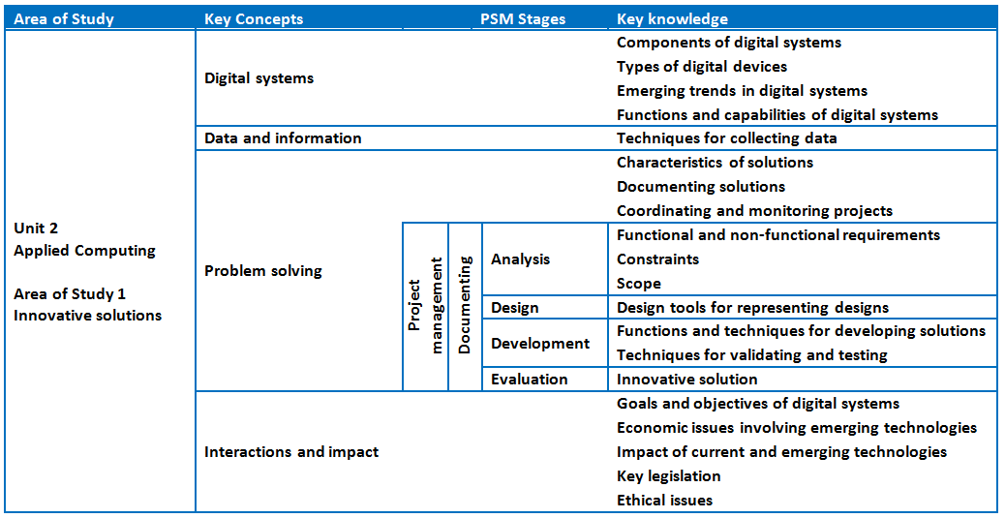
Unit 2 Outcome 1 Innovative solutions

Slide 7
Unit 2 Outcome 1 – Background Innovative solutions
The innovative solution may take the form of a proof of concept, prototype or product. Students choose one of the following topics to explore in greater detail:
artificial intelligence, machine learning or neural networks
assistive and wearable technologies or Internet of Things (IoT)
creating with digital systems such as drones, microcontrollers, nanosatellites and robotic devices
games development, multimedia programming or web authoring
mixed realities such as augmented and virtual reality
investigation/research project on innovative uses for emerging technologies such as blockchain
any other innovative digital solution.

Slide 8
Unit 2 Outcome 1 – Background Innovative solutions
Students should be able to:
in collaboration with other students
analyse, design, develop and evaluate an innovative solution to a need or opportunity
involving a digital system.
The innovative solution can be in the form of a proof of concept, prototype or a product.
Collaborative project.

Slide 9
Unit 2 Outcome 1 – Assessment Innovative solutions
Suitable tasks for assessment may be selected from the following:
a presentation (oral, multimedia, visual) of an innovative solution
a written report
an annotated visual report.

Slide 10
Unit 2 Outcome 2 Network security

Slide 11
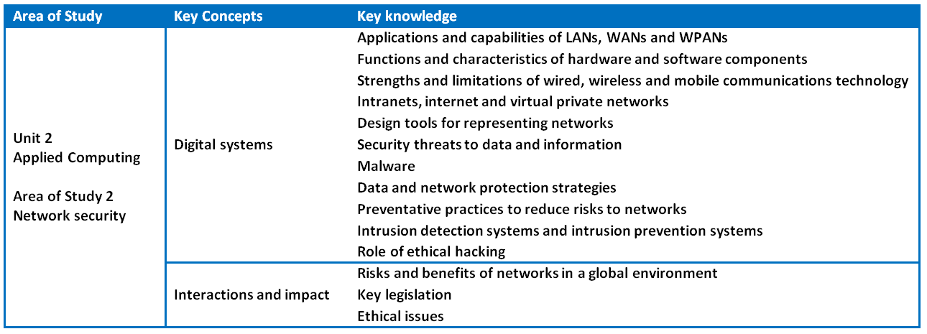
Unit 2 Outcome 2 Network security

Slide 12
Unit 2 Outcome 2 – Background Network security
Students should be able to:
respond to a teacher-provided case study
examine the capabilities and vulnerabilities of a network
design a network solution
discuss the threats to data and information
propose strategies to protect the security of data and information.
Design a network using an appropriate software tool.

Slide 13
Unit 2 Outcome 2 – Assessment Network security
Suitable tasks for assessment may be selected from the following:
a written report or an annotated visual report
a case study with structured questions
the design of a wireless network or a working model of a wireless network.

Slide 14
Phil Feain Curriculum Manager, Digital Technologies Victorian Curriculum and Assessment Authority
Ph: (03) 9032 1724 feain.philip.a@edumail.vic.gov.au

