Slide 1
Unit 3 Data analytics Delivering the outcomes
2020–2024

Slide 2
Copyright
© Victorian Curriculum and Assessment Authority (VCAA) 2019.
VCAA presentations may be reproduced in accordance with the VCAA’s Copyright and Intellectual Property Policy, and as permitted under the Copyright Act 1968.
VCE is a registered trademark of the VCAA.

Slide 3
Unit 3 Data analytics

Slide 4
Overview
O1
Data analytics
O2
Analysis and design
Unit 3
Data analytics

Slide 5
Delivering Unit 3 Outcome 1 Data analytics

Slide 6
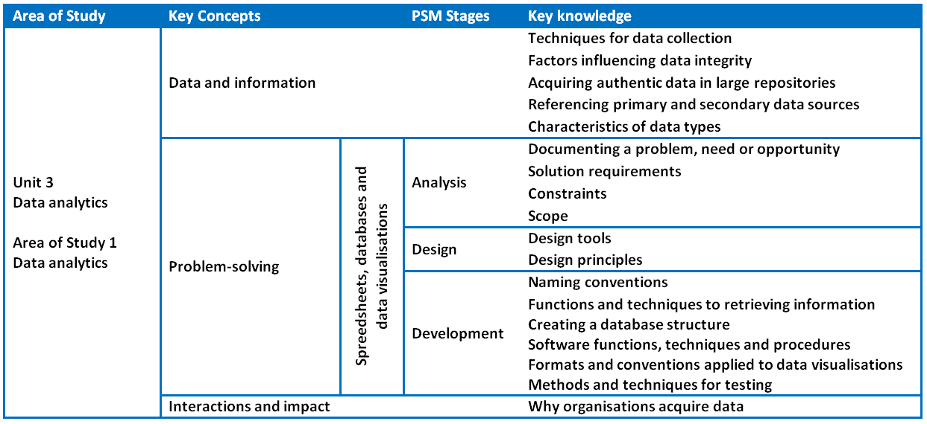
Unit 3 Outcome 1 – Background

Slide 7
Unit 3 Outcome 1 – Background
Students should be able to:
respond to teacher-provided solution requirements and designs
extract data from large repositories
manipulate and cleanse data
apply a range of functions to develop software solutions to present findings.
Software tools:
Database software, spreadsheet software and data visualisation software.
Assessment contribution and marks:
School-assessed Coursework for Unit 3 will contribute 10 per cent to the study score.
Total marks will be 100.
Assessment task:
SAC.
Respond to solution requirements and designs to create software solutions.
Address VCAA performance descriptors.

Slide 8
Unit 3 Outcome 1 – Descriptors
Performance descriptors from the Advice for teachers (Very high):
All solution requirements and designs are interpreted accurately in developing the database, spreadsheet and data visualisation solutions.
All relevant data is identified, selected and extracted from appropriate data repositories and referenced to acknowledge intellectual property.
Comprehensive use of features of the database software tool used to store, manipulate and validate data.
Comprehensive use of features of the spreadsheet software tool used to manipulate and validate data.
Comprehensive use of functions, formats and conventions to create effective data visualisations.
Comprehensive justification and explanation of how the selected functions, formats and conventions are used to create data visualisations.
Comprehensive range of test data is expressed in testing tables, with both expected and actual output stated.

Slide 9
Unit 3 Outcome 1 – Planning questions
Some questions to consider when planning for Unit 3 Outcome 1:
How will you prepare your students for this outcome?
What do your students need to know about data, spreadsheets, databases, data visualisations and presenting findings?
What software functions do they need to use? Refer to the Software functions and tools document for Data Analytics on the study page.
How long will you need to teach and assess this task?
Will you teach and assess spreadsheets separately?
Will you teach and assess databases separately?
Will you teach and assess data visualisations separately?
Will you teach all areas and assess in one task?
How will you bring the key knowledge and key skills together to develop tasks that meet requirements?

Slide 10
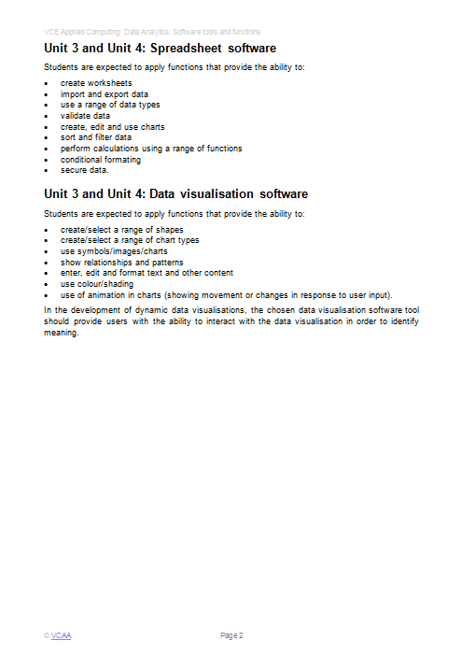
Software functions and tools

Slide 11
Unit 3 Outcome 1 – Strategies
There are several possible strategies for delivering this outcome.
Strategy 1
Break the outcome into its components and teach and assess:
Component 1 – interpret requirements and designs – extract data – create spreadsheet – test – 2 weeks to prep – < 1 week to assess.
Component 2 – interpret requirements and designs – extract data – create database – test – 2 weeks to prep – < 1 week to assess.
Component 3 – interpret requirements and designs – extract data – create data visualisations – justify formats – test – 2 weeks to prep – < 1 week to assess.
Strategy 2
Teach the outcome over 5-6 weeks and then assess at the end over 2 weeks.
Strategy 3
A combination of Strategy 1 or 2 while preparing for the SAT at the same time.

Slide 12
Unit 3 Outcome 1 – Task development
An approach for developing an assessment task could be:
Determine the number of activities that you require students to complete.
Use the key knowledge, key skills, performance descriptors and Software tools and functions to determine the required content within the task.
Determine a scenario or small case study that the task will address. Include:
solution requirements
designs
Check that the task is accessible to students and can be completed in the required time. Do the task yourself.
Develop a marking scheme consistent with the key skills and the performance descriptors (100 marks).
Determine the weighting of the criteria within each module.

Slide 13
Unit 3 Outcome 1 – Commercial tasks
If using a commercial task:
Check the task against the outcome statement, key knowledge and key skills.
Only include content that is within the scope of the outcome.
The task it is to be significantly modified in terms of context and content.
Marking schemes also need to be checked to ensure accuracy and that they contribute to 100 marks.

Slide 14
Delivering Unit 3 Outcome 2 Analysis and design

Slide 15
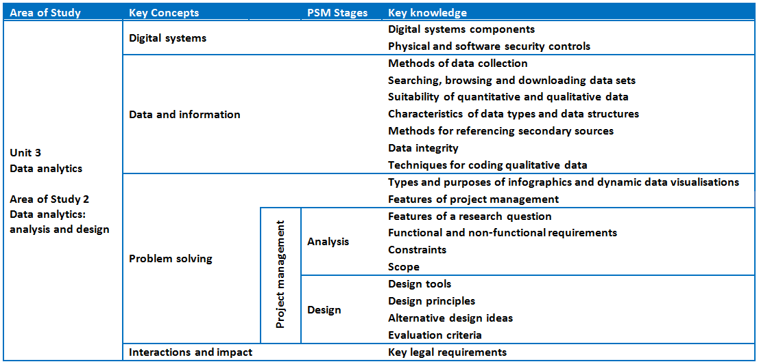
Unit 3 Outcome 2 – Background

Slide 16
Unit 3 Outcome 2 – Background
On completion of this unit the student should be able to:
propose a research question
formulate a project plan
collect and analyse data
generate alternative design ideas
represent the preferred design for creating infographics or dynamic data visualisations.
Software tools:
Appropriate tool for documenting project plans.
Assessment contribution:
School-assessed Task for Unit 3 Outcome 2 and Unit 4 Outcome 1 will contribute 30 per cent to the study score.
Unit 3 Outcome 2 is worth 15 per cent.
SAT.
Address VCAA SAT criteria.

Slide 17
Unit 3 Outcome 2 – Planning questions
Some questions to consider when planning for Unit 3 Outcome 2:
How will you prepare your students for this outcome?
What do your students need to know about proposing a research question?
How will they collect and analyse data?
What assessment criteria will they need to meet? Refer to the Administrative information for the SAT on the study page.
How will your students manage a project over months involving analysis and design?
How will you observe, authenticate and assess this task?
What model will you use for teaching and assessment?
Teaching and assessing each criterion – feedback between criterion
Teaching while students completing Part 1 of the SAT and submit as one – feedback on all criterion

Slide 18
Unit 3 Outcome 2 – SAT components
Project management:
Students will create, monitor and modify a project plan (Gantt chart) which outlines the tasks, sequencing, time allocation, dependencies, milestones and the critical path.
Analysis stage:
Students will:
frame a research question
analyse and document requirements, constraints and scope
apply techniques for searching, downloading, browsing and referencing data sets
apply methods to secure stored data.
Design stage:
Students will:
use design tools to generate two or three design ideas for their proposed infographics and dynamic data visualisations
develop evaluation criteria to evaluate their design ideas and their infographics and dynamic data visualisations in Unit 4 Outcome 1
develop detailed designs of how the proposed infographics and dynamic data visualisations will appear and function.

Slide 19
Unit 3 Outcome 2 – Strategies
There are two possible strategies for delivering this outcome.
Strategy 1 – Milestones
For each criterion:
Teaching and learning – assessing – feedback (repeat).
Advantages – quick feedback for students and very effective for motivating students, particularly if they start off slow – better authentication.
Disadvantages – you need to be responsive and disciplined.
Strategy 2 – Submit all
Teaching and learning.
Students work on criteria and submit as one submission for assessment.
Advantages – less marking throughout the SAT.
Disadvantages – some students will struggle due to less feedback – possible issues with authentication – more concentrated marking in a busy time of Term 2.
Be aware of your VASS due date.

Slide 20
Unit 3 Outcome 2 – Commercial Instructions
If using commercial instructions:
They need to be modified as they can be very detailed and basically tell students what to do. This could be considered as undue assistance.
Check the task against the outcome statement, key knowledge and key skills.
Only include content that is within the scope of the outcome.
VCAA assessment criteria only to be used for assessment.

Slide 21
Phil Feain Curriculum Manager, Digital Technologies Victorian Curriculum and Assessment Authority
Ph: (03) 9032 1724 feain.philip.a@edumail.vic.gov.au

