Slide 1
Unit 3 Data analytics Introduction
2020–2024

Slide 2
Copyright
© Victorian Curriculum and Assessment Authority (VCAA) 2019.
VCAA presentations may be reproduced in accordance with the VCAA’s Copyright and Intellectual Property Policy, and as permitted under the Copyright Act 1968.
VCE is a registered trademark of the VCAA.

Slide 3
Unit 3 Data analytics

Slide 4
Unit 3 Data analytics Overview
O1
Data analytics
O2
Analysis and design
Unit 3
Data analytics

Slide 5
Unit 3 Outcome 1 Data analytics

Slide 6
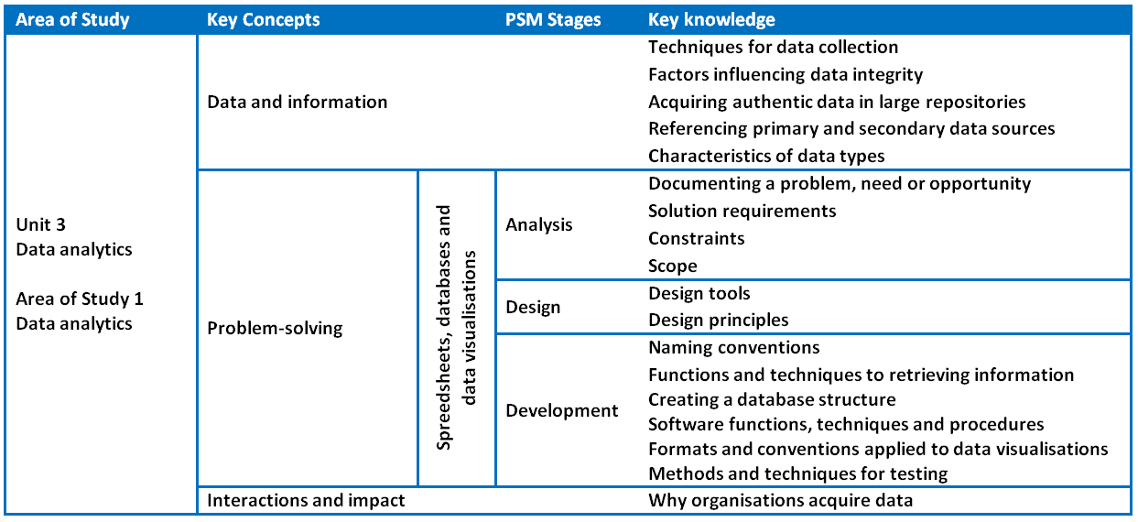
Unit 3 Outcome 1 (SAC) Data analytics

Slide 7
Unit 3 Outcome 1 (SAC) Data analytics
Outcome 1
Students should be able to:
respond to teacher-provided solution requirements and designs
extract data from large repositories
manipulate and cleanse data
apply a range of functions to develop software solutions to present findings.
Software tools
Database software, spreadsheet software and data visualisation software.
Assessment contribution and marks
School-assessed Coursework for Unit 3 will contribute 10 per cent to the study score.
Total marks will be 100.

Slide 8
Unit 3 Outcome 1 (SAC) Data analytics
Students will:
interpret solution requirements and designs
identify, select and extract relevant data from large repositories
use a standard referencing system
organise, manipulate and cleanse data
use database and spreadsheet software
create effective data visualisations
develop and apply suitable validation and testing techniques.
Assessment task
SAC
Respond to solution requirements and designs to create software solutions.
Address VCAA performance descriptors.

Slide 9
Unit 3 Outcome 2 Analysis and design

Slide 10
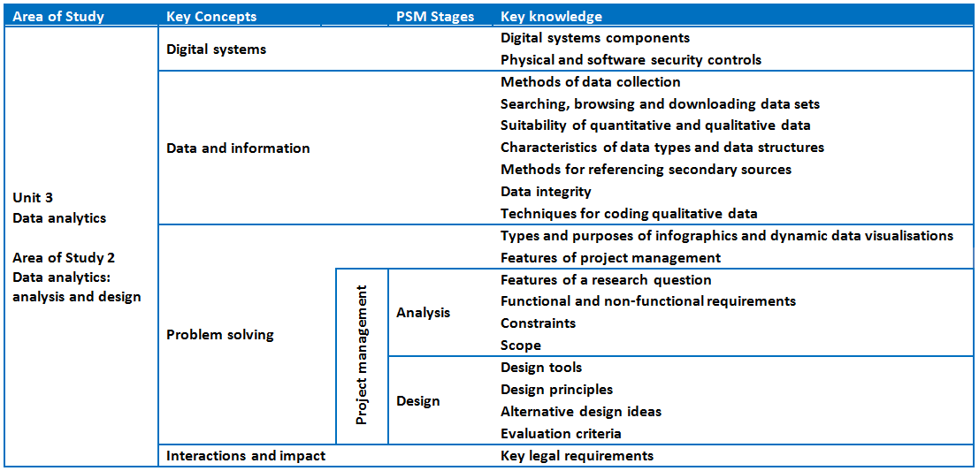
Unit 3 Outcome 2 (SAT Part 1) Analysis and design

Slide 11
Unit 3 Outcome 2 (SAT Part 1) Analysis and design
Outcome 2
Students should be able to:
propose a research question
formulate a project plan
collect and analyse data
generate alternative design ideas
represent the preferred design for creating infographics or dynamic data visualisations.
Software tools
At least one data manipulation tool and one visualisation tool, for example database software, spreadsheet software, data visualisation software, tool for planning a project.
Assessment contribution
School-assessed Task for Unit 3 Outcome 2 and Unit 4 Outcome 1 will contribute 30 per cent to the study score. Unit 3 Outcome 2 is worth 15 per cent.

Slide 12
Unit 3 Outcome 2 (SAT Part 1) Analysis and design
Students will:
frame a research question
analyse and document solution requirements, constraints and scope
search, download, browse and reference data sets
use design tools to represent the functionality and appearance of infographics or dynamic data visualisations
generate alternative design ideas
develop evaluation criteria to select designs
produce detailed designs
propose and apply methods to secure stored data
create, monitor and modify project plans.
Assessment task
SAT
Address VCAA SAT criteria.

Slide 13
Phil Feain Curriculum Manager, Digital Technologies Victorian Curriculum and Assessment Authority
Ph: (03) 9032 1724 feain.philip.a@edumail.vic.gov.au

