Slide 1
Unit 4 Data analytics Introduction
2020–2024

Slide 2
Copyright
© Victorian Curriculum and Assessment Authority (VCAA) 2019.
VCAA presentations may be reproduced in accordance with the VCAA’s Copyright and Intellectual Property Policy, and as permitted under the Copyright Act 1968.
VCE is a registered trademark of the VCAA.

Slide 3
Unit 4 Data analytics

Slide 4
Unit 4 Data analytics Overview
O1
Development and evaluation
O2
Data and information security
Unit 4
Data analytics

Slide 5
Unit 4 Outcome 1 Development and evaluation

Slide 6
Unit 4 Outcome 1 (SAT Part 2) Development and evaluation

Slide 7
Unit 4 Outcome 1 (SAT Part 2) Development and evaluation
Outcome 1
Students should be able to:
develop and evaluate infographics or dynamic data visualisations
present findings in response to a research question
assess the effectiveness of the project plan in monitoring progress.
Software tools
At least one data manipulation tool and one visualisation tool, for example database software, spreadsheet software, data visualisation software, tool for planning a project.
Assessment contribution
School-assessed Task for Unit 3 Outcome 2 and Unit 4 Outcome 1 will contribute 30 per cent to the study score.
Unit 4 Outcome 1 is worth 15 per cent.

Slide 8
Unit 4 Outcome 1 (SAT Part 2) Development and evaluation
Students will:
monitor, modify and annotate project plans
propose and implement procedures for managing files
develop infographics or dynamic data visualisations
select and apply data validation and testing techniques
make necessary modifications
evaluate the infographics or dynamic data visualisations
assess the project plan.
Assessment task
SAT
Address VCAA SAT criteria.

Slide 9
Unit 4 Outcome 2 Data and information security

Slide 10
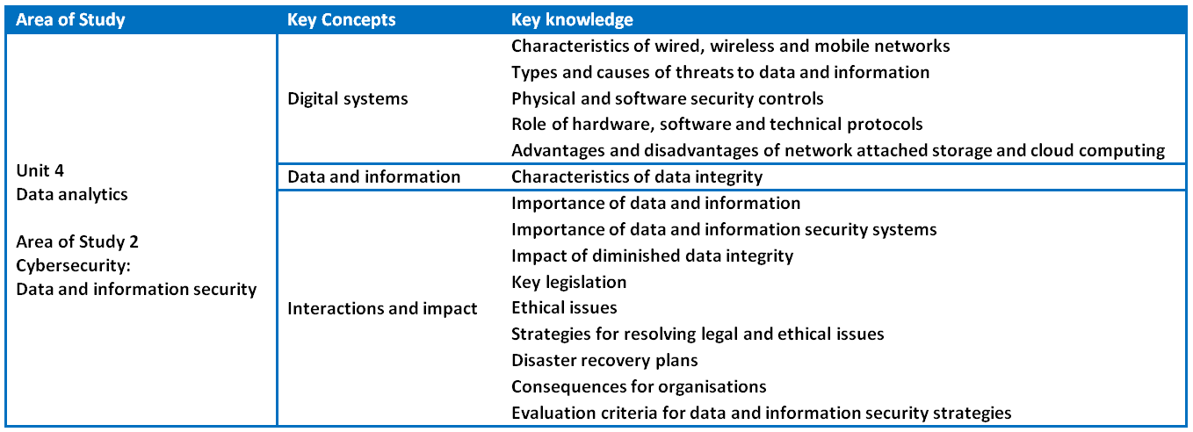
Unit 4 Outcome 2 (SAC) Data and information security

Slide 11
Unit 4 Outcome 2 (SAC) Data and information security
Outcome 2
Students should be able to:
respond to a teacher-provided case study
investigate the current data and information security strategies of an organisation
examine the threats to the security of data and information
recommend strategies to improve current practices.
Assessment contribution and marks
School-assessed Coursework for Unit 4 will contribute 10 per cent to the study score.
Total marks will be 100.

Slide 12
Unit 4 Outcome 2 (SAC) Data and information security
Students will:
analyse and discuss current data and information security strategies
propose and apply criteria to evaluate data and information security strategies
identify and evaluate threats to the security of data and information
identify and discuss possible legal and ethical consequences
recommend and justify strategies to improve data and information security practices.
Assessment task
SAC
A case study with one of the following:
structured questions
written report
multimedia report
Address VCAA performance descriptors.

Slide 13
Phil Feain Curriculum Manager, Digital Technologies Victorian Curriculum and Assessment Authority
Ph: (03) 9032 1724 feain.philip.a@edumail.vic.gov.au

