Slide 1
Unit 4 Software development Introduction
2020–2024

Slide 2
Copyright
© Victorian Curriculum and Assessment Authority (VCAA) 2019.
VCAA presentations may be reproduced in accordance with the VCAA’s Copyright and Intellectual Property Policy, and as permitted under the Copyright Act 1968.
VCE is a registered trademark of the VCAA.

Slide 3
Unit 4 Software development

Slide 4
Unit 4 Software development Overview
O1
Development and evaluation
O2
Software security
Unit 4
Software development

Slide 5
Unit 4 Outcome 1 Development and evaluation

Slide 6
Unit 4 Outcome 1 (SAT Part 2) Development and evaluation

Slide 7
Unit 4 Outcome 1 (SAT Part 2) Development and evaluation
Outcome 1
On completion of this unit the student should be able to:
develop and evaluate a software solution that meets requirements
evaluate the effectiveness of the development model
assess the effectiveness of the project plan.
Software tools
An appropriate programming language. Appropriate tool for documenting project plans.
Assessment contribution
School-assessed Task for Unit 3 Outcome 2 and Unit 4 Outcome 1 will contribute 30 per cent to the study score. Unit 4 Outcome 1 is worth 15 per cent.

Slide 8
Unit 4 Outcome 1 (SAT Part 2) Development and evaluation
Students will:
monitor, modify and annotate project plans
propose and implement procedures for managing data and files
develop a software solution
write internal documentation
select and apply data validation and testing techniques
make necessary modifications
prepare and conduct usability tests
evaluate the software solution
evaluate the selected development model
assess the project plan.
Assessment task
SAT
Address VCAA SAT criteria.

Slide 9
Unit 4 Outcome 2 Software security

Slide 10
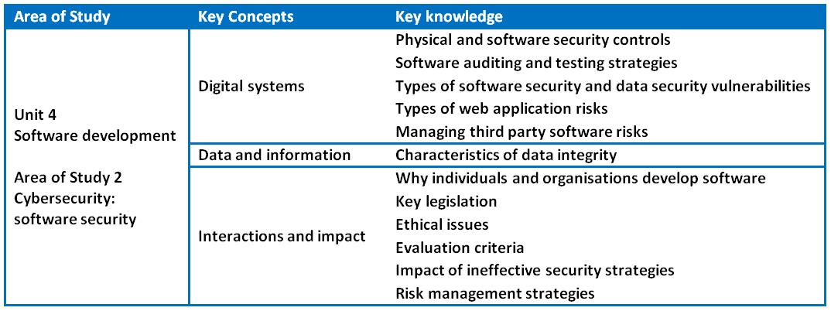
Unit 4 Outcome 2 (SAC) Software security

Slide 11
Unit 4 Outcome 2 (SAC) Software security
Outcome 2
On completion of this unit the student should be able to:
respond to a teacher-provided case study
examine the current software development security strategies of an organisation
identify the risks and the consequences of ineffective strategies
recommend a risk management plan to improve current security practices.
Assessment contribution and marks
School-assessed Coursework for Unit 4 will contribute 10 per cent to the study score.
Total marks will be 100.

Slide 12
Unit 4 Outcome 2 (SAC) Software security
Students will:
analyse and discuss current security controls
identify and discuss potential risks to software and data security
propose and apply criteria to evaluate current security practices
identify and discuss possible legal and ethical consequences
recommend and justify a risk management plan
Assessment task
SAC
A case study with one of the following:
structured questions
written report
multimedia report
Address VCAA performance descriptors.

Slide 13
Phil Feain Curriculum Manager, Digital Technologies Victorian Curriculum and Assessment Authority
Ph: (03) 9032 1724 feain.philip.a@edumail.vic.gov.au

