Slide 1
Music (2023-2027)
Units 1 and 2
Supporting Digital Music-Makers

Slide 3
Digital Musicians in VCE
Digital Musicians are music-makers who use music software and hardware to create and perform music
Music Software examples - Ableton Live, Logic, FL Studio, Music apps
Music Hardware examples - Launchpad, Push, MIDI Keys, Drum Pads, Samplers, Synthesizer, Computers, iPads
.

Slide 4
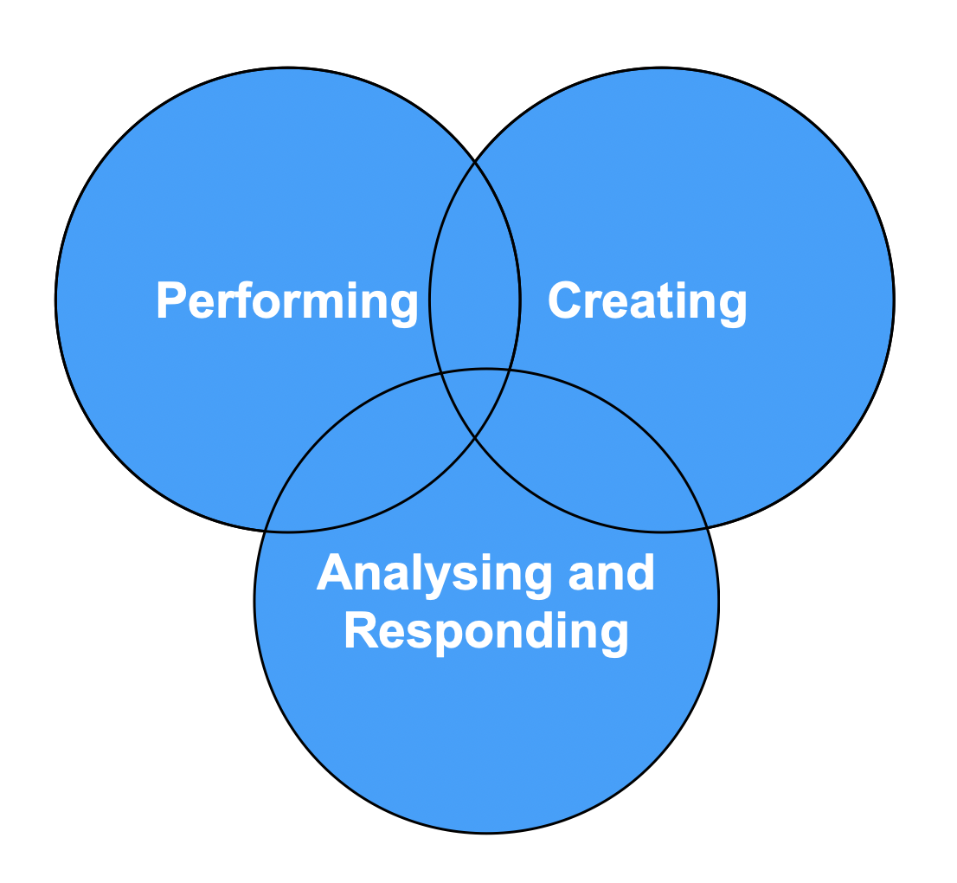
Pathway from the Victorian Curriculum
Unit 1 and 2 provides a pathway from the Victorian Curriculum, into three areas of study
Performing
Creating
Analysing and Responding

Slide 5
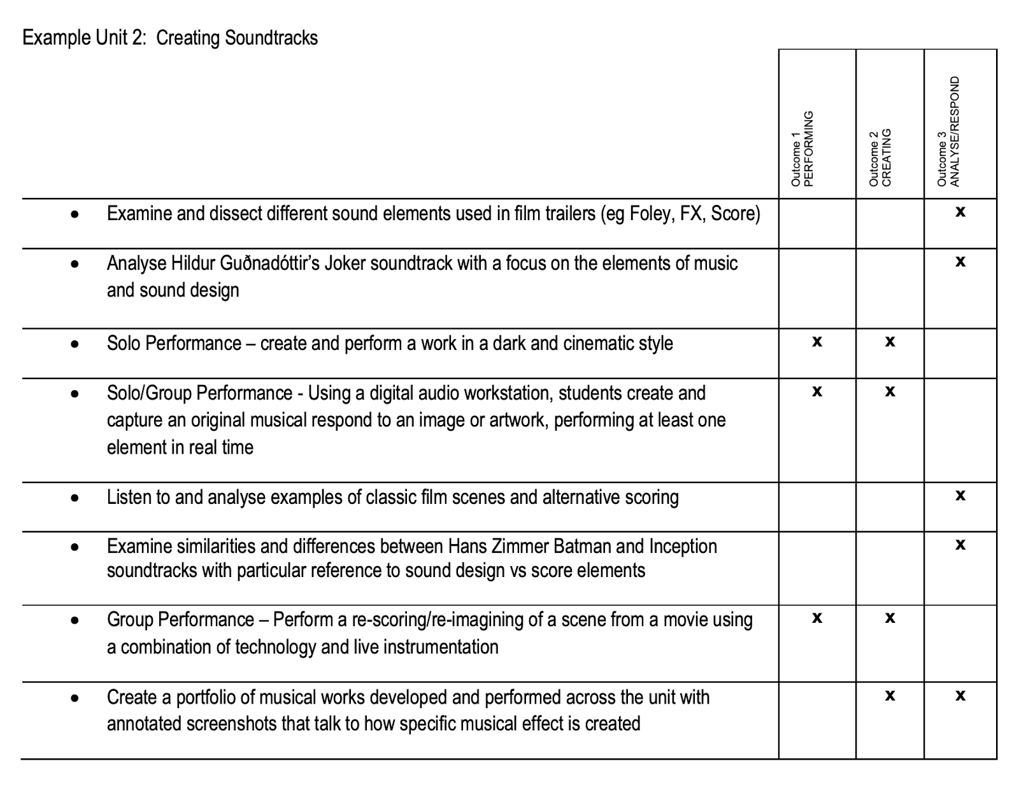
Example of Integrated Outcomes
Areas of study are intended to be run simultaneously
Consider clustering around a topic rather than discrete tasks
Allowing for multiple opportunities to demonstrate skills

Slide 6
Area of Study 1 - Performing
Strategies for students performing with digital tools/instruments
Solo and Group performances - Integrate digital musicians into groups with other instrumentalists, create digital ensembles.
Encourage: real-time playing/manipulations; finger drumming, clip launching, live-looping, real-time virtual instrument or sample triggering.
Avoid playback/non-interactivity

Slide 7
Area of Study 2 - Creating
Strategies for students Creating with music software & hardware
Create short works / musical responses related to the area of study
Develop and refine musical ideas within a digital audio workstation
Document the creative process and capture different versions and phases of the creative process
Consider which methods are appropriate to document the creative process and final work

Slide 8
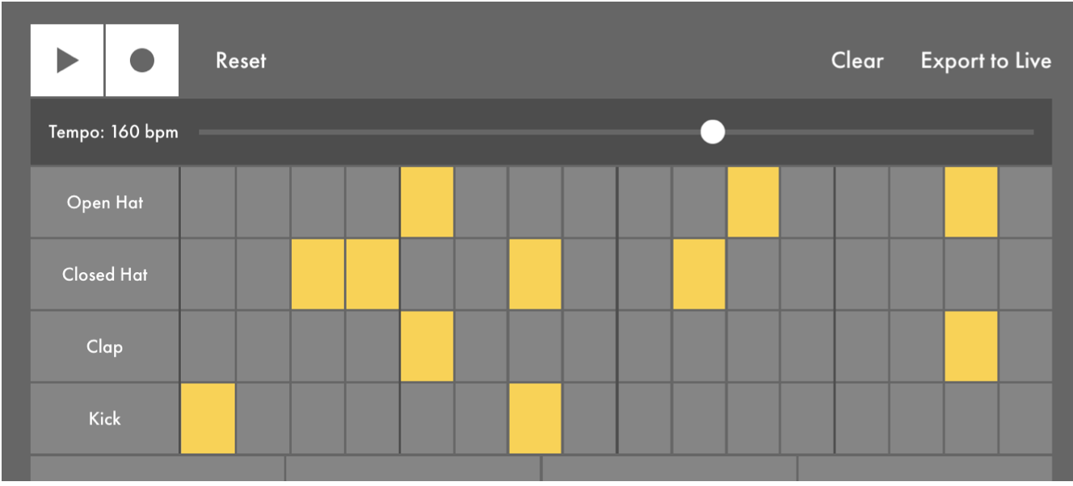
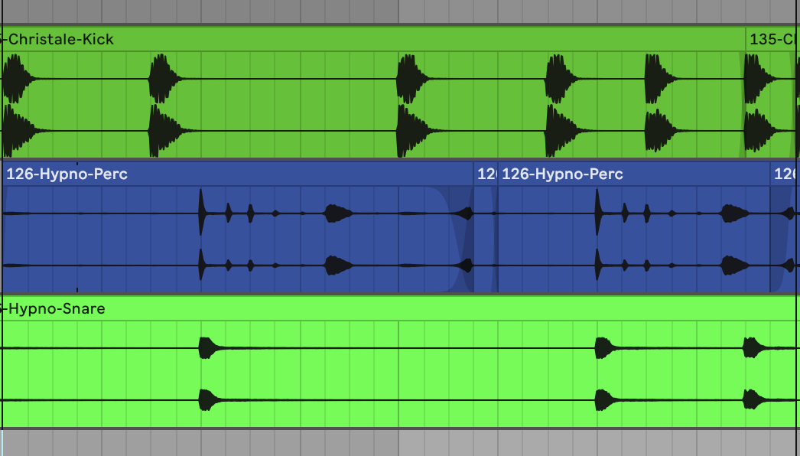
Area of Study 3 - Analysing and responding
Strategies for students coming from new music-making contexts
Contextualizing musical learning with appropriate examples
Documenting musical concepts graphically in understood forms
Refining musical language as appropriate to genre and convention

Slide 9
Further Support and Guidance
Electronic Music Performance - Youtube Playlist
Examples of artists using digital tools for electronic music performance.
Contemporary Music Analysis - Youtube Playlist
Examples of contemporary electronic musical works that could be used for analysis.

