Slide 1
VCE Outdoor and Environmental Studies study design
2018 - 2023

Slide 2
© Victorian Curriculum and Assessment Authority 2017
The copyright in this PowerPoint presentation is owned by the Victorian Curriculum and Assessment Authority or in the case of some materials, by third parties. No part may be reproduced by any process except in accordance with the provisions of the Copyright Act 1968 or with permission from the Copyright Officer at the Victorian Curriculum and Assessment Authority.

Slide 3
Session outline
Overview of changes to the new VCE Outdoor and Environmental Studies study design (2018-2023)
Assessment, including:
discussion about the new core task journal or report
Advice for teachers
Your questions

Slide 4
VCE Outdoor and Environmental Studies study design
Implementation for all Units will begin in 2018.
Teacher should thoroughly familiarise themselves with the study design including:
Introduction, including scope rationale and aims (p. 5–7)
Assessment and reporting (p. 8)
Units 1–4 (p. 9–22)

Slide 5
Understanding the study design
Each outcome is described in terms of key knowledge and key skills
Key knowledge | Key skills
Provides the content | Provides the application For example: plan reflect compare describe explain analyse evaluate

Slide 6
Features of the study design that remain the same
The unit titles and the broad focus of all units have been retained
All units retain two areas of study
Specific reference to practical outdoor experiences has been retained in both outcome statements and key skills

Slide 7
Outdoor experiences
Outdoor experiences should be selected that:
allow students to make connections to key knowledge within the study design
allow a journey through an environment
facilitate the observation of the characteristics and types of environments
allow students to observe the effects of nature on humans and the effects of humans on nature.

Slide 8
Outdoor experiences
Can include:
day and multi-day trips
school-based practical experiences
conservation or restoration activities
excursions
other relevant experiences.
Note: outdoor experiences need to occur before student assessment.

Slide 9
Selection of outdoor environments
need to relate to the key knowledge and key skills
should provide reference to a particular type of environment (e.g. surf coast or alpine region) rather than reference to a general area (e.g. south-west Victoria) that includes a range of environments
may have been subject to different levels of human intervention.

Slide 10
Unit 1: Exploring outdoor experiences
Two areas of study:
Motivations for outdoor experiences
Influences on outdoor experiences

Slide 11
Unit 1: Exploring outdoor experiences Key differences
Key knowledge moved from AoS 1 to AoS 2
ways people know, experience and respond to outdoor environments
media portrayals of outdoor environments
personal responses to risk

Slide 12
Unit 1: Exploring outdoor experiences Key differences
New to AoS 1
practical skills for safe participation in outdoor experiences including basic first aid
New to AoS 2 (formerly in Unit 2, AoS 2)
rationales for codes of conduct
Wording changes to outcome statements

Slide 13
Unit 1: Exploring outdoor experiences Key knowledge explained
Practical skills for safe participation in outdoor experiences could include:
planning for emergencies in outdoor environments
risk management procedures
first aid courses
skills necessary for safe participation in outdoor activities.

Slide 14
Assessment Unit 1
New core assessment task for Unit 1
a journal or report demonstrating links between theoretical content and practical experiences.
Additionally, at least one task for assessment of each outcome is to be selected from:
a case study
an oral presentation including the use of multimedia and podcasts
data analysis
structured questions
written responses, including essays and web discussion forums.

Slide 15
Unit 2: Discovering outdoor environments
Two areas of study:
Investigating outdoor environments
Impacts on outdoor environments

Slide 16
Unit 2: Discovering outdoor environments Key differences
New to AoS 1
scientific understandings - the effect of fire (both controlled burns and wildfire) on outdoor environments.

Slide 17
Assessment Unit 2
New core assessment task
a journal or report demonstrating links between theoretical content and practical experiences
Additionally, at least one task for assessment of each outcome is to be selected from:
a case study
an oral presentation including the use of multimedia and podcasts
data analysis
structured questions
written responses, e.g. essays and web discussion forums

Slide 18
Unit 3: Relationships with outdoor environments
Two areas of study:
1. Historical relationships with outdoor environments
2. Relationships with outdoor environments since 1990

Slide 19
Unit 3: Relationships with outdoor environments Key differences
New to AoS1:
the study of the foundations of environmental movements through at least one of Lake Pedder, the Franklin River or the Little Desert
the development of political movements though increasing environmental awareness.
New to AoS2:
an overview of contemporary environmental politics.

Slide 20
Unit 3:Relationships with outdoor environments Key knowledge explained
AoS 1 impact of increasing environmental awareness … on the policies of political parties
Who were the key individuals and groups through the 1970s and 1980s, (What were their goals? What happened during this time?)
What were some of the policy proposals, successes and/or failures of the major political parties?
How did these events change relationships with outdoor environments?

Slide 21
Unit 3: Relationships with outdoor environments Key knowledge explained
AoS 2–overview of environmental politics:
the environmental policies of major political parties
the formation of green political parties
signing of the Kyoto Protocol and Paris Agreement
the proposals for carbon tax and emissions trading schemes
the role of the Victorian Environmental Assessment Council (VEAC), including examples of its work.

Slide 22
Assessment Unit 3
Outcome 1 | 10% | A journal or report demonstrating links between theoretical content studied and practical experiences undertaken
 | 40% | At least one task from the following: • a case study • a multimedia presentation or podcast • a written report.
Outcome 2 | 10% | A journal or report demonstrating links between theoretical content studied and practical experiences undertaken
 | 40% | At least one task from the following: • data analysis • structured questions.

Slide 23
Unit 4: Sustainable outdoor relationships
Two areas of study:
Healthy outdoor environments
Sustainable outdoor environments

Slide 24
Unit 4: Sustainable outdoor environments Key differences
Change to wording in AoS 1
Referring to the current national State of the Environment report
New to AoS 2
The environmental conflicts listed have been updated and now include the proposed Great Forest National Park and extraction of coal seam gas.

Slide 25
Assessment Unit 4
Outcome 1 | 10% | A journal or report demonstrating links between theoretical content studied and practical experiences undertaken
 | 40% | At least one task from the following: • data analysis • structured questions • a written report.
Outcome 2 | 10% | A journal or report demonstrating links between theoretical content studied and practical experiences undertaken
 | 40% | At least one task from the following: • case study • structured questions.

Slide 26
Journal or report on practical experiences
new and core assessment task listed in each unit
requires students to:
collect information/data during outdoor experiences
reflect on their outdoor experiences
write about these experiences from the perspective of the key knowledge and key skills within the study design.

Slide 27
Journal or report on practical experiences
Data collection could be recorded in a variety of ways:
responding to prompt questions provided by the teacher
jotting observations and notes in a journal or notebook
taking photographic or video images
using an iPod or mobile phone to record an audio file.

Slide 28
Journal or report on practical experiences
Task format
journal notes
using data collected to respond to a question or series of questions
annotation of images collected
construction of a concept map which could include both text and images
or a combination of any of the points above.

Slide 29
Journal or report on practical experiences
Authentication strategies could include:
observing the data collected and notes taken by students during outdoor experiences
asking students to submit their notes/booklets from outdoor experiences
requiring students to write their journal or report in class.
Note: students should retain their journal/report to assist in preparation for the end of year exam.

Slide 30
Journal or report on practical experiences

Slide 31
Units 3 and 4 assessment weighting
Unit 3 School-assessed coursework 25%
Unit 4 School-assessed coursework 25%
End-of-year examination 50%
(2 hours)

Slide 32
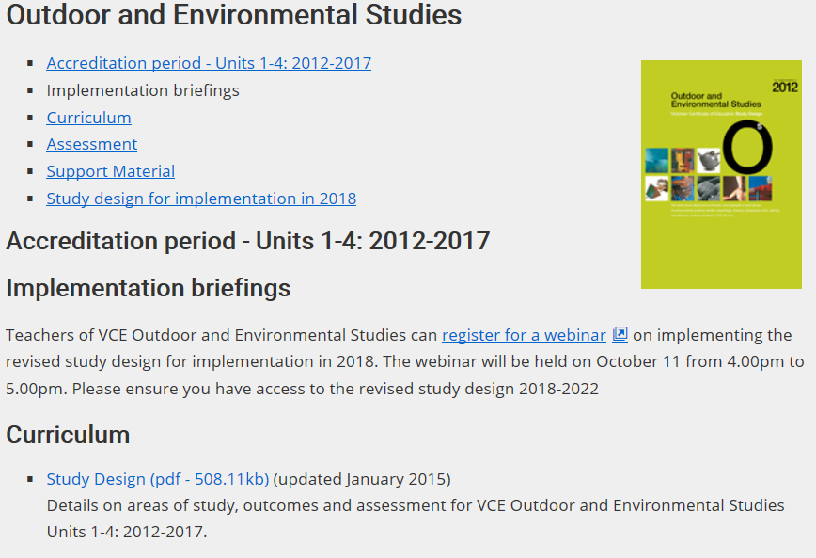
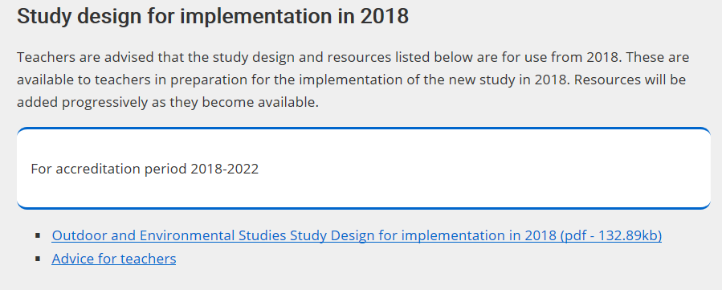
VCAA website
Material to prepare for 2018 is located on the VCAA website. Scroll to the bottom of the VCE Outdoor and Environmental Studies webpage.

Slide 33
Advice for teachers
Advice for teachers is online and includes:
developing a program
ideas for teaching and learning activities
resource lists
assessment advice, including performance descriptors
clarification of terminology

Slide 34
What is next?
Frequently asked questions (FAQs)
Exam specifications and sample examination questions

Slide 35
VCAA Bulletin online
The VCAA Bulletin VCE, VCAL and VET is now online
A free subscription is available at www.vcaa.vic.edu.au
See ‘Subscriptions’ at the bottom of the page
Follow the prompts to enter your details
Ensure your email address is entered correctly

Slide 36
Contact details
Dr Rachael Whittle
Curriculum Manager, Health and Physical Education
ph: (03) 9032 1721 II m: 0488 674 822
e: whittle.rachael.j@edumail.vic.gov.au

