Slide 1
Introducing Languages

Slide 2
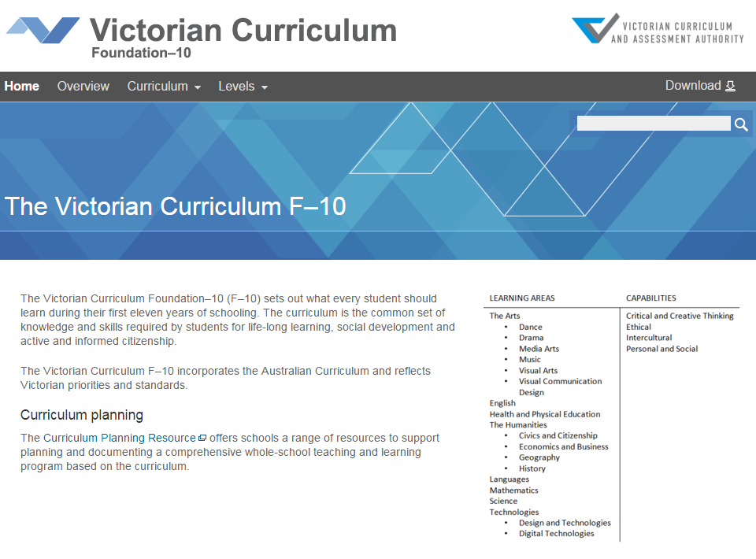
Victorian Curriculum F–10
Released in September 2015 as a central component of the Education State
Provides a stable foundation for the development and implementation of whole-school teaching and learning programs
The Victorian Curriculum F–10 incorporates the Australian Curriculum and reflects Victorian priorities and standards
http://victoriancurriculum.vcaa.vic.edu.au/

Slide 3
Aims
The Languages curriculum aims to develop the knowledge, understanding and skills to ensure that students:
communicate in the language they are learning
understand the relationship between language, culture and learning
develop intercultural capabilities
understand themselves as communicators.

Slide 4
Structure
Strands and Sub-strands
Strand | Communicating | Understanding
Sub-strands | Socialising | Systems of language
 | Informing | Language variation and change
 | Creating | The role of language and culture
 | Translating
 | Reflecting

Slide 5
Structure
Achievement standards
The learning sequence undertaken by students will determine the number and progression of achievement standards, as follows:
F–10 Sequence: the first achievement standard is provided at Foundation–Level 2 and then at Levels 4, 6, 8 and 10.
7–10 Sequence: the first achievement standard is provided at Level 8 and then at Level 10.
Please note the additional Pathway for Chinese language learners:
Chinese Second Language Learner
Background Language Learner
First Language Learner (7–10 sequence only)

Slide 6
Key messages
The languages are grouped into six categories
The VCAA has developed a curriculum for Roman and Non-Roman Alphabet languages which will allow any world language to be offered by a Victorian school
Some language specific curriculums are still being finalised and will be progressively incorporated into the Victorian Curriculum F-10.
Language categories
Roman Alphabet Languages | Non-Roman Alphabet Languages
Character Languages | Classical Languages
Sign Languages | Aboriginal Languages

Slide 7
Key messages
Use of English
Students are encouraged to use the language being studies as much as possible for classroom routines, social interactions, structured learning tasks, and language experimentation and practice.
Students will have opportunities to engage with members of the community who speak the language being studies, which in some cases will be facilitated via digital technologies.
English is used for discussion, explanation and reflection, enabling students to develop a language for sharing ideas about language and culture.

