Slide 1
Curriculum Planning: F-10 EAL
Tuesday 20th October 2020

Slide 2
Acknowledgment of Country
In recognition of Aboriginal and Torres Strait Islander people’s spiritual and cultural connection to country, we acknowledge the traditional custodians of the Kulin Nations. We acknowledge the continued care of the lands and waterways over generations and celebrate the continuation of a living culture that has a unique role in this region.
We pay our respects to Elders past, present and emerging, for they hold the memories, traditions, culture and hopes of all Aboriginal and Torres Strait Islander peoples across the nation and hope they will walk with us on our journey.

Slide 3
GOVERNMENT SCHOOLS
CURRICULUM PLANNING

Slide 4
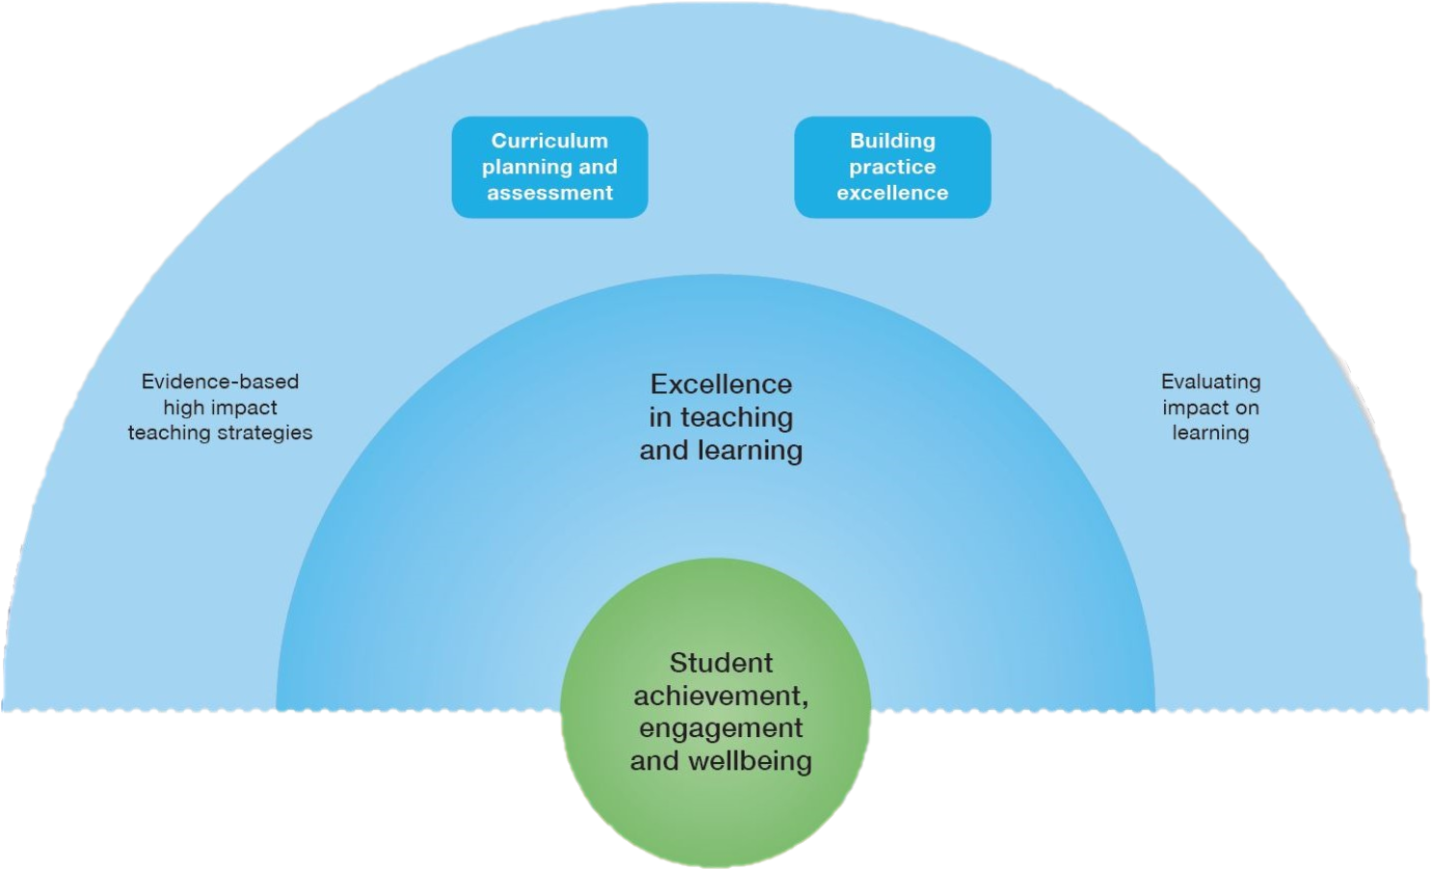
Framework for Improving Student Outcomes (FISO)
Notes:
Teachers from government schools would be familiar with the FISO Improvement Model, which is an evidence-based framework designed to focus schools’ improvement efforts on priorities that are proven to have the greatest impact on student achievement, wellbeing and engagement.
Our focus is on this section of the FISO Improvement Model, which is the priority area of excellence in teaching and learning, through the lens of teaching and learning for EAL students.

Slide 5
IMPROVEMENT CYCLE
The FISO Improvement Cycle supports teachers, school leadership teams and school improvement teams to focus on better outcomes for our students.
Improvements to teaching practice and student learning are strongly dependent on effective implementation within an evidence-based Improvement Cycle.
The Improvement Cycle can be used at different levels, from the whole-school to the classroom. It can also be used over different time periods, from four week cycles to annual cycles.
Evaluate and diagnose
Prioritise and set goals
Develop and plan
Implement and monitor
Notes:
One of the elements in the FISO Improvement Model is the FISO Improvement Cycle. The Improvement Cycle guides school leaders and teachers to follow an inquiry process and enables schools to identify areas of strength and areas of practice that need improving and to plan the improvement strategies for EAL students.
Effective use of the FISO improvement cycle is a staged and continuous process. It is a collaborative approach that is flexible, disciplined and focused on learning.
The improvement cycle will help guide principals, school leaders and teachers to:
combine good evidence with effective inquiry processes
highlight areas of strength and the areas of existing practice that need improving
plan and monitor key improvement strategies
be involved in, and engage in identifying and implementing improvement priorities.
The Improvement Cycle can be used at different levels, from the whole-school to the classroom. It can also be used over different time periods, from four-week cycles to annual cycles.
The four stages of the Improvement Cycle are:
Evaluating and diagnosing​ performance successes and challenges around the key improvement initiatives and strategies
Prioritising and setting goals​ for improvement strategies and initiatives that have the greatest impact on student learning
Developing and planning​ improvement strategies and initiatives to ensure successful implementation
Implementing and monitoring selected improvement strategies and initiatives and the impact these have on EAL student learning.
In the next few slides, I will go into detail about each of the four stages in relation to EAL teaching and learning.

Slide 6
IMPROVEMENT CYCLE
Evaluate and diagnose
Prioritise and set goals
Develop and plan
Implement and monitor
The 'evaluate and diagnose' step involves reviewing existing school practices and programs. As part of this process you could consider:
how well your school is supporting EAL student learning
how aligned your school’s teaching and assessments are to the EAL curriculum.
Actions may include:
assessing current student learning
understanding – or supporting teachers to understand – the new EAL curriculum
evaluating current EAL teaching and learning programs.
Notes:
The EAL curriculum describes the ‘what’ of teaching. Schools and teachers develop the ‘how’ in EAL teaching and learning programs. To do this effectively, it helps if you understand what EAL students need and what the EAL curriculum requires.
When reviewing your existing curriculum to put the new EAL curriculum in place, you could consider:
how well your school is supporting EAL student learning
how aligned your school’s teaching and assessments are to the EAL curriculum.
You may want to:
assess current learning of your EAL students, including reviewing EAL student achievement data
develop an understanding of the new EAL curriculum, or supporting other staff to do so
evaluate current EAL teaching and learning programs at your school.
I’ll elaborate on each step in the next few slides.

Slide 7
IMPROVEMENT CYCLE
Evaluate and diagnose
Prioritise and set goals
Develop and plan
Implement and monitor
1. Assessing current student learning
Where school leaders can find EAL data
Panorama dashboard – access to the Panorama School Dashboards, the School Information Portal and other performance reports
School Information Portal – two EAL student achievement reports by stage and mode reflect teacher judgements of student proficiency across modes
CASES21 report ST21905 – gives a history of teacher judgement data for individual EAL students for up to seven years.
Data coaching services can help you interpret and use school data.
Notes:
At the evaluate and diagnose stage, you could look at school-level data about EAL students’ English language proficiency and learning growth. These are available from:
*Read dot points*
Questions to consider in relation to the data could include:
Are EAL students progressing over time?
Are some EAL students, classes or cohorts progressing more quickly than others?
Is student progress consistent across the three language modes?
What are some areas of strength – and areas of development – for EAL students?
What level of growth would the school aim to see in its data? Would this vary for individual students or across the three language modes?
What does the data tell you about the effectiveness of your EAL programs?
If you are from a government school, the DET’s data coaching services can help you interpret and use school data.

Slide 8
IMPROVEMENT CYCLE
Evaluate and diagnose
Prioritise and set goals
Develop and plan
Implement and monitor
2. Understanding the new EAL curriculum
Teachers and school leaders
To become familiar with the new EAL curriculum, you could:
discuss the EAL curriculum during whole-school or team meetings
refer to the EAL glossary to help with understanding the EAL curriculum
use Getting to know the Victorian Curriculum F-10 EAL for self-study or discussions at meetings.
School leaders
You could work with teachers to identify:
curriculum implementation priorities, for example, updating scope and sequence documents
next steps.
Notes:
You could set aside time upfront to become familiar with the EAL curriculum. This will save time when developing a teaching and learning program.
To become familiar with the new EAL curriculum, you could:
*Read first section of slide (Teachers and school leaders)*
If you are a school leader, you could do the above and also talk to teachers about the priorities and next steps for your school. For example, are your priorities in:
developing a teaching and learning program with this curriculum as its basis
integrating the cultural and plurilingual awareness strand into your programs
supporting teachers in all areas using the curriculum to support the learning of EAL students in their classrooms
connecting EAL curriculum implementation with literacy work already in place – paying careful attention to the needs of EAL learners
supporting teachers to use key content descriptions from the EAL curriculum that could benefit all students in their mainstream classes
brainstorming elaborations for the key content descriptions that suit your school setting and your EAL learners
giving opportunities for EAL specialists to support teams to understand the curriculum
reviewing the existing curriculum documents (whole school, year level, units of work or learning sequences) and identifying gaps between them and the new curriculum
making contact with schools with established programs, if your EAL program is new.

Slide 9
IMPROVEMENT CYCLE
Evaluate and diagnose
Prioritise and set goals
Develop and plan
Implement and monitor
3. Evaluating current EAL teaching and learning programs
Specialist EAL teachers
A specialist EAL teacher may act as the coordinator or leader of the school’s EAL teaching and learning program.
Generalist primary school teachers
A primary teacher caters for students with different learning needs, including EAL students. Reflect on how you’re teaching EAL learners now. Consider what you might need to update in your teaching and learning program.
Notes:
At this first stage, you could be evaluating your school’s current EAL teaching and learning program.
Two main questions to ask when evaluating current EAL teaching and learning programs are:
How well is the school’s current EAL teaching and learning program differentiated to support EAL student learning?
How well is the current EAL teaching and learning program aligned to the new EAL curriculum?
If you are:
A specialist EAL teacher in your school…(read slide)
You might be critically reviewing the assessments, teaching plans and reporting process for EAL leaners in your school, and consider how the school’s current teaching and learning program align with the key shifts in the EAL curriculum.
As a generalist teacher with EAL students in a primary school, you … (read slide)

Slide 10
IMPROVEMENT CYCLE
Evaluate and diagnose
Prioritise and set goals
Develop and plan
Implement and monitor
3. Evaluating current teaching and learning programs
Secondary school teachers of other learning areas
Different learning areas have particular language and literacy demands. School leaders and EAL specialists could consider how to support teachers of other learning areas in meeting the language and learning needs of the EAL students in their class.
School leaders
How well do the current EAL teaching and learning programs support EAL student learning?
Notes:
Read section re secondary teachers.
Some of the questions you might consider:
In order to support EAL learners, how would learning area teachers find out what the EAL students in their class are currently capable of in terms of speaking and listening, reading and viewing, and writing?
Using this knowledge, how can learning area teachers then support the students to read, write, listen and talk to develop knowledge building and understanding in their learning area?
How might they plan and prepare lessons to ensure diverse learners, including EAL learners, can meet the complex language and literacy demands of your subject?
The Literacy Teaching Toolkit for Levels 7-10 provides teachers with strategies to support the development of literacy within 7 learning areas of the Victorian Curriculum:
The Arts (NY)
English
Health and Physical Education (NY)
The Humanities
Mathematics
Science
Technologies.
It outlines the language demands that all students will face in the different learning areas, and is also a good place to start.
*Read slide re school leaders*
Are current EAL teaching and learning programs aligned to the content descriptions of the new EAL curriculum? Do you need to edit, redraft or rewrite content, teaching or assessment strategies?
Do all teachers have diagnostic assessment information for EAL students, and tools for ongoing formative and summative assessment?
Are the teachers supported to use EAL teaching strategies in all curriculum areas?
Is there a reporting process for EAL student learning?
Are EAL learners’ needs visible in whole school and year level curriculum and assessment plans? Is learning differentiated to meet their needs?
Who is currently involved in EAL curriculum planning? Should this change with the introduction of the new curriculum?
What’s the leadership and accountability structure overseeing EAL teaching? Should this change with the introduction of the new curriculum?
Is your current provision model the most appropriate to deliver the new curriculum?

Slide 11
IMPROVEMENT CYCLE
Evaluate and diagnose
Prioritise and set goals
Develop and plan
Implement and monitor
Improving assessment practices
Building teacher understanding of EAL-informed pedagogy
Updating teaching plans
Implementing a whole-school EAL approach
Aligning to other school initiatives
Notes:
After you have completed the evaluation and diagnosis, you should have a better understanding of the current situation for your EAL learners. There may be things you want to change and improve while implementing the new EAL curriculum. Try prioritising the work that needs to happen first.
Look at any current EAL diagnostic assessments, formative assessments or summative assessments. These may be EAL-specific or mainstream assessments that EAL students undertake.
If there is limited information on EAL student learning available:
prioritise collecting better assessment data that will support your teaching and learning program
review informal interactions with EAL students or examples of student work. Even with data from formal assessments, it’s important to use these other data points.
With the new curriculum, some teachers may have new responsibilities for EAL teaching. Other teachers may want to better understand how to best support EAL students.
If you’re a school leader, you could consider areas of teacher pedagogical knowledge your school could deepen to create a more effective teaching and learning program. What areas of professional learning do you want to prioritise?
Your priority might be in updating teaching and learning programs. Consider the learning needs of EAL students in your classes with your analysis of the current plan’s alignment to the EAL curriculum. If there are many areas that don’t align, start with the areas that will support student learning the most.
The new EAL curriculum is meant for all teachers. School leaders could consider how this changes the whole-school EAL approach. This may mean changing:
how teachers of EAL learners work together
who is involved in EAL planning
who has oversight of the EAL program.
School leaders could consider other school initiatives that may support parts of EAL curriculum implementation. These might be areas that can become quick wins, because there is already momentum.
For example:
if the school has recently implemented professional learning communities (PLCs), you could use these for teacher discussion of the new EAL curriculum
if the school has recently worked on developing formative assessments, teachers could consider what formative assessments are best to use for measuring student learning on EAL pathways.
Consider the most important changes. Set a goal for EAL student learning improvement to review at the end of the year. Short, medium, and long-term goals are appropriate.

Slide 12
IMPROVEMENT CYCLE
Evaluate and diagnose
Prioritise and set goals
Develop and plan
Implement and monitor
Teachers
Check the resources to support implementation of the new EAL curriculum. These resources help teachers to understand the new EAL curriculum and teach and assess EAL students.
Translate your priorities and goals into plans. You could consider the following questions:
What assessments do you need and when for diagnostic, formative, and summative information?
How do curriculum area plans, year level plans, and units of work need to change to align to the EAL curriculum and better support EAL learners?
What needs to change about reporting on EAL student learning?
Notes:
Now that your school has priorities and goals, you can work on a plan to put them in place.
*Read slide*

Slide 13
IMPROVEMENT CYCLE
Evaluate and diagnose
Prioritise and set goals
Develop and plan
Implement and monitor
School leaders
You could consider how to provide resources to support teachers in their development and planning.
Resources to support the new EAL implementation are available. Some of these resources are designed for school leaders in particular.
Principals and school leaders can drive the planning and implementation of whole-school EAL program changes. There may also be curriculum area or year-level changes that will be teacher led.
Notes:
At this stage, you could consider how to provide resources to support teachers in their development and planning. For example, time and expertise.
There are Resources to support the new EAL implementation. Some of these resources are designed specifically for school leaders. They support understanding of the new EAL curriculum, and teaching and assessing EAL students.
Principals and school leaders can drive the planning and implementation of whole-school EAL program changes. There may also be curriculum area or year-level changes that will be teacher led.
Principals and school leaders can drive the planning and implementation of whole-school EAL program changes. There may also be curriculum area or year-level changes that will be teacher led.
School leaders could consider:
How much time do teachers need to develop and implement a new EAL teaching and learning program?
What do teachers need to know to be able to implement the curriculum? Do they have access to the right support materials and expertise?
How can the school make sure they have the right support?

Slide 14
IMPROVEMENT CYCLE
Evaluate and diagnose
Prioritise and set goals
Develop and plan
Implement and monitor
Teachers
You can implement plans, monitor student learning and adjust plans in a continuous cycle. Allocate time in team meetings to support a collaborative approach to achieving these goals.
School leaders
You can trial new practices, monitor their effectiveness, adapt and make continual improvements over time. Make sure the documented curriculum (what’s on paper) is also the enacted curriculum (what’s actually being taught in classrooms).
You can support teachers to enact plans by:
observing lessons informally
setting benchmark dates each year to formally review EAL student learning data and discuss curriculum details with teachers.
Notes:
The 4th stage: the implementation and monitoring stage will typically last longer than other stages.
Teachers will need to implement plans, monitor student learning and adjust plans in a continuous cycle. Allocate time in team meetings to support a collaborative approach to achieving these goals.
School leaders could plan for specific times of the year to:
review EAL teaching and learning programs
formally monitor EAL student learning and teaching against the curriculum.
You'll need to trial new practices, monitor their effectiveness, adapt and do more trials over time.
Your role is to make sure the documented curriculum (what’s on paper) is also the enacted curriculum (what’s actually being taught in classrooms).
You can support teachers to enact plans by:
observing lessons informally
setting benchmark dates each year to formally review EAL student learning data and discuss curriculum details with teachers.
For both teachers and school leaders, you could continuously monitor student learning throughout the school year. Milestone dates are also helpful for formally reviewing progress and supporting open discussions with other leadership staff and teachers.

Slide 15
CATHOLIC SCHOOLS
CURRICULUM PLANNING

Slide 16
CECV
Reflective Inquiry Process:
Reflective questions to identify goals and priorities
Collaborative and team approaches to review
Ongoing cycle or process of review and improvement

Slide 17
CECV
To support implementation, existing school curriculum and planning structures can be used:
School Annual Action Plans
School Improvement Plans
Curriculum planning resources (holistic design)

Slide 18
CECV
Review process should include review of existing:
Enrolment processes – how to identify EAL learners
Opportunities for planning and collaboration between teachers and EAL specialists across learning areas
Reporting processes for EAL learners

Slide 19
CECV
Opportunity to review whole school approaches:
Partnerships and engagement with families and communities
Professional learning opportunities
Teaching, assessment and reporting practices
Leadership of EAL learning
Policy and school level guidelines for working with EAL students
Inclusive environment

Slide 20
CECV
Professional learning:
Knowledge about language learning and language acquisition
Knowledge about plurilingualism
Knowledge about functional language learning

Slide 21
Macro Vs Micro Planning
Hammond (2001) scaffolding of language learning discusses two levels of planning:
Macro level – organisation and sequencing of activities and content including explicit planning of language features relevant to the topic and the genre.
Micro level – responding in interactions to individual students needs or teachable moments.

Slide 22
Teaching and Learning Cycle for EAL
Building the context or field - understanding the role of texts in our culture and building shared understanding of the topic
Modelling the text (or deconstruction) - the use of mentor or model texts to focus explicitly on the structure and the language of the text, how language choices work to shape meaning, and to build a metalanguage
Guided practice (or joint construction) - teachers and students jointly constructing a text
Independent construction – students’ independent writing or approximation of the genre
(Derewianka & Jones, 2016; Humphrey, 2017; Humphrey & Feez, 2016)

Slide 23
Planning in different context
For individual students or groups of students
At a unit, year level, curriculum or whole school level
From an understanding of the language level of the student
Moving towards a progression point or goal
Across learning areas
Across language modes and strands

Slide 24
VCAA
Curriculum statements
The school is committed to offering a comprehensive curriculum based on the Victorian Curriculum F-10.
The school has some unique offerings including:
25 places in a Select Entry Accelerated Learning (SEAL) program in Mathematics and English, and entrance is based on a test and interview
an Accelerated Sports program is also offered including netball, athletics, swimming and basketball an International Student’s program
single gender classes.
Immersion for English as an Additional Language Learners

Slide 25
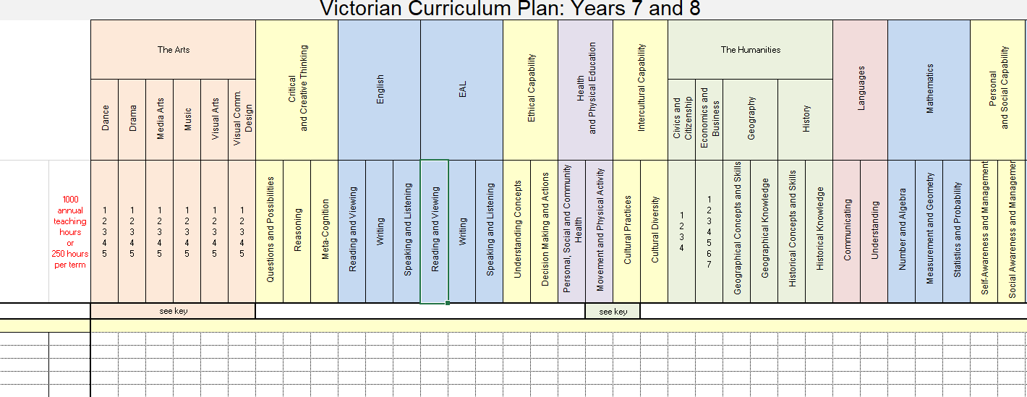
VCAA

Slide 26
Curriculum Planning Templates
By school
By curriculum area
By year level
By unit/lessons
https://curriculumplanning.vcaa.vic.edu.au/home

Slide 27
Resources
DET Data coaching
FUSE resource – Getting to know the new EAL curriculum
Resources for implementing the new EAL curriculum
Levels 7 to 10 Literacy Teaching Toolkit

Slide 28
Additional Webinars
Thursday 22nd October 2020 at 3.45pm-4.45pm
DIFFERENTIATION STRATEGIES TO SUPPORT EAL STUDENTS
Thursday 29th October 2020 at 3.45pm-4.45pm
FINAL Q & A WEBINAR

Slide 29
Contacts
Kellie Heintz VCAA
Kellie.Heintz@education.vic.gov.au
EAL Unit DET
eal@education.vic.gov.au
Mollie Daphne CECV
mdaphne@cem.edu.au

