Slide 1
Chronology
Levels 5 to 8

Slide 2
Introduction
Provocation
Chronology in the curriculum context
Chronology in Victorian Curriculum History
Chronology in the continuum of learning
Towards the classroom
Examples of practice
Conclusion

Slide 3
Chronological thinking is at the heart of historical reasoning. Without a clear sense of historical time – time past, present, and future – students are bound to see events as one great tangled mess. Without a strong sense of chronol­ogy – of when events occurred and in what temporal order – it is impos­sible for students to examine relationships among them or to explain historical causality. Chronology provides the mental scaffolding for organizing historical thought.
Stephane Levesque, Thinking Historically: Educating Students for the Twenty-First Century
Notes:
Levesque, S 1971, Thinking Historically: Educating Students for the Twenty-First Century, University of Toronto Press, Toronto, p. 78.

Slide 4
Chronology in Victorian Curriculum History

Slide 5
Victorian Curriculum History
Skill/Concept
Historical Knowledge
Achievement Standard
Learning in History

Slide 6
Learning in History
‘Chronology involves the arrangement of events in order of time. However, the sequencing of events is not an end in itself. It allows students to understand the sequence and flow of events and identify patterns of continuity and change, analyse cause and effect, distinguish between long-term causes and short-term triggers and provides the starting point and basis of explanatory narratives about the past.’
Victorian History Curriculum, Learning in History: Sequencing Chronology
Notes:
Victorian History Curriculum, Learning in History: Sequencing Chronology, https://victoriancurriculum.vcaa.vic.edu.au/the-humanities/history/introduction/learning-in-history

Slide 7
Achievement Standard
Levels 5 and 6 Achievement Standard
Students sequence events and people (their lifetime) in chronological order, and represent time by creating timelines.
Levels 7 and 8 Achievement Standard
Students sequence events and developments within a chronological framework with reference to periods of time.
Note the progression from Levels 5 and 6 to Levels 7 and 8.
Notes:
Students sequence events and people vs Students sequence events and developments
Chronological order vs Chronological framework
Represent time by creating timelines vs With reference to periods of time

Slide 8
Historical Concepts and Skills: Chronology
Levels 5 and 6
Sequence significant events and lifetimes of people in chronological order to create a narrative to explain the developments in Australia’s colonial past and the causes and effects of Federation on its people (VCHHC082)
Levels 7 and 8
Sequence significant events in chronological order to analyse the causes and effects and identify continuities and changes (VCHHC097)
Describe and explain the broad patterns of change over the period from the Ancient to the Modern World (VCHHC098)

Slide 9
Connections
Chronology connects with:
other Historical Concepts and Skills
historical content knowledge
instructional terms.
Levels 7 and 8
Sequence significant events in chronological order to analyse the causes and effects and identify continuities and changes (VCHHC097)
Describe and explain the broad patterns of change over the period from the Ancient to the Modern World (VCHHC098)

Slide 10
Connections: your turn
Levels 5 and 6
Sequence significant events and lifetimes of people in chronological order to create a narrative to explain the developments in Australia’s colonial past and the causes and effects of Federation on its people (VCHHC082)
Identify:
other Historical Concepts and Skills
instructional terms.
Notes:
Other Historical Concepts and Skills: Historical Significance, Cause and Effect
Instructional terms: sequence, create, explain

Slide 11
Continuum of learning
Levels 5 and 6
Levels 7 and 8
Achievement Standard
Students sequence events and people (their lifetime) in chronological order, and represent time by creating timelines.
Historical Concepts and Skills
Sequence significant events and lifetimes of people in chronological order to create a narrative to explain the developments in Australia’s colonial past and the causes and effects of Federation on its people (VCHHC082)
Achievement Standard
Students sequence events and developments within a chronological framework with reference to periods of time.
Historical Concepts and Skills
Sequence significant events in chronological order to analyse the causes and effects and identify continuities and changes (VCHHC097)
Describe and explain the broad patterns of change over the period from the Ancient to the Modern World (VCHHC098)
Levels 9 and 10
Achievement Standard Students sequence events and developments within a chronological framework, and identify relationships between events across different places and periods of time.
Historical Concepts and Skills
Sequence significant events in chronological order to support analysis of the causes and effects of these events and identify the changes they brought about (VCHHC121) Analyse and evaluate the broad patterns of change over the period 1750–present (VCHHC122)
Notes:
Discussion question – How can we design a task that can scaffold for students operating over a wide range of achievement levels? What would that look like?

Slide 12
Chronology and Historical Knowledge
Historical Knowledge
Where is chronology explicit?
Where is chronology implied?
Where is chronology necessary?
Where is there an opportunity for chronology?
Use this structure to break down the knowledge content descriptions to understand the application of the skill.

Slide 13
Historical Knowledge: Levels 5 and 6
Australia as a nation
The significance of key figures and events that led to Australia’s Federation, including British and American influences on Australia’s system of law and government (VCHHK093)
The different experiences and perspectives of Australian democracy and citizenship, including the status and rights of Aboriginal and Torres Strait Islander peoples, migrants, women, and children (VCHHK094)
The stories and perspectives of people who migrated to Australia, including from one Asian country, and the reasons they migrated (VCHHK095)
Significant contributions of individuals and groups, including Aboriginal and Torres Strait Islander peoples and migrants, to changing Australian society (VCHHK096)
Notes:
This is an example of where the Historical Concepts and Skills intersect with Historical Knowledge. There is more Historical Knowledge in the Victorian Curriculum beyond this example.

Slide 14
Towards the classroom

Slide 15
Towards the classroom
Levels 5 and 6
For the first time, students explore an extended sequence of events in one setting and observe how individuals, groups, ideas and decisions shaped the experiences of the people who lived there. The ability to sequence chronology underpins students’ learning of other historical thinking concepts; students must understand the order in which things happened before they can describe patterns of continuity and change, understand the purpose of sources created at different times during the period, or explain the causes of significant events. The ‘when’ is an important clue that leads to the ‘why’.
Students move from composing historical stories in the right order to thinking about how each person, event or decision is influenced by those preceding it. By the end of Level 6 they should have achieved a level of mastery over the concept of ‘time’ by creating informative, sequential narratives that deepen their understanding. They are able to create chronological pathways and maps to organise their knowledge.

Slide 16
Towards the classroom
Levels 7 and 8
Students think about chronological sequencing on several levels. They encounter big picture ideas such as the history of human civilisation and the contribution of archeology to our understanding of the past.
Sequencing chronology helps students understand the patterns and commonalities across the societies they investigate and consider their legacies in the present day. For their study of a specific society, students use key dates to understand and create narratives about leadership, architectural features, conflicts, the spread of religious ideas, trade and exploration.
Students are introduced to the conventions of reading and writing about chronology. This includes the use of BCE (Before Common Era) and CE (Common Era), and terms such as the ‘20th century’ to describe the period from 1900 to 2000. They also become adept at applying terms to describe time, such as long term and short term.

Slide 17
Indicative examples
By the end of Level 6:
By the end of Level 8:
students construct a timeline that identifies significant events and lifetimes
students can use chronological terms: for example, era, period, lifetime and so on
students can use a timeline to identify significant events and developments
students can use a timeline to construct a narrative explanation.
students use timelines to identify patterns of change over time
students use timelines to identify sequences of causation and consequences
students explain broad patterns over large time periods in a written response
students use timelines to identify significant events in the life of key individuals.

Slide 18
Language of Chronology
Date
Timeline
Circa
Prehistory
Before Common Era
After
Annotated
Chronology
Before present
Long term
Short term
Common Era
Epoch
Century
Decade
Sequence
Year
Time

Slide 19
Classroom ideas
Levels 5 and 6
Levels 7 and 8
Create an enhanced timeline that identifies significant events, periods and developments.
Play a mix-and-match game where students must sequence events in the correct order.
Create an enhanced timeline and annotate it to identify patterns over time.
Write a piece of historical fiction that sequences events in their correct order.

Slide 20
Example of practice
Levels 5 and 6

Slide 21
Context
2
Students should be able to sequence events in the correct order to fulfill a specific purpose. This could include identifying significant events, causes, consequences, changes or continuities. The correct sequencing of chronology is the beginning of the process and is foundational to further historical study.

Slide 22
Events in the colony of Victoria
1861 First Melbourne Cup
1857 All adult male British subjects in the colony of Victoria are entitled to vote
1833 or 1834 Convincing Ground Massacre near Portland
1834 The Hentys establish first successful British settlement in Portland
1842 New South Wales Constitution Act creates Australia’s first representative legislature
1851 Colony of Victoria established
1880 Royal Exhibition Building in Carlton completed
1824–1825 Hume and Hovell cross the Murray River from the colony of NSW
1856 Victorian Parliament established
1851 Gold discovered near Ballarat, initiating the Gold Rush
1901 Victoria becomes a State of the Commonwealth of Australia
1803 Settlement established at Sullivan Bay
1854 Eureka Rebellion
1770 Lieutenant James Cook in HM Bark Endeavour sighted land at Point Hicks
1883 Sydney and Melbourne linked by railway
1856 Stonemasons win eight-hour day
1857 Gas lights introduced in Melbourne
1835 Melbourne founded by John Batman
1860 Burke and Wills depart Melbourne
Before 1700 Approximately 35 Aboriginal nations live for thousands of years in the region that becomes Victoria
1861 Melbourne's population reaches 125,000
3
Notes:
A random list of events or developments.

Slide 23
Events sequenced in chronological order
4
Before 1700 Approximately 35 Aboriginal nations live for thousands of years in the region that becomes Victoria
1770 Lieutenant James Cook in HM Bark Endeavour sighted land at Point Hicks
1803 Settlement established at Sullivan Bay
1824–1825 Hume and Hovell cross the Murray River from the colony of NSW
1833 or 1834 Convincing Ground Massacre near Portland
1834 The Hentys establish first successful British settlement in Portland
1835 Melbourne founded by John Batman
1842 New South Wales Constitution Act creates Australia’s first representative legislature
1851 Colony of Victoria established
1851 Gold discovered near Ballarat, initiating the Gold Rush
1854 Eureka Rebellion
1856 Stonemasons win eight-hour day
1856 Victorian Parliament established
1857 Gas lights introduced in Melbourne
1857 All adult male British subjects in the colony of Victoria are entitled to vote
1860 Burke and Wills depart Melbourne
1861 First Melbourne Cup
1861 Melbourne's population reaches 125,000
1880 Royal Exhibition Building in Carlton completed
1883 Sydney and Melbourne linked by railway
1901 Victoria becomes a State of the Commonwealth of Australia
Notes:
Students sort the list of events into a chronological sequence.

Slide 24
Annotate the events
5
Before 1700 Approximately 35 Aboriginal nations live for thousands of years in the region that becomes Victoria
1770 Lieutenant James Cook in HM Bark Endeavour sighted land at Point Hicks
1803 Settlement established at Sullivan Bay
1824–1825 Hume and Hovell cross the Murray River from the colony of NSW
1833 or 1834 Convincing Ground Massacre near Portland
1834 The Hentys establish first successful British settlement in Portland
1835 Melbourne founded by John Batman
1842 New South Wales Constitution Act creates Australia’s first representative legislature
1851 Colony of Victoria established
1851 Gold discovered near Ballarat, initiating the Gold Rush
1854 Eureka Rebellion
1856 Stonemasons win eight-hour day
1856 Victorian Parliament established
1857 Gas lights introduced in Melbourne
1857 All adult male British subjects in the colony of Victoria are entitled to vote
1860 Burke and Wills depart Melbourne
1861 First Melbourne Cup
1861 Melbourne's population reaches 125,000
1880 Royal Exhibition Building in Carlton completed
1883 Sydney and Melbourne linked by railway
1901 Victoria becomes a State of the Commonwealth of Australia
Notes:
Students classify events in terms of relevance to the development of the colony of Victoria.
Note the connection with Historical Significance.

Slide 25
Refined chronology of the development of Victorian colony
6
Before 1700 Approximately 35 Aboriginal nations live for thousands of years in the region that becomes Victoria
1824–1825 Hume and Hovell cross the Murray River from the colony of NSW
1834 The Hentys establish first successful British settlement in Portland
1835 Melbourne founded by John Batman
1851 Colony of Victoria established
1851 Gold discovered near Ballarat, initiating the Gold Rush
1856 Victorian Parliament established
1857 All adult male British subjects in the colony of Victoria are entitled to vote
1861 Melbourne's population reaches 125,000
1883 Sydney and Melbourne linked by railway
1901 Victoria becomes a State of the Commonwealth of Australia
Notes:
Narrowed down to relevant events.

Slide 26
Identify the five most significant events
7
 | EVENT
1. | 1856 Victorian Parliament established
2. | 1861 Melbourne's population reaches 125,000
3. | 1883 Sydney and Melbourne linked by railway
4. | Before 1700 approximately 35 Aboriginal nations live in the region that becomes Victoria for thousands of years
5. | 1851 Gold discovered near Ballarat initiating the Gold Rush
Explain your selections
Notes:
Narrow down the relevant events and evaluate and rank significance. Again, note the relationship with Historical Significance.
Is this the correct order?
It depends on the questions.

Slide 27
Example of practice
Levels 7 and 8

Slide 28
Activity
2
Key question: How can we use timelines to understand the past?
Activity:
Use the following slides and Levels 7 and 8: Chronology – Student Handout to assess your students’ understanding of chronology.

Slide 29
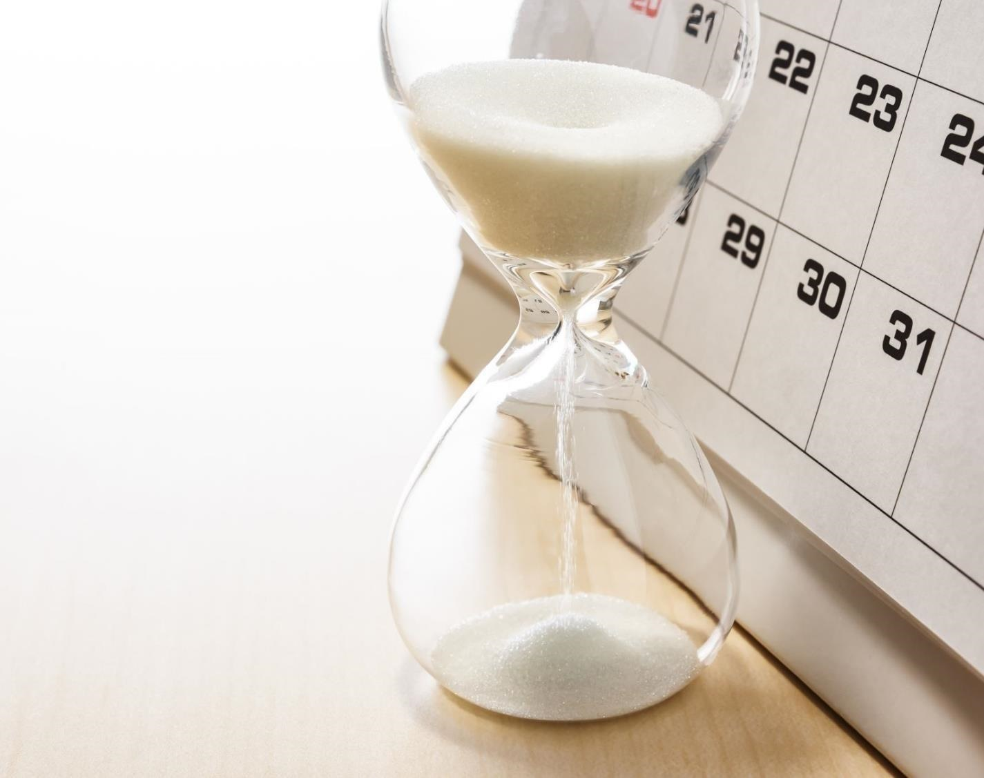
Sequencing Chronology
3
Notes:
Students should be able to put historical events in the right order. As students progress, it means that they understand that the order of events can teach us something about:
cause and effect
continuity and change
the flow of a historical narrative.

Slide 30
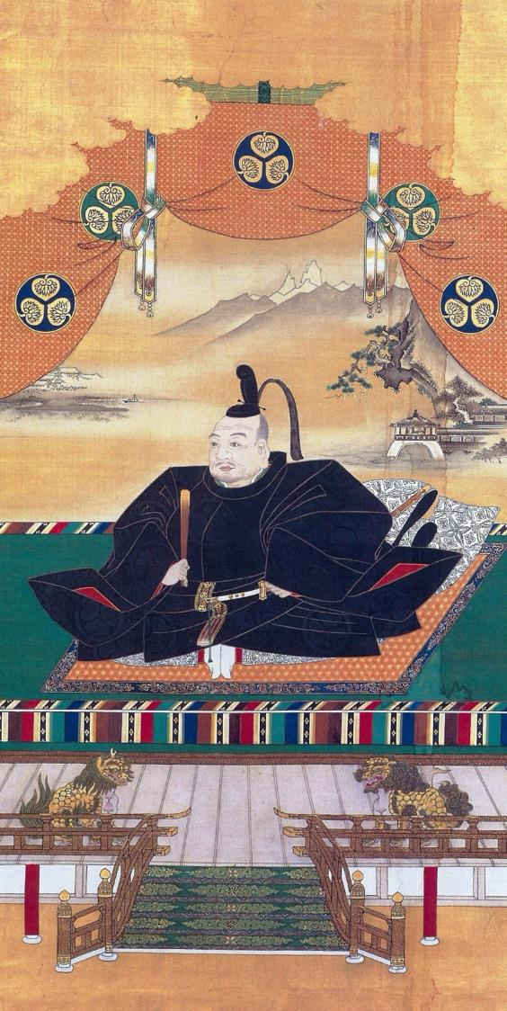
4
A chronology of Japan under the Shoguns
(c.794–1867)
Notes:
Please refer to Levels 7 and 8: Chronology – Student Handout and Teacher Notes.
Slide 6 is a simplified example of a timeline for your students to help them answer Question 1 on the handout.
Timelines can be made using shapes and text boxes in Word documents and PowerPoint presentations. They can also be made in an Excel spreadsheet.
Differentiated Learning:
Support: Students could complete the handout in pairs or as a small group under teacher guidance.
Extension: Students could use their accumulated knowledge to debate with other students whether ‘Japan under the Shoguns was a time of great change’.
Image attribution
Image Title: Portrait of Shogun Tokugawa Ieyasu
Creator: Kanō Tan’yū (1602 – 1674 AD)
Source: https://commons.wikimedia.org/wiki/File:Tokugawa_Ieyasu2_full.JPG
License: This work is out of copyright

Slide 31
We will need to understand the meaning of these words to learn about Japan under the Shoguns
5
empire
daimyo
shogun
sakoku
divine wind
shogunate
imperial rule
civil war
emperor
feudalism
dynasty
sovereign
Notes:
Your students will need to understand these words in order to engage fully with this activity. After finding out which words the students already understand, you might wish to ask the students to look up these words and share their meanings. These words could then be added to a word wall or a shared glossary on their LMS.
empire – a large area under one political rule or a group of territories under one rule
emperor – the ruler of an empire
feudalism – a society that is based upon the holding of land and power by a few individuals in exchange for protection and the giving of service or labour by the many
daimyo – a warlord or powerful Japanese feudal lord
shogun – an all-powerful military ruler of Japan with an emperor as a figurehead ruler
sakoku – Japanese foreign policy that forbade any Japanese person from leaving Japan or any foreigner entering it; the ‘locked country’ policy
divine wind – name given to the typhoons that saved Japan from invasion by the Mongols, twice
shogunate – the period of time when Japan was ruled by a shogun
imperial rule – the periods of time when the emperor had complete power and ruled Japan
civil war – when groups of people from within the same country fight for power and control
dynasty – a line of rulers from the same family
sovereign - a king or queen

Slide 32
6
Emperor Go-Daigo overthrows Kamakura shogunate
Shogun Yoshimitsu unifies Japan again
Warring States period begins
Minamoto no Yoritomo becomes shogun
1185 AD
1333 AD
1337 AD
1392 AD
1467 AD
Emperor Go-Daigo is challenged by Muromachi shogunate – civil war follows
Notes:
This is a simplified example of a timeline to help your students answer Question 1 on the handout.

Slide 33
Conclusion

Slide 34
Discussion points
How often do your students return to creating timelines or tables to help them understand the period they are studying?
Do you ask students to describe the criteria they are using to decide which events or turning points are significant enough to be included in their timelines?
Does your class ‘play’ with different modes and presentation formats for timelines, analysing which are most useful for a particular investigation?
What is the most powerful, informative timeline that you have ever developed with your students?
Once a timeline is complete, do you press your students to analyse what light it shines on the narrative?
How can we ensure that student-produced timelines are rich tasks and not just a series of dates and facts taken from Wikipedia?
How do we design activities that cater for a wide range of learners?
Notes:
Individually or in groups, use these questions to reflect on your teaching. How do you approach teaching the concept of chronology? How might you approach it differently?

Slide 35
Reflection activity
Use the following thinking routine to reflect:
What excites you about this idea?
What do you find worrisome?
What else do you need to know?
What is your current stance or opinion?

