Slide 1
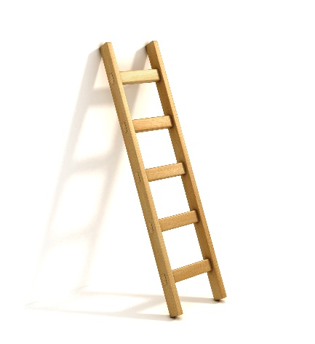
Module 3: Two-way Planning The Victorian Curriculum F–10: Health and Physical Education and Personal and Social Capability, including Respectful Relationships
Activity
Curriculum

Slide 2
Multiple entry points

Slide 3
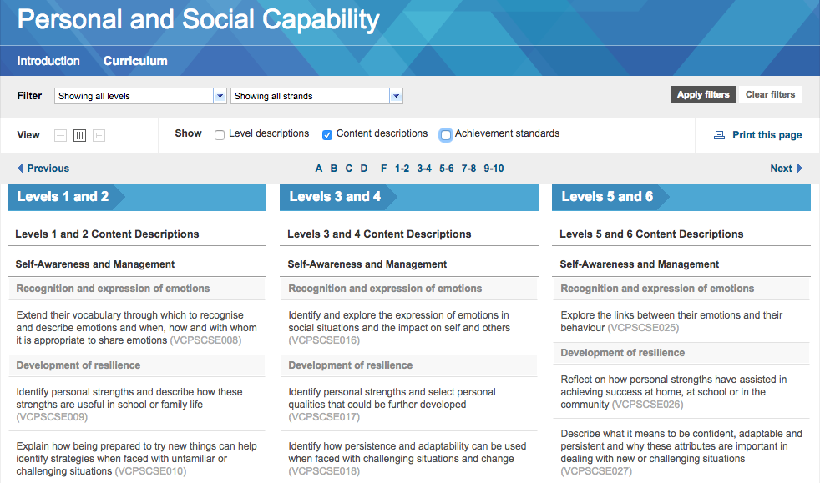
Start with the curriculum

Slide 4
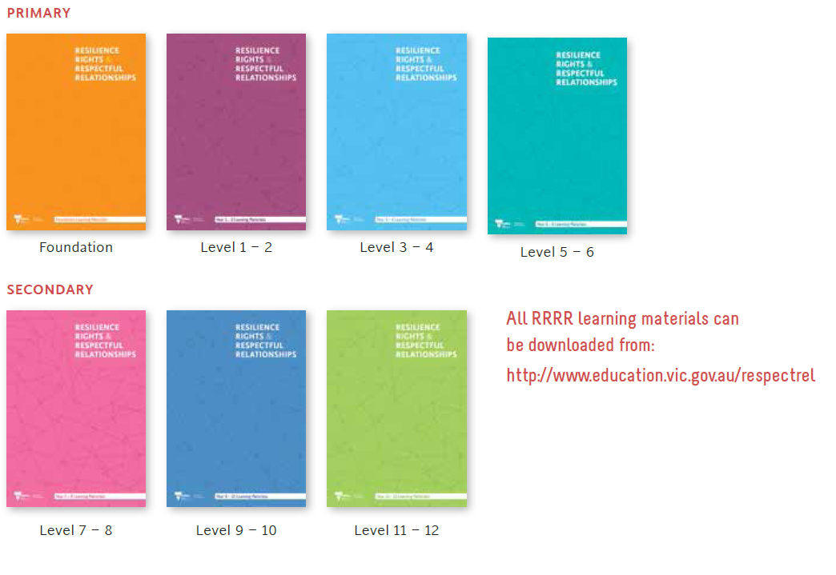
Or start with the teaching and learning activity (Resilience, Rights and Respectful Relationships resource) and work back to the curriculum

Slide 6
Activity
What is gender-based violence?
Levels 3–4, Topic 8, Activity 2, page 76

Slide 7
What is gender-based violence?

Slide 8
It was ‘Sports and Leisure Day’ at school, and the students were asked to come in the clothes they wear to play sports or active games. Many of the girls wore their netball uniforms, and some wore ballet costumes, or karate uniforms. Kellie arrived with her skateboard, wearing her helmet, knee pads and elbow pads. Several of the boys were talking to Kellie, looking at her skateboard and asking if they could try it out. She showed them a few of the tricks she had perfected. In the playground, Aisha whispered something to Megan while pointing and laughing at Kellie. This continued in class during group work, Aisha kept whispering, “Boy. Boy. You’re a boy. You should go sit with the boys.” When they had to go to the bathrooms to wash hands before snack time, Aisha stood in the doorway, blocking Kellie’s entry, and said, “This toilet is only for girls! Skatey Kellie is a boy! Go and use the boys toilets!” Megan said nothing, just looked away, even when Kellie looked straight at her. Several other younger students who were leaving the toilets witnessed this too.

Slide 11
Personal and Social Capability
3 and 4
Describe the ways in which similarities and differences can affect relationships (VCPSCSO021)
Students discuss the value of diverse perspectives and through their interactions they demonstrate respect for a diverse range of people and groups.
What is gender-based violence?
Students complete an individual X-chart based on a scenario you provide them.
Can use a scenario that commonly occurs at school.
They describe factors that contribute to positive relationships with peers, other people at school and in the community.

Slide 12
Example

Slide 13
Next steps
Work through this for the topics you are covering …

Slide 14
Sapna Sachdeva VCAA Specialist Teacher Health Education and Personal and Social Capability, including Respectful Relationships

