Slide 1
Introducing Mathematics

Slide 2
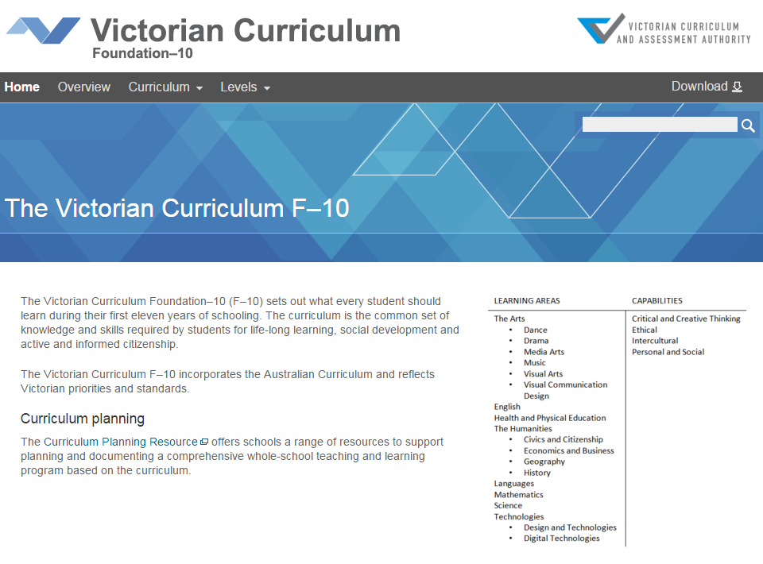
Victorian Curriculum F–10
Released in September 2015 as a central component of the Education State
Provides a stable foundation for the development and implementation of whole-school teaching and learning programs
The Victorian Curriculum F–10 incorporates the Australian Curriculum and reflects Victorian priorities and standards
http://victoriancurriculum.vcaa.vic.edu.au/

Slide 3
Aims
The Mathematics curriculum aims to ensure that students:
develop useful mathematical and numeracy skills for everyday life, work and as active and critical citizens in a technological world
see connections and apply mathematical concepts, skills and processes to pose and solve problems in mathematics and in other disciplines and contexts
acquire specialist knowledge and skills in mathematics that provide for further study in the discipline
appreciate mathematics as a discipline – its history, ideas, problems and applications, aesthetics and philosophy.

Slide 4
Structure
Strands and Sub-strands
Number and Algebra | Measurement and Geometry | Statistics and Probability
Number and place value | Using units of measurement | Chance
Fractions and decimals | Shape | Data representation and interpretation
Real numbers | Geometric reasoning
Money and financial mathematics | Location and transformation
Patterns and algebra | Pythagoras and trigonometry
Linear and non-­linear relationships

Slide 5
Structure
Achievement standards
The first achievement standard at Foundation and then at Levels 1, 2, 3, 4, 5, 6, 7, 8, 9 and 10.
The curriculum also provides an optional Level 10A, which is intended for students working at Level 10 requiring further mathematical studies.
A curriculum for students with disabilities is provided in this learning area.

Slide 6
Key messages
Mathematics in the Victorian Curriculum F-10 is substantially similar to AusVELS Mathematics with the majority of the curriculum unchanged.
The level descriptions in the Victorian Curriculum Mathematics have all been revised to more fully articulate the proficiencies of understanding, fluency, reasoning and problem solving in relation to the content descriptions and achievement standards
The Mathematics curriculum has been strengthened with the addition of content relating to algorithms and coding in the Patterns and algebra sub-strand of the Number and Algebra strand at each level.
A small number of new content descriptions and elaborations have been developed, and a small number of existing content descriptions and elaborations revised, at various levels to enhance the coherence, consistency and completeness of the curriculum.
Reporting progress in Mathematics
These changes do not cause a break in reporting data and student progress can be shown from AusVELS Mathematics to the Victorian Curriculum F–10 Mathematics.

