Slide 1
Victorian Curriculum F–10 Version 2.0 Mathematics
High-level changes between the
Victorian Curriculum F–10 Version 1.0 and Version 2.0,
Levels 5 to 10

Slide 2
Overview
Timeline and aims
Revisions to the Mathematics learning area – Levels 5 to 10
The 4 mathematical processes
VCAA resources

Slide 3
Implementation timeline
Victorian Curriculum F–10 Mathematics Version 2.0 published 28 July 2023
Phased implementation from 2024 onwards:
  Victorian government and Catholic schools can implement from 2024, with full implementation in 2025
  Implementation in independent schools is at the discretion of each school in the sector
 | 2022 |  | 2023 |  | 2024 | 2025
Mathematics |  | Revision | Revision | Familiarisation | Familiarisation | Full implementation
 |  |  |  |  | Start implementation (optional) | Implementation
Notes:
Victorian government schools can commence implementing the Victorian Curriculum F–10 Version 2.0 Mathematics (also known as Mathematics Version 2.0) from 2024, with full implementation by 2025.
Implementation in independent schools is at the discretion of each school in the sector.

Slide 4
Mathematics Version 2.0: Aims
Mathematics aims to ensure that students:
develop useful mathematical and numeracy skills for everyday life and work, as emerging active and critical citizens in a technological world
become confident, proficient, effective and adaptive users of mathematics
become effective communicators of mathematics who can investigate, represent and interpret situations in their personal and work lives, think critically, and make choices as active, engaged, numerate citizens
develop proficiency with mathematical concepts, skills, procedures and processes, and use them to demonstrate mastery in mathematics as they pose and solve problems, and reason with number, algebra, measurement, space, statistics and probability
Notes:
The rationale and aims of Mathematics Version 2.0 provide the basis for the construction of the Mathematics curriculum and an understanding of why it is studied by all students from Levels F to 10.
When you are planning teaching and learning units, it’s important to keep in mind that the aims cover multiple purposes, from developing numeracy, to concepts, skills and processes that support learning and applications in other disciplines, as well as background for further study in the discipline itself.

Slide 5
Mathematics Version 2.0: Aims continued
make connections between areas of mathematics and apply mathematics to model situations in various fields and disciplines
develop a positive disposition towards mathematics, recognising it as an accessible and useful discipline to study
appreciate mathematics as a discipline – its history, ideas, problems and applications, aesthetics and philosophy
Notes:
Together, the aims address the development of essential knowledge, skills and dispositions for now and in the future.
Consider undertaking Activity 1: Explore the Mathematics Version 2.0 aims in the Mathematics Learning Area Leader Guide.
Discuss each of the aims of the curriculum and explore how they relate to the content covered in Levels 7 to 10.
What emphasis is placed on each of the aims in different contexts?

Slide 6
Revisions to the Mathematics learning area
Levels 5 to 10

Slide 7
Overview of structural changes
Mathematics Version 2.0:
organises content under 6 strands: Number, Algebra, Measurement, Space, Statistics and Probability (from Level 3) with no sub-strands
embeds the proficiencies in achievement standards and content descriptions
includes greater emphasis on the 4 mathematical processes of mathematical modelling, computational thinking and simulations, statistical investigation, and probability experiments and simulations in content descriptions across the strands
includes better-aligned achievement standards and clearer content descriptions
provides improved sequencing of concepts, with stronger links across strands
includes play- and exploration-based content positioned from Foundation to Level 2
provides enhanced clarity through:
  level descriptions that outline in greater detail the content, skills and expected outcomes at each level
  content descriptions with clearer articulation of the essential mathematical facts, procedures and skill
  elaborations with more examples.
Notes:
The Victorian Curriculum F–10 Mathematics Version 2.0 has incorporated content from the Australian Curriculum Version 9.0 and refined the overall design and content to make it easier for teachers to implement efficiently and effectively.
Some key points to note are:
content descriptions have been made clearer and are better-aligned to achievement standards
sequencing of concepts has been improved, noting that Probability now commences at Level 3
the previously dual strands have been split
the proficiencies have been embedded in achievement standards and content descriptions, and this has the added benefit of placing them with relevant mathematics content and processes.
greater emphasis has been placed on the 4 mathematical processes, providing increased opportunity for relating the content to real-life practical examples and investigations.
increased focus on play- and exploration-based content Foundation to Level 2
revised and new elaborations that provide a range of quality suggestions that contextualise the content have been included
Consider undertaking Activity 4: Compare the curriculums (Version 1.0 to Version 2.0) in the Mathematics Learning Area Leader Guide, either as a way of introducing the revisions made from Mathematics Version 1.0 to Mathematics Version 2.0 now or, at the end, once the related slides have been discussed.

Slide 8
Proficiencies
Strands
Fluency
Reasoning
Problem-solving
Understanding
At each level, the 4 proficiencies of Understanding, Fluency, Reasoning and Problem-solving have been embedded in achievement standards and content descriptions, which now more clearly articulate the proficiencies.
Notes:
The proficiencies are characterised as connecting the 'what' of mathematics with the 'how' and 'why'.
In the Mathematics Version 1.0 curriculum structure, the proficiencies were presented separately to content descriptions, in the Learning in Mathematics page of the Introduction to the curriculum as 4 paragraphs, each with several dot points. This required teachers to make connections between the proficiencies and the content descriptions themselves.
The revised Mathematics Version 2.0 curriculum has clarified the relationship to the curriculum by embedding the proficiencies within content descriptions and achievement standards to make the connections explicit.

Slide 9
Proficiencies in content descriptions
Content description clarity has been improved so that content descriptions more clearly articulate the proficiencies.
Level 7 – Algebra | Level 9 – Statistics
apply the associative, commutative and distributive laws to aid mental and written computation, and formulate algebraic expressions using constants, variables, operations and brackets VC2M7A02 | choose appropriate forms of display or visualisation for a given type of data; justify selections and interpret displays for a given context VC2M9ST04
Proficiencies: Understanding, Fluency | Proficiencies: Reasoning, Problem-solving
Notes:
Here are 2 examples of how the proficiencies have been embedded into content descriptions.

Slide 10
Proficiencies in achievement standards
The following extracts from the Level 7 and Level 9 achievement standards correspond to the 2 content description examples from the previous slide.
Level 7 achievement standard extracts | Level 9 achievement standard extract
Students use algebraic expressions to represent situations, describe the relationships between variables from authentic data and substitute values into formulas to determine unknown values. | Students compare and analyse the distributions of multiple numerical data sets, choose representations, describe features of these data sets using summary statistics and the shape of distributions, and consider the effect of outliers.
Proficiencies: Understanding, Fluency | Proficiencies: Reasoning, Problem-solving
Notes:
Here are 2 examples of extracts from achievement standards at 2 levels that illustrate how the proficiencies have been embedded in the achievement standards.
These extracts correspond to the 2 content description examples from the previous slide.
Where a proficiency has been embedded in a content description, this embedding will typically also apply to the extract of the achievement standard that covers this content description.
Consider undertaking Activity 2: Understand the structure of the revised Mathematics curriculum in the Mathematics Learning Area Leader Guide:
This could involve working in small groups to identify and discuss how the proficiencies have been incorporated into content descriptions and achievement standards of the revised curriculum.
This could be done by discussing a range of examples from across levels and strands, initially looking at selected content descriptions, and then the corresponding extracts from the achievement standards.

Slide 11
The 6 strands
Number
Algebra
Measurement
Space
Statistics
Probability
6 strands
The dual strands have been decoupled – now 6 individual strands
Notes:
The revised curriculum organises the content into 6 individual strands.
This split from the dual strands provides teachers with the option to explore new connections across different strand pairings.
You may choose to connect content from across 2 or more strands – for example, from the Number and Space strands, or the Algebra and Measurement strands – when designing teaching and learning units.

Slide 12
Connecting content across strands
Level 8 | Number | Measurement | Unit outline example (extract)
Content description | recognise irrational numbers in applied contexts, including π and numbers that develop from the square root of positive real numbers that are not perfect squares, and recognise that irrational numbers cannot develop from the division of integer values by natural numbers VC2M8N01 | use Pythagoras’ theorem to solve problems involving the side lengths of right-angled triangles VC2M8M06 | the recognition, demonstration and proof of Pythagoras’ theorem, and its use to calculate side lengths in right-angled triangles application of the theorem to solve practical problems involving lengths and distances in the plane Pythagorean triples
Achievement standard extract | … students recognise irrational numbers as numbers that cannot develop from the division of integer values by natural numbers and terminating or recurring decimals. | They use Pythagoras’ theorem to solve measurement problems involving unknown lengths of right-angled triangles.
Notes:
For example, you may choose to connect and cover these 2 Level 8 Number content descriptions in the same unit of work.

Slide 13
Scope and sequence: Number
Level 5 | Level 6 | Level 7 | Level 8
Content descriptions
use mathematical modelling to solve practical problems involving additive and multiplicative situations, including simple financial planning contexts; formulate the problems, choosing operations and efficient mental and written calculation strategies, and using digital tools where appropriate; interpret and communicate solutions in terms of the situation VC2M5N09 | use mathematical modelling to solve practical problems involving rational numbers and percentages, including in financial contexts; formulate the problems, choosing operations and using efficient mental and written calculation strategies, and using digital tools where appropriate; interpret and communicate solutions in terms of the situation, justifying the choices made VC2M6N09 | use mathematical modelling to solve practical problems involving rational numbers and percentages, including financial contexts such as ‘best buys’; formulate problems, choosing representations and efficient calculation strategies, designing algorithms and using digital tools as appropriate; interpret and communicate solutions in terms of the situation, justifying choices made about the representation VC2M7N10 | use mathematical modelling to solve practical problems involving rational numbers and percentages, including financial contexts involving profit and loss; formulate problems, choosing efficient mental and written calculation strategies and using digital tools where appropriate; interpret and communicate solutions in terms of the context, reviewing the appropriateness of the model VC2M8N06
Notes:
The content is also connected progressively within strands.
As you move through the levels in the Number strand you can see the progression of increasing sophistication from left to right.
The VCAA scope and sequence charts nicely illustrates how content and required thinking evolves through the levels.

Slide 14
Overview of key Levels 5–10 revisions
The revised Mathematics curriculum has reduced the total number of content descriptions in Foundation to Level 10 from 286 to 257.
As part of this process, some content descriptions were combined and realigned within and across strands and levels, resulting in various extents of change.
To support schools and teachers, the VCAA has provided a range of resources documenting the changes between Victorian Curriculum F–10 Version 1.0 and Victorian Curriculum F–10 Version 2.0.
Notes:
While some new content descriptions have been added, most of the additions and revisions expand on existing content areas. The revisions:
provide clearer articulation of the essential mathematical facts, procedures and skills
combine and realign content descriptions to improve sequencing of concepts
consolidate and strengthen specific content areas.
Through this process, a number of content descriptions have also been removed, often due to the content having being integrated into a revised content description.
The VCAA has developed a range of resources that outline the changes between Mathematics Version 1.0 and Mathematics Version 2.0. We will discuss these a bit later.

Slide 15
Overview of key Levels 5–10 revisions
New content descriptions that extend the scope of learning:
Level 8: inclusion of three-dimensional mapping
Level 10: inclusion of networks and network diagrams
Level 10: inclusion of logarithmic scales (not equations or laws)
Notes:
There are only 3 content descriptions that extend the scope of learning across Levels 5–10, as distinct from expanding on existing content.
Let’s take a brief look at these now.

Slide 16
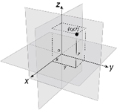
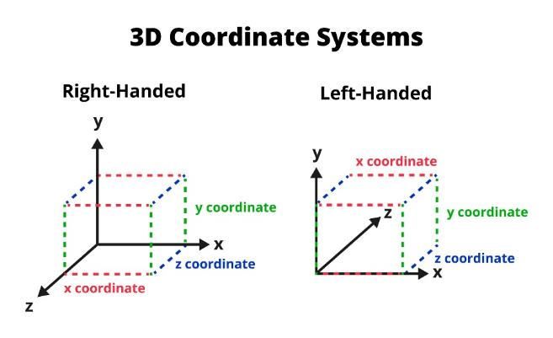
Three-dimensional mapping
Level 8 – Space
Content description
describe in different ways the position and location of three-dimensional objects in 3 dimensions, including using a three-dimensional Cartesian coordinate system with the use of dynamic geometry software or other digital tools VC2M8SP03
Notes:
Representation in 3 dimensions has been included in Level 8 Space.
This inclusion reflects the change in accessibility of 3D printers and the increased focus on robotics and STEM in general, which often include the use of 3-dimensional representation software, and the importance of students developing spatial measurement skills.

Slide 17
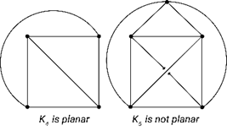
Networks and network diagrams
Level 10 – Space
Content description
interpret networks and network diagrams used to represent relationships in practical situations and describe connectedness VC2M10SP02
Notes:
Advancements in technology and the availability of data has seen an increased use of networks and network diagrams.
Network diagrams are used to represent a variety of real-world systems, for example:
transport networks
utilities networks
computer networks
social networks.
As technology and data become even more integral to jobs and daily life, the inclusion of networks and network diagrams at Level 10 provides an introduction to this area of mathematics for all learners prior to VCE.

Slide 18
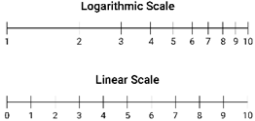
Logarithmic scales
Level 10 – Measurement
Content description
interpret and use logarithmic scales in applied contexts involving small and large quantities and change VC2M10M02
Notes:
Logarithmic scales offer a compact way of displaying numerical data involving very large and/or very small numbers. They make it easier to spot patterns and identify relationships. The recent COVID-19 pandemic saw an increased number of graphs using logarithmic scales in the media.
It’s important to note that this content description is about logarithmic scales, and not about solving logarithmic equations.
Logarithmic scales sit in the Measurement strand. There is no intention to have students solve logarithmic equations – that remains an element of Level 10A.

Slide 19
Overview of key Levels 5–10 revisions
Main content shifts
Level 5:
introduction of percentages and connecting common percentages to their decimal and fraction equivalents (previously at Level 6)
Level 6:
number properties: associative, commutative and distributive laws (previously at Level 7)
Level 7:
formal calculation of volume (previously at Level 5)
volume of prisms using appropriate units (previously at Level 8)
relationship between π and circumference (previously at Level 8)
increased focus on the distribution of data, commenting on the shape, centre and spread, including outliers and determining the range, median, mean and mode (previously at Level 8)
Notes:
These next 2 slides provide an overview of the key content shifts between levels at Levels 5 to 10.
It’s important to be aware of these shifts, as they will impact the knowledge students bring to specific topics.

Slide 20
Overview of key Levels 5–10 revisions
Main content shifts
Level 8:
solving one-variable inequalities (realigned from Levels 9 and 10)
connecting volume and capacity (previously at Level 6)
introduction of Pythagoras’ theorem (previously at Level 9)
Level 9:
explicitly addressing the factorisation of monic quadratic expressions (previously at Level 10)
Level 10:
inclusion of the use of simulation with digital tools to model conditional probability
Notes:
In the VCAA’s Mathematics comparison of curriculums document, you can find the detailed outline of all the changes across Foundation to Level 10.

Slide 21
Content realigned down levels
In the first year of implementation, content moved down a level will need to be covered at both levels.
Victorian Curriculum F–10 Version 1.0​
calculate volumes of rectangular prisms (VCMMG259)​ develop the formulas for volumes of rectangular and triangular prisms and prisms in general. Use formulas to solve problems involving volume (VCMMG289)​
Victorian Curriculum F–10 Version 1.0​
explore the use of brackets and order of operations to write number sentences (VCMNA220) apply the associative, commutative and distributive laws to aid mental and written computation and make estimates for these computations (VCMNA240)​
Level 8 to Level 7
Level 7 to Level 6
Victorian Curriculum F–10 Version 2.0​​
solve problems involving the volume of right prisms including rectangular and triangular prisms, using established formulas and appropriate units (VC2M7M02​​)
Victorian Curriculum F–10 Version 2.0​​
find unknown values in numerical equations involving brackets and combinations of arithmetic operations, using the properties of numbers and operations (VC2M6A02)
Notes:
It's important to familiarise yourselves with content that has been realigned down levels in particular, as this content will need to be covered at both levels in the first year of implementation.
I recommend you make a note within your planning documents where relevant.
The example on the left shows how a Level 8 content description referring to calculating the volume of prisms using appropriate units has been combined with an existing Level 7 content description to form the revised content description VC2M7M02.
The example on the right highlights how the understanding of number properties has moved from Level 7 to Level 6. The revised curriculum now explicitly introduces applying the associative, commutative and distributive laws at Level 6 and extends this to applying these number properties to algebraic expressions at Level 7.
Consider showing this VCAA document, which offers advice about covering content that has moved down a curriculum level: Mathematics Version 2.0 – transitional advice (for first year of implementation only).

Slide 22
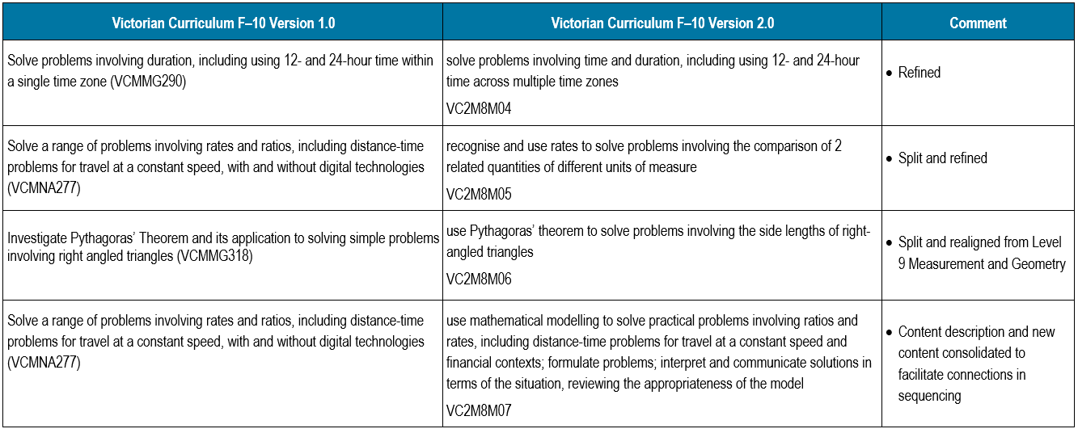
VCAA resource detailing revisions
The comparison of curriculums document details the changes between Mathematics Version 1.0 and Version 2.0. It maps Version 1.0 content descriptions to the corresponding Version 2.0 content descriptions.
Notes:
There is a VCAA document that provides a detailed outline of the revisions between Victorian Curriculum F–10 Mathematics Version 1.0 and Mathematics Version 2.0.
Let’s take a quick look.
The comparison of curriculums document covers Foundation to Level 10.
In the middle column, content descriptions are listed in the order in which they appear in the revised curriculum.
The left column shows which Version 1.0 content descriptions have been mapped to each Version 2.0 content description.
The right column provides a brief commentary on the revisions made.
This document is especially helpful if you want to find out where a specific content description has been mapped to.
Consider showing the Mathematics comparison of curriculums document (Version 1.0 to Version 2.0).

Slide 23
Level 10A
Level 10A:
provides optional, additional content to extend students in their mathematical studies in number, algebra, function, geometry, probability and statistics
does not require reporting
organises content by strand and complements Level 10 content
is not a standalone level and has no achievement standard
is not required for access to any of the VCE Mathematics Units 1 and 2 studies.
Notes:
The revised curriculum includes an improved Level 10A that continues to support teachers and students by providing relevant content for students to enhance their Level 10 studies.
The Level 10A content descriptions suggest ways in which students could extend their studies of mathematical content in each of the strands.
Content may be selected for extension by the student or the teacher, depending on the learning context.
Level 10 content forms the necessary and sufficient basis for study of VCE Mathematics Units 1 and 2.
It’s important to keep in mind that:
Level 10A is not designed to be a substitute for Level 10. It's designed to complement Level 10 content.
It doesn't facilitate the learning of Level 10 content, nor does it provide, in and of itself, an adequate preparation for VCE.

Slide 24
The 4 mathematical processes

Slide 25
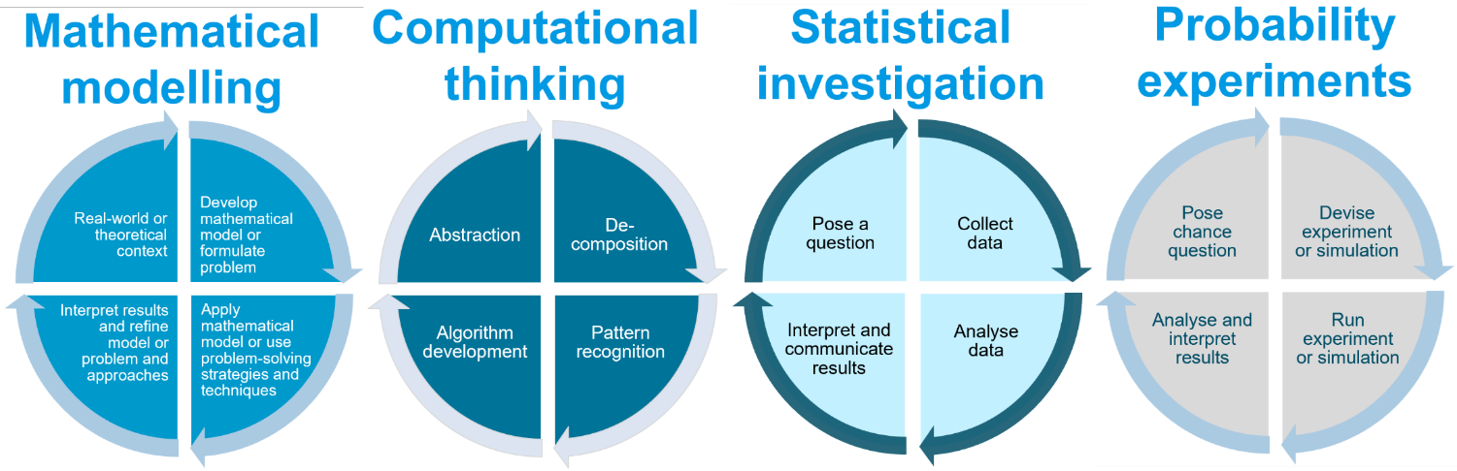
The 4 mathematical processes
Notes:
Each of the 4 mathematical processes can be represented using a similar 4-component diagram that shows a cycle of actions for that process.
The components of the diagram are distinctive to each process. Let's go through each one in turn.
The processes are described in more detail in the Learning in Mathematics section of the curriculum online, as part of the Introduction.
Consider undertaking Activity 3: Explore the mathematical processes and their role in the curriculum in the Mathematics Learning Area Leader Guide. This could include tracking examples of each process through the scope and sequence Levels 7–10.

Slide 26
Process: Mathematical modelling
Develop mathematical model or formulate problem
Apply mathematical model or use problem-solving strategies and techniques
Interpret results and refine model or problem and approaches
Real-world or theoretical context
Notes:
The process of mathematical modelling provides the basis for connecting mathematical concepts and skills with real-life applications.
It involves formulating a situation or problem mathematically and then using mathematics to explore the situation, identify behaviour and patterns, and make predictions or solve a problem.
This diagram shows the 4 components of this process as a cycle.
There are a range of sample application contexts to which the mathematical modelling process can be applied. These are described in the elaborations for content descriptions in the strands and levels. The next slide shows an example of this.

Slide 27
Mathematical modelling
Problem:
How do I use exchange rates to budget for an overseas trip?
Establish travel budget and itinerary
Determine travel expenses in each country
Identify exchange rates and calculate costs in AUD
Compare travel costs to travel budget in AUD
Level 8 – Measurement
Content description
use mathematical modelling to solve practical problems involving ratios and rates, including distance-time problems for travel at a constant speed and financial contexts; formulate problems; interpret and communicate solutions in terms of the situation, reviewing the appropriateness of the model VC2M8M07
Notes:
This example for the mathematical modelling process is based on a content description from the Measurement strand at Level 8 and involves the application of rates in a financial context.
The related elaboration for this content description is: ‘modelling problems involving converting money amounts using different exchange rates and applying them when planning and budgeting for overseas travel’.
Other elaborations that indicate practical problems involving ratios and rates include simple motion problems, map scales, phone charges, tax scales and mixing ingredients.

Slide 28
Process: Computational thinking
Decomposition
Pattern recognition
Algorithm development
Abstraction
Notes:
Computational thinking is a problem-solving process with 4 components. Approaches involve experiment and logical analysis, empirical reasoning and computer-based simulations.
Students develop computational thinking through the application of its various components: abstraction, decomposition, pattern recognition, use of models and simulations, algorithms and generalisation.
A set of resources that address computational thinking and algorithms at each level were developed for Mathematics Version 1.0. These are still available from the VCAA website F–10 Teaching Resources page: www.vcaa.vic.edu.au/curriculum/foundation-10/resources/mathematics/Pages/TeachingResources.aspx

Slide 29
Computational thinking
Problem:
Exploring graphs of parabolas
General form
y = a(x + h)² + k
Cases of
y = ax²
y = (x + h)²
y = x² + k
Patterns of
- dilation
- reflection
- translation
Steps from
y = x² to
y = a(x + h)² + k
Level 9 – Algebra
Content description
experiment with the effects of the variation of parameters on graphs of related functions, using digital tools, making connections between graphical and algebraic representations, and generalising emerging patterns VC2M9A07
Notes:
This example of the computational thinking process is based on a content description from the Algebra strand at Level 9 and involves applying combinations of transformations to the graph of the basic quadratic function y = x^2
The related elaboration for this content description is: ‘investigating transformations of the parabola …’
Other elaborations include applying similar processes to the graph of y = x or graphs of other basic functions such as the reciprocal, square root or exponential function.

Slide 30
Process: Statistical investigation
Collect data
Analyse data
Interpret and communicate results
Pose a question
Notes:
This diagram shows a cycle for the statistical investigation process. This is a common simple representation of this process and can be applied to questions of interest involving different data types across the levels.
The collection of data will involve activities such as developing a tool, for example a survey, and selecting a sample from the population. Once the data has been gathered, it can then be analysed, interpreted and communicated.
The process may then lead to refining the question and tool and repeating the cycle.

Slide 31
Statistical investigation
Question: Should there be more school uniform options?
Create a survey and identify a sample of school population
Collect survey data from population sample
Interpret survey data. Make inferences about school population
Report findings and acknowledge uncertainty
Level 8 – Statistics
Content description
plan and conduct statistical investigations involving samples of a population; use ethical and fair methods to make inferences about the population and report findings, acknowledging uncertainty VC2M8ST04
Notes:
This example of a statistical investigation considers the question of interest with respect to more choice with school uniform options, investigated using a survey with a sample of the school population.
The related elaboration that provides the basis for the investigation is: ’identifying situations where the collection of data from a sample is necessary due to efficiency, cost or restricted time for collection of data, and is sufficiently reliable for making inferences about a population’.

Slide 32
Process: Probability experiments and simulations
Devise experiment or simulation
Run experiment or simulation
Analyse and interpret results
Pose chance question
Notes:
Probability experiments and simulations provide the basis for gathering empirical data about questions of interest related to random or chance events in real life, and their long-run relative frequency.

Slide 33
Probability experiments and simulation
Question: What is the frequency of numbers in repeated rolls of a dice?
Develop chance question
Devise or select a simulation
Run simulation and record results as sample size increases
Compare results and explain differences
Level 7 – Probability
Content description
conduct repeated chance experiments and run simulations with a large number of trials using digital tools; compare predicted with observed results, explaining the differences and the effect of sample size on the outcomes VC2M7P02
Notes:
This example of a probability simulation considers convergence in long-run frequency as the number of trials (sample size) increases.
The related elaboration that provides the basis for the activity is: ’conducting simulations using online simulation tools and comparing the combined results of a large number of trials to predicted results’.

Slide 34
VCAA resources

Slide 35
Understanding the revised curriculum
The VCAA has prepared a range of resources to support teachers in understanding the revised curriculum:
Introducing Mathematics Version 2.0
Mathematics – comparison of curriculums document (Version 1.0 to Version 2.0)
Mathematics Version 2.0 scope and sequence documents
a glossary of mathematical terms used in the revised curriculum
downloadable Word version of the Mathematics Version 2.0 curriculum
Notes:
This set of documents focuses on understanding the revised curriculum.
All are available on the new Victorian Curriculum F–10 Version 2.0 website https://f10.vcaa.vic.edu.au and on the VCAA website www.vcaa.vic.edu.au/curriculum/foundation-10/resources/mathematics/Pages/MathematicsVersion2_0.aspx

Slide 36
Planning for the revised curriculum
The VCAA has prepared a range of resources to support teachers in planning for implementation of the revised curriculum, including:
Mathematics Teacher Guide (Prep–10)
Mathematics Learning Area Leader Guide (Prep–10)
teaching and learning unit template
example teaching and learning units for Levels 3 and 8
example assessment tasks that address specific aspects of the revised achievement standards for Levels 3 and 8
other planning templates and examples, such as curriculum area maps and curriculum area plans.
Notes:
This set of documents focuses on planning for the revised curriculum.
All are available on the VCAA website: www.vcaa.vic.edu.au/curriculum/foundation-10/resources/mathematics/Pages/MathematicsVersion2_0.aspx
These resources will also be moved over to the new F–10 website in late 2024 or early 2025, as the VCAA expands and adds greater functionality to the new website: https://f10.vcaa.vic.edu.au

Slide 37
Notes:
Time for questions
School-specific information

