Slide 1

VCE CCAFL Languages
An Australian Focus in the
study design

Slide 2
Acknowledgement
The Victorian Curriculum and Assessment Authority proudly acknowledges and pays respect to Victoria’s Aboriginal and Torres Strait Islander communities and their rich and enduring cultures.
We acknowledge Aboriginal and Torres Strait Islander people as Australia’s first peoples and as the Traditional Owners and custodians of the lands and waters on which we rely. We pay respect to Elders past and present of the lands where we conduct our work and recognise their ongoing contributions as the first educators on the land now known as Victoria.

Slide 3
Purpose of this video
To explore the Australian focus in the study design, including:
what the Australian focus means
why this is important
where it is located in the study design
a focus on the key knowledge and key skills
teaching and learning activities
and assessment tasks.
Notes:
Welcome to our on-demand video about the ‘Australian focus’ in the CCAFL Languages study design. During this video, we will unpack what ‘Australian focus’ means, why this is important and where it is located in the study design. This will include looking at the key knowledge and key skills, the teaching and learning activities, and assessment tasks.

Slide 4

Study Design
It is important that teachers regularly reference the study design.
Notes:
As you view this on-demand video, you will notice that the study design is regularly referenced. You may like to have a copy of this available throughout the video.

Slide 5
‘Australian Focus’ - Explanation
Promotes understanding of different attitudes and values within the wider Australian community and the global community.
Explores perspectives in the target language and within the Australian context.
Recognises significant social, cultural and economic contributions in the Australian context.
Explores and communicates aspects of Australian society in culturally and linguistically appropriate ways in the target language.
Relates to a subtopic with a focus on Australia.
May explore comparisons between Australia and target language-speaking countries or communities.
Notes:
The ‘Australian focus’:
may promote understanding of different attitudes, values and perspectives both within an Australian context, and also the global community. Students learn more about this by studying a subtopic with a focus on Australia.
As part of this subtopic, students may explore comparisons between Australia and countries or communities where the target language is spoken.
The teaching and learning activities may help students to develop their understanding of significant social, cultural and economic contributions made in the Australian context.

Slide 6

Australian Focus - Importance
Supports the exploration of aspects of Australian society from different perspectives.
Supports exploration of different attitudes and values within the wider Australian community.
Links with students’ experience.
Notes:
The ‘Australian focus’ is an important feature in the study design, given Australia’s multilingual and multicultural society. This focus allows students to explore aspects of Australian society in culturally and linguistically appropriate ways. Students may also be able to further connect with communities where the target language is spoken, as they explore different attitudes and values within the wider Australian community.

Slide 7

Australian Focus – In the study design
Australian focus is in
  Unit 2 Area of Study 3
  Some subtopics might be more suited to the ‘Australian focus’ in Unit 2 Outcome 3.
Notes:
So, where does the ‘Australian focus’ feature in the study design?
You will note that the Australian focus is explicitly referenced in Unit 2 Area of Study 3, and that the outcome requires students to deliver a spoken presentation on a subtopic related to Australia. This is where the link to Australia MUST be featured.
When planning, it is important to note that SOME subtopics may be more suited to the ‘Australian focus’ than others, and teachers are encouraged to see the ‘Suggested subtopics’ document on the language study page for examples.

Slide 8
Key Knowledge and Key Skills
Teaching and learning activities, and assessment tasks must be based on the key knowledge and key skills.
Unit 2 Outcome 3
    understanding of one or more aspects of Australian society
    explain an aspect of the subtopic related to Australia through an original spoken presentation
    select relevant examples to present an aspect of Australian society
Notes:
When creating a teaching and learning plan, it is important to consider the key knowledge and key skills listed in the study design for each Area of Study. The teaching and learning activities and assessment tasks will be based on these.
Here you can see examples of key knowledge and key skills for Unit 2 Outcome 3 which explicitly reference the Australian focus, for example:
understanding of one or more aspects of Australian society
explain an aspect of the subtopic related to Australia through an original spoken presentation
And select relevant examples to present an aspect of Australian society

Slide 9
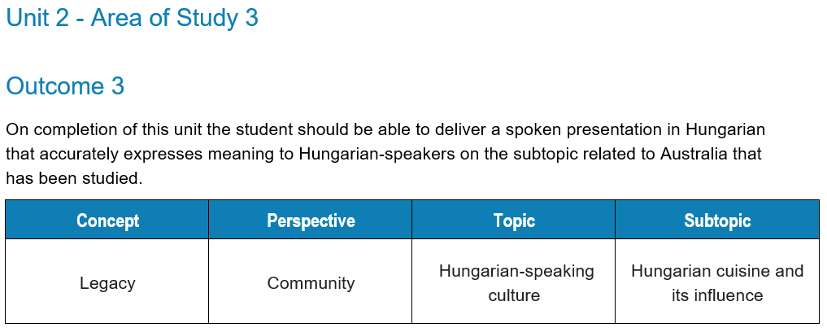
Australian Focus – Learning Activities
Notes:
On the study page you will find sample learning activities that give examples of classroom activities that could be used when teaching different subtopics.
Here you will see an example from Hungarian, focusing on
The concept ‘legacy’ from the ‘community perspective
And focusing on the Topic ‘Hungarian-speaking culture’
As you can see, the selected subtopic is ‘Hungarian cuisine and its influence’.

Slide 10
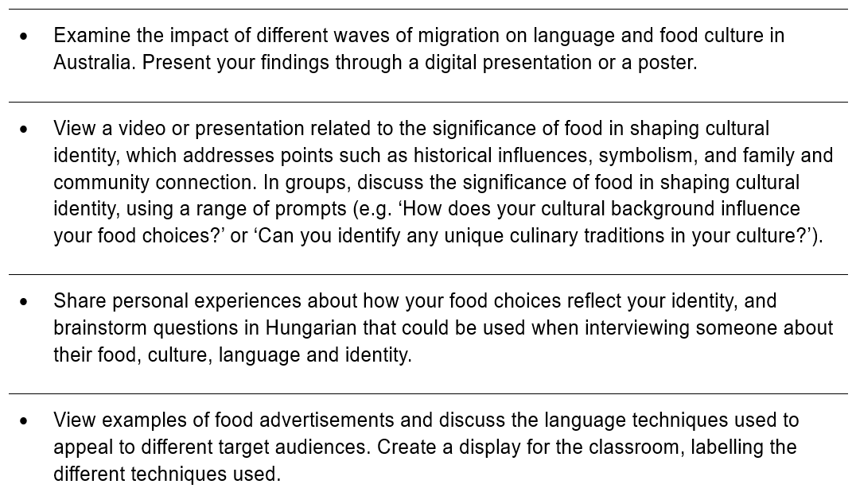
Australian Focus – Learning Activities
Notes:
When we look more closely at the teaching and learning activities, we see references to Australia. For example (CLICK)
‘Examine the impact of different waves of migration on language and food culture in Australia. Present your findings through a digital presentation or poster.’
The sample learning activities may also provide examples of how students can reflect on their own experiences, (CLICK) for example, ‘Share personal experiences about how your food choices reflect your identity.’

Slide 11
Unit 2 Outcome 3
Outcome 3
On completion of this unit the student should be able to deliver a spoken presentation in Hungarian that accurately expresses meaning to Hungarian-speakers on the subtopic related to Australia that has been studied.
To achieve this outcome the student will apply key knowledge and key skills outlined in Area of Study 3.
Notes:
When planning your school-based assessment tasks, it is important to ensure the outcome is designed to reflect the information provided in the study design.
As this is the outcome statement for Unit 2 Outcome 3, you can see the explicit reference to the ‘subtopic related to Australia’.
You can also see how important the key knowledge and the key skills are when you read the outcome statement. This is evident in the final line, which states ‘applying the key knowledge and key skills outlined in Area of Study 3’.

Slide 12
Example assessment tasks
Unit 2 Outcome 3
Narrate a life story, tradition, activity, event or incident that highlights an aspect of Australian history or contemporary society
Tell the class about the achievements of a person from a target language-speaking community and their contribution to Australian life; for example, an actor, sportsperson, poet, influencer, scientist or teacher
Present a personal reflection on the influence of traditional dishes on Australian cuisine
Notes:
Unlike Units 3 and 4, assessment tasks are NOT prescribed for Unit 1 and Unit 2. You will, however, find example assessment tasks in the study design. These examples are provided at the end of Unit 1 and Unit 2 to help support you in the development of the assessment tasks for your school.
Here you can see the example assessment tasks provided for Unit 2 Outcome 3. Each example has an explicit reference to the ‘Australian focus’.
Where teachers allow students to choose between tasks, they must ensure that the tasks set are of comparable scope and demand.

Slide 13

Australian Focus
  The Australian focus may also feature in other Units and/or Areas of Study, based on the concept, topic, subtopic and perspective being studied.
Notes:
But schools and teachers may also identify natural links in subtopics being covered in other Units and Areas of Study, and of course you are welcome to continue to make these connections throughout the 2-year teaching and learning program.

Slide 14

Australian Focus
  There may also be a range of ways to incorporate the Australian focus in the teaching and learning program.
Notes:
As you can see, the outcome statement and assessment task, along with the key knowledge and key skills, provide guidance about what to include in your teaching and learning program. Teachers are encouraged to carefully consider the subtopic for use in Unit 2 Area of Study 3, to ensure this lends itself to the Australian focus.
It’s also important to remember that the subtopics provided in the subtopic list are suggestions only. Developing teaching and learning programs around another subtopic with an Australian focus may help you to cater to the interests of students in your classroom.

Slide 15
Contact
Languages Unit
vcaa.languages.curriculum@education.vic.gov.au
© Victorian Curriculum and Assessment Authority (VCAA) 2025. Some elements in this presentation may be owned by third parties. VCAA presentations may be reproduced in accordance with the VCAA Copyright Policy, and as permitted under the Copyright Act 1968. VCE is a registered trademark of the VCAA.
Notes:
If you have any additional questions about the ‘Australian focus’, we would encourage you to contact our Languages Unit, and please don’t forget to view the other on-demand videos available on the study page.

Slide 18


