Slide 1

VCE CCAFL Languages
Designing effective integrated tasks

Slide 2
Acknowledgement
The Victorian Curriculum and Assessment Authority proudly acknowledges and pays respect to Victoria’s Aboriginal and Torres Strait Islander communities and their rich and enduring cultures.
We acknowledge Aboriginal and Torres Strait Islander people as Australia’s first peoples and as the Traditional Owners and custodians of the lands and waters on which we rely. We pay respect to Elders past and present of the lands where we conduct our work and recognise their ongoing contributions as the first educators on the land now known as Victoria.

Slide 3
Purpose of this video
Provide teachers with guidance about designing effective school-based assessment tasks for Area of Study 2: Analysis of [Language].
Notes:
On behalf of the VCAA, I’d like to welcome you to this presentation, focusing on providing guidance and advice about designing effective integrated tasks. This video will focus on what the integrated task is, where it appears in the study design and will provide some tips for setting effective integrated tasks. We will also share an example integrated task.

Slide 4
Defining integrated tasks
Students analyse information from texts (e.g. reading, listening, viewing).
Information in the texts should be related to different aspects of the same subtopic.
There are different numbers or combinations of texts for each Unit and/or Outcome.
Integrated tasks may require students to identify, interpret, analyse or synthesise.
Notes:
So, what are integrated tasks?
These are tasks that require students to analyse information from 2 or more texts, for example a reading and listening. They assess students’ ability to identify, analyse, synthesis, compare, contrast or summarise information from a range of texts, which are based on different aspects of one subtopic.
Each text should contain unique information that students are required to extract. Integrated tasks may also require different combinations of stimulus texts.

Slide 5
Integrated tasks
Integrated writing tasks appear in the study design in
  Unit 1 Outcome 2
  stimulus texts: reading with an optional visual text AND listening
  Unit 3 Outcome 2
  stimulus texts: two reading texts with an optional visual text
  Unit 4 Outcome 2
  stimulus texts: reading with an optional visual text AND listening
Notes:
When you read the study design, you will notice that the required stimulus texts for Unit 1 Outcome 2 are a reading text (with an optional visual text) AND a listening text.
Whereas, Unit 3 Outcome 2 requires 2 reading texts, with an optional visual text.
It is also important to ensure that tasks are developed to demonstrate the key knowledge and key skills for each of the outcomes related to integrated tasks.

Slide 6
Setting effective integrated tasks - tips
Ensure that
  the selected texts include relevant information
  the selected texts include responses to the questions/prompts
  each text provides different information
  all texts contain information that students are required to extract
  students should be required to extract information from more than one text in response to the prompt or to at least one question
reading
listening
viewing
(optional)
Notes:
Here are a few tips to help with setting effective integrated tasks.
Ensure that
the selected texts include relevant information based on the concept, topic, subtopic and perspective being studied.
the selected texts include the responses to the questions or prompts
each text contains unique information that students are required to extract
students are required to obtain information from ALL texts. None of the texts should be a ‘decoration’
at least one aspect of the response should require information from 2 or more texts.

Slide 7

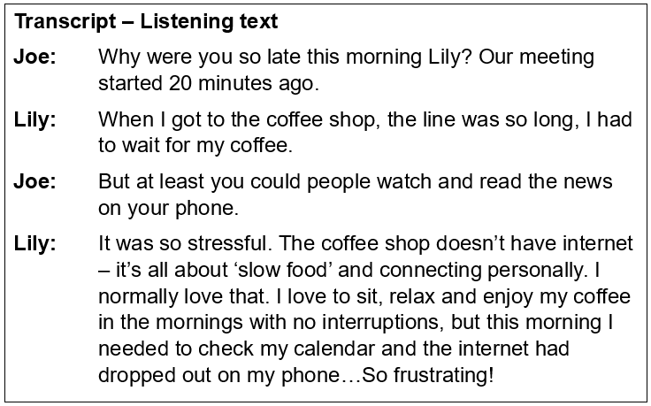
Example integrated task
Notes:
Here you can see an example integrated task. This integrated task includes a reading stimulus text (an article) with an embedded visual text (a photo), AND the transcript of a listening stimulus text (a conversation).
What information can you identify that each text might contribute that is unique from the other texts?
You might like to pause the video to briefly read and view the texts provided.

Slide 8

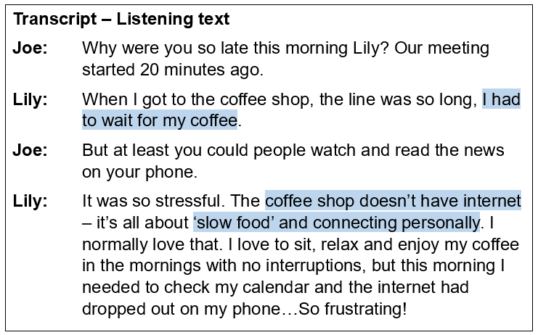
Integrated task: About the café
Notes:
If we compare the texts, identifying the information provided about the café, we might find the following points…
From the reading text you can extract information about
Artwork on the walls
Local musicians performing
Communal tables
And from the listening text, the points may include…
Waiting for coffee
No access to the internet
‘slow food’

Slide 9

Integrated task: Example
What information could you obtain about the café from the image provided?
Notes:
Did you remember to extract information from the visual text?
It’s important to remind students that whenever a visual text appears in an assessment task, they should analyse it to identify relevant information.
So, what information could we obtain from this viewed text?
You might like to consider:
Outdoor seating or a courtyard, as there are plants and outdoor furniture
Dog friendly, as the dog is sitting with the two people as they have a cup of coffee
And it is possible to ride bikes to the location, as there is a bike parked near the door
Please note that this is an example integrated task only, and you are advised to consult the study design and refer to the suggested subtopic list for information that is relevant for the language you are teaching. Please also check the requirements for each of your outcomes, as the integrated task for different outcomes may have different requirements.

Slide 10

Integrated tasks - Questions
According to the study design
what language should students be responding in?
does the task require responses to short-answer questions?
or does the task require an extend response?
Notes:
As you are planning and designing your assessment tasks, it is important to remember
whether students are responding in English or the target language. It is important that this is clearly specified.
whether students are responding to short-answer questions. If so, you are encouraged to consider the types of questions you use to ensure ALL students can demonstrate their highest level of achievement. For more information about command terms, please access the ‘Glossary of Command Terms’ on the study page.
whether students are required to provide an extended response. If you’d like more information about designing extended response questions, please watch the on-demand video ‘Designing effective extended writing tasks’.

Slide 11
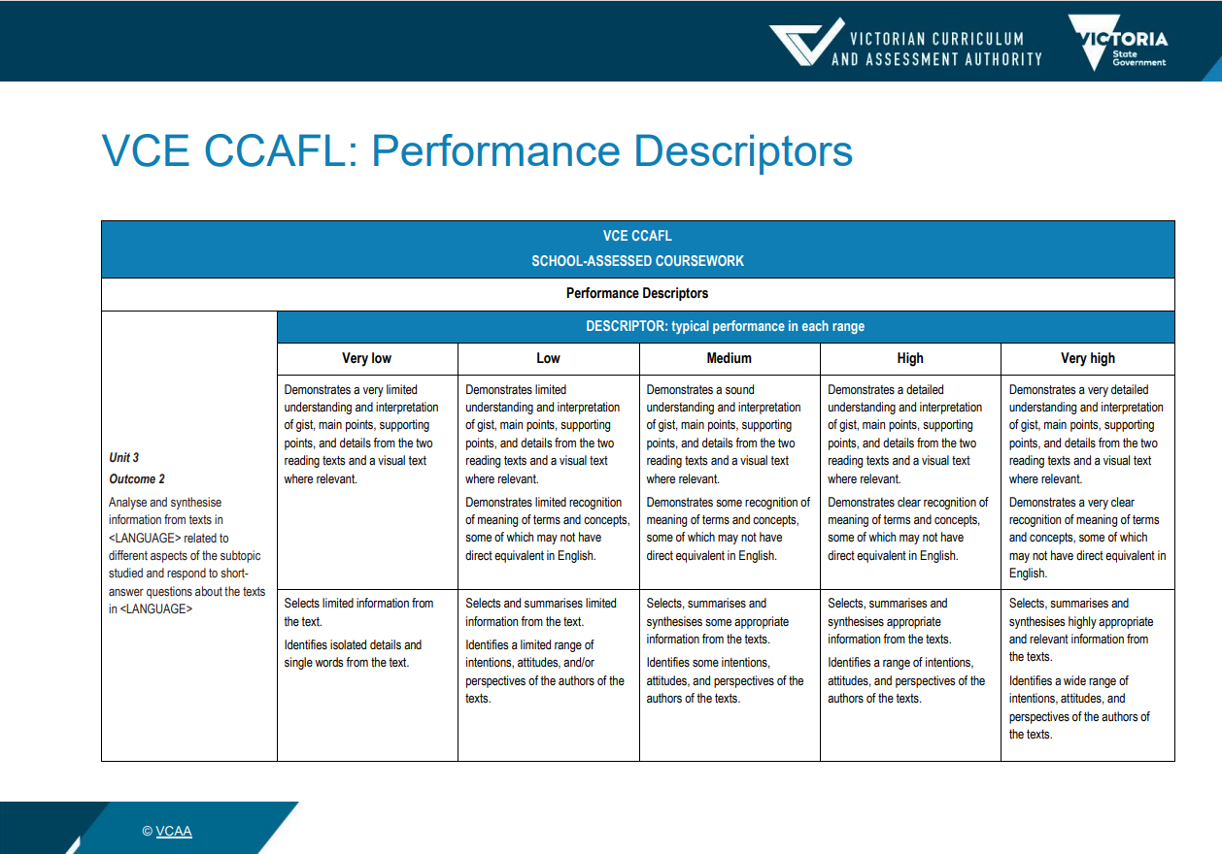
Assessing integrated tasks
Notes:
You will also find the VCAA performance descriptors on the study page, which can be used as provided or adapted to suit the assessment task.

Slide 12
Contact
Languages Unit
vcaa.languages.curriculum@education.vic.gov.au
© Victorian Curriculum and Assessment Authority (VCAA) 2025. Some elements in this presentation may be owned by third parties. VCAA presentations may be reproduced in accordance with the VCAA Copyright Policy, and as permitted under the Copyright Act 1968. VCE is a registered trademark of the VCAA.
Notes:
If you have any additional questions about integrated tasks, we would encourage you to contact the Languages Unit.

Slide 15


