Slide 1

VCE CCAFL Languages
Planning a 2-year program

Slide 2
Acknowledgement
The Victorian Curriculum and Assessment Authority proudly acknowledges and pays respect to Victoria’s Aboriginal and Torres Strait Islander communities and their rich and enduring cultures.
We acknowledge Aboriginal and Torres Strait Islander people as Australia’s first peoples and as the Traditional Owners and custodians of the lands and waters on which we rely. We pay respect to Elders past and present of the lands where we conduct our work and recognise their ongoing contributions as the first educators on the land now known as Victoria.

Slide 3
Purpose of this video
Planning a 2-year program
Introducing the VCAA Curriculum Planning Template
Other support materials
Notes:
On behalf of the VCAA, I’d like to introduce a tool for planning your 2-year VCE CCAFL Languages Program.
During this video, we will introduce you to the VCAA Curriculum Planning Template for VCE CCAFL Languages, along with additional resources and support materials.

Slide 4

Study design
Read and refer regularly to the study design
Watch the on-demand videos in this series
Notes:
The most important document when planning and teaching a VCE study is the VCE Study Design. We will be referring to the Study Design throughout this presentation, and you may find it beneficial to have a copy of this available. Teachers are encouraged to regularly read and refer to the Study Design when both planning and teaching Units 1 – 4, and are reminded to always download the most recent version of the study design from the VCAA web page.

Slide 5
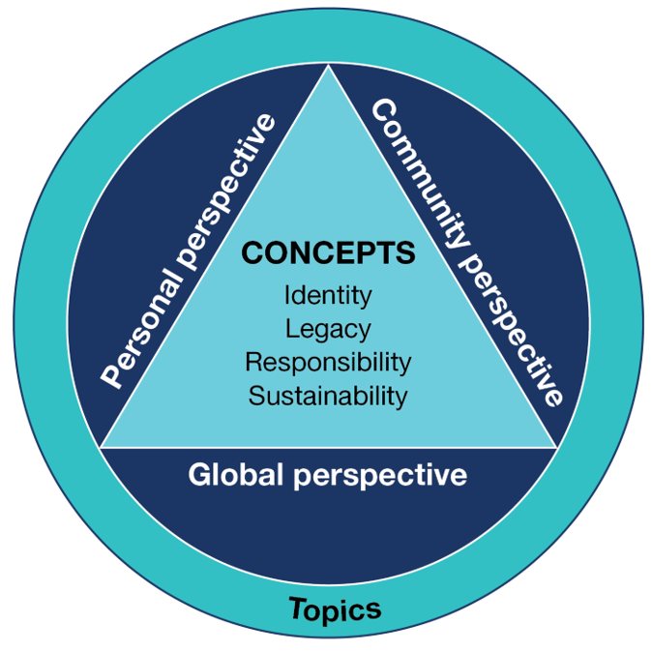
Planning a 2-year program
Concepts and topics are prescribed
Perspectives are prescribed and all 3 must be represented across the 2-year program
  teachers can choose which perspective to use, and when
Subtopics are teacher choice (examples in the downloadable ‘Suggested subtopics’ document on your study page)
Notes:
In the Study Design, teachers will see this circular image, introducing the concepts and topics, which are prescribed. The 3 perspectives (personal, community and global) are also prescribed, however, teachers can choose WHEN each of the perspectives is covered, as long as each perspective is covered across the 4 units of study.
The subtopics can be chosen by the teacher, with suggested subtopics provided in the ‘Planning’ section on the VCAA website. The suggested subtopics document can also be accessed via a link in the Study Design.
Please note that all of the concepts, topics and perspectives must be covered within the 2-year program. Teachers are therefore encouraged to spend time carefully planning their program for Units 1 - 4, considering the time allocation for each unit, identifying assessment tasks and using the key knowledge and key skills to plan.

Slide 6
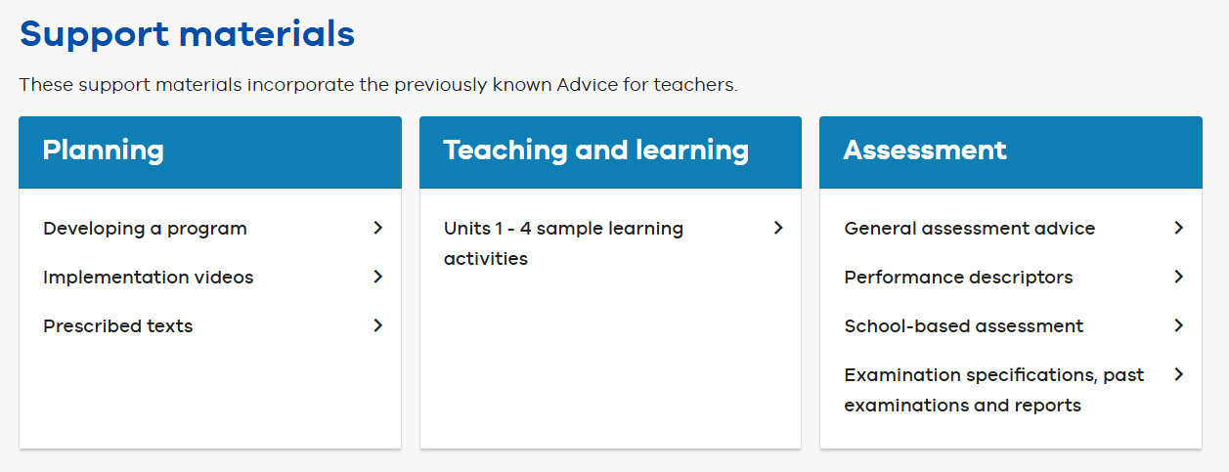
Key resources for planning
Informative videos
A downloadable planning template
Suggested subtopics
FAQs
Notes:
The VCAA website also has a range of additional support material that may be helpful when planning and delivering a 2-Year CCAFL VCE Language Study.
To access these support materials, navigate to the Study Design Page under ‘planning’ where you will find links to a range of resources and a series of on-demand videos to guide you through the planning process.
In this video, we will be focusing on the Curriculum Planning Template for VCE CCAFL Languages.

Slide 7
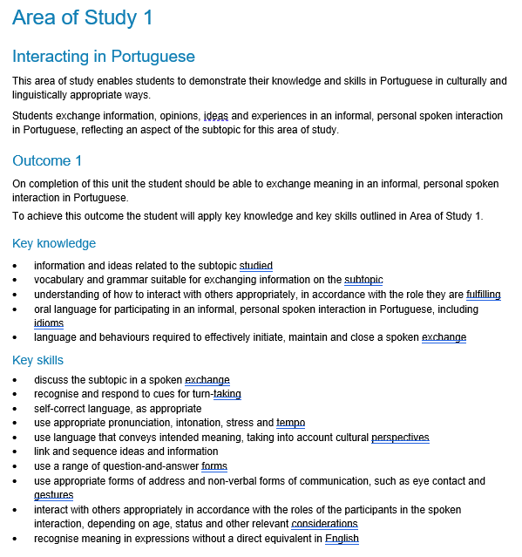
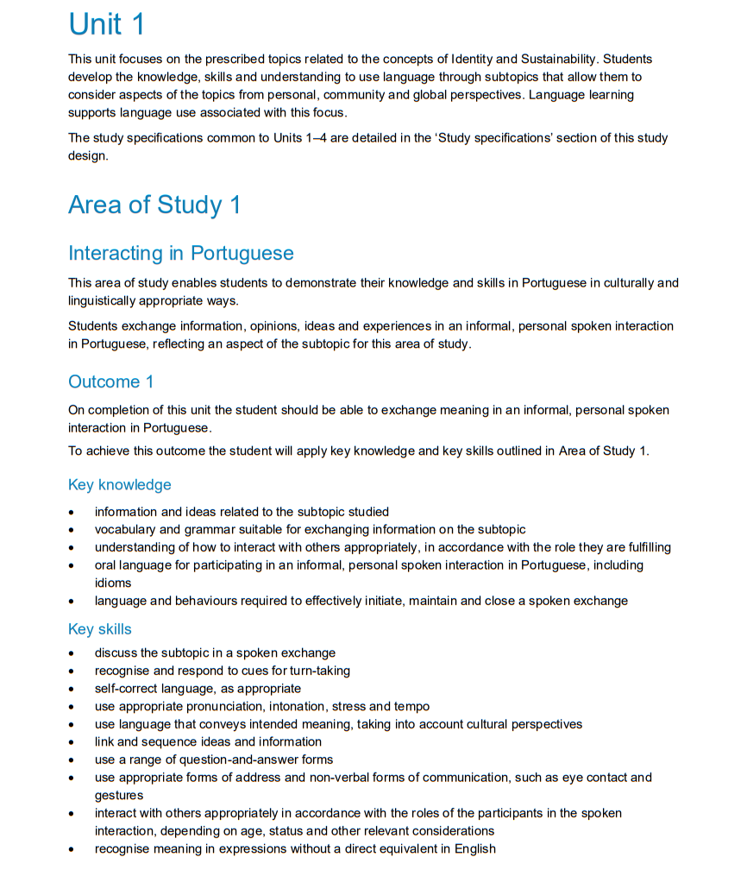
Where to start?
Locate the study design
Check the accreditation period
Read about each Area of Study for all 4 Units
Identify important information, including:
    Key Knowledge and
    Key Skills
Identify the outcome information for each Area of Study
Notes:
So where do we recommend you start?
It is recommended that you first locate the Study Design, remembering to check the accreditation period before you begin your planning.
As you will be planning a 2-year program, please read about each Area of Study for all 4 Units and identify important information for each.
This will include the introductory statements, Key Knowledge and Key Skills and the outcome information for each Area of Study. The outcome statement starts with “On completion of this unit the student should be able to…

Slide 8
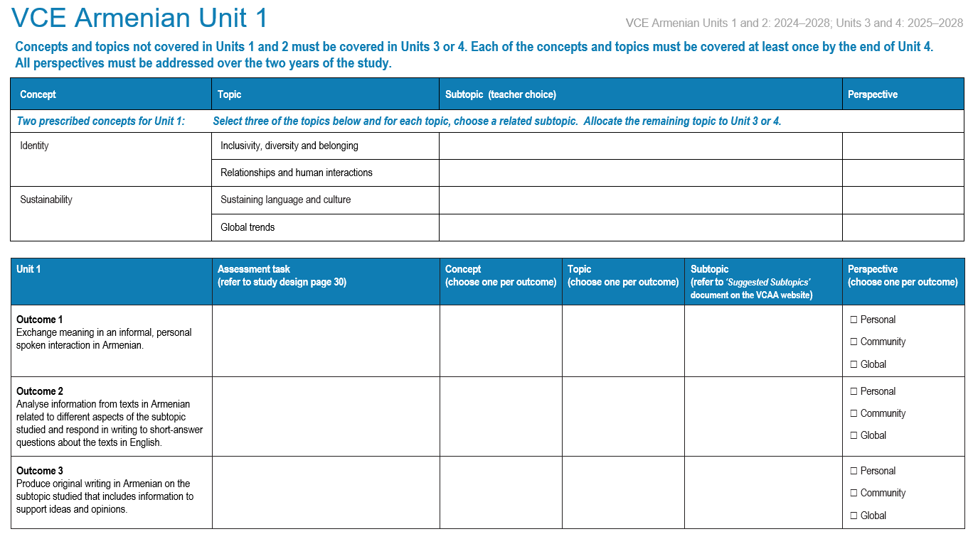
Populating the planning document
Access the study page
Watch the videos
Download the 2-year planning document
Re-read the outcome statements
Notes:
You may find it beneficial to access the language study page, watch the relevant on-demand videos and then download the 2-year planning document.
Before you begin filling out the planning template, please re-read the outcome statements and check these against the information provided in your study design.

Slide 9
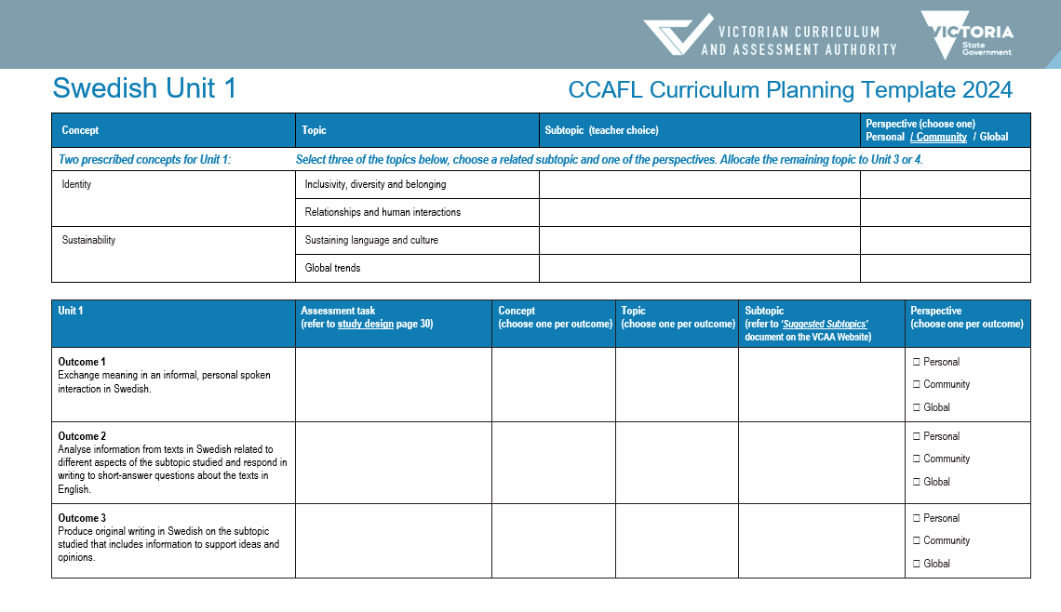
Populating the planning document
Select 3 topics from the first table on each page
Choose a
  concept and associated topic (prescribed)
  subtopic (choice)
  perspective
  Add your assessment task
  Complete tables for each unit
Notes:
As you now start filling out the template (CLICK), select 3 topics from the first table on each page.
Each outcome must be linked to one of these three topics (CLICK), which are matched to a prescribed concept (CLICK).
The subtopic (CLICK) is selected by the teacher and must be taught through one of the three perspectives (CLICK), personal, community or global.
Once the concept, topic, subtopic and perspective have been finalised an assessment task will need to be added (CLICK), which assesses the key knowledge and key skills. Match the assessment task carefully to the outcome statement provided in your Study Design.
For Units 1 and 2, there are lists of suggested tasks provided in the Study Design. These may be used, or teachers may create their own assessment task.
Please note, students will complete only ONE task per outcome.
On the screen you can currently see the planning page for Unit 1, however, this document contains tables for Units 1 – 4, to help you plan your 2-year program.

Slide 10

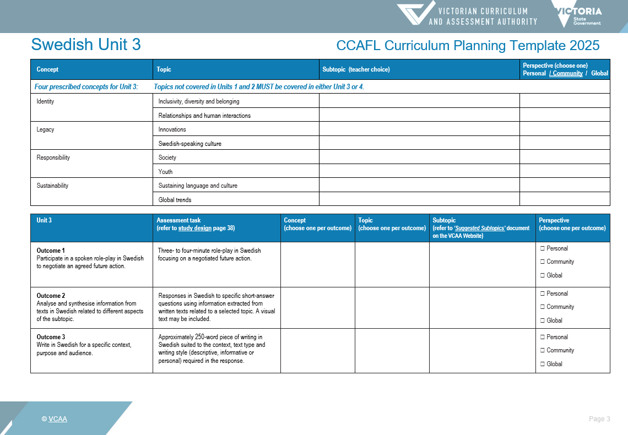
Populating the planning document
Unit 3 and Unit 4:
There are 4 prescribed concepts
Topics not covered in Unit 1 and Unit 2 MUST be covered in either Unit 3 or Unit 4
Each of the concepts and topics must be covered at least once by the end of Unit 4
Perspectives must be addressed over the 2 units
Assessment tasks are prescribed
Notes:
You will notice the tables provided for Unit 3 and Unit 4 look slightly different from the tables provided for Unit 1 and Unit 2.
In Units 3 and 4
there are 4 prescribed concepts
any topics and the associated concepts NOT COVERED in Unit 1 and Unit 2 MUST be covered in either Unit 3 or Unit 4
and each of the concepts and topics must be covered at least once by the end of Unit 4.
Additionally, all perspectives must be addressed over the two units.
The subtopics are a school-based decision and therefore chosen by the teacher.
The assessment tasks for Unit 3 and Unit 4 are prescribed and teachers are encouraged to refer regularly to the study design.

Slide 11
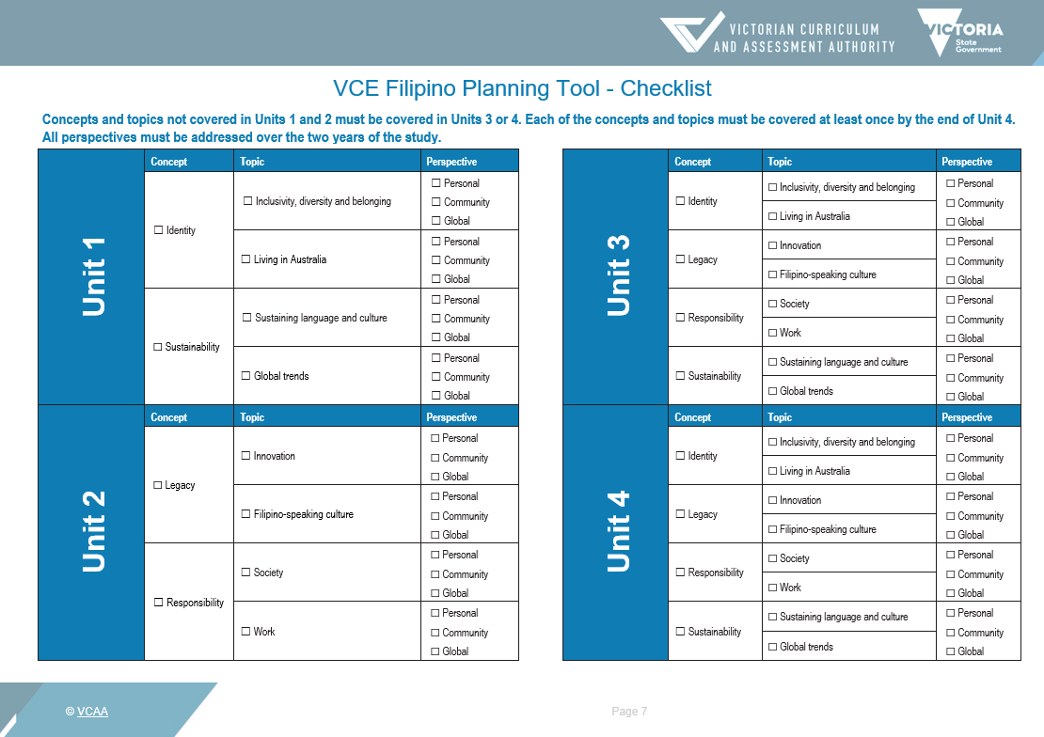
Planning checklist
Notes:
The final page of the planning document provides a checklist. This checklist provides an overview of the concepts, topics and perspectives you have selected for each unit of work, with the aim to ensure all the relevant topics and concepts have been covered, and that the perspectives are well represented.

Slide 12
Contact
Languages Unit
vcaa.languages.curriculum@education.vic.gov.au
© Victorian Curriculum and Assessment Authority (VCAA) 2025. Some elements in this presentation may be owned by third parties. VCAA presentations may be reproduced in accordance with the VCAA Copyright Policy, and as permitted under the Copyright Act 1968. VCE is a registered trademark of the VCAA.
Notes:
Please continue to refer regularly to the study design for your language, to the VCE Bulletin, which will contain any relevant updates, and also to the language study page, where other supporting documents are located.
If you have any additional questions, we would encourage you to contact our Languages Unit.

Slide 15


