Slide 1

VCE CCAFL Languages
Selecting subtopics

Slide 2
Acknowledgement
The Victorian Curriculum and Assessment Authority proudly acknowledges and pays respect to Victoria’s Aboriginal and Torres Strait Islander communities and their rich and enduring cultures.
We acknowledge Aboriginal and Torres Strait Islander people as Australia’s first peoples and as the Traditional Owners and custodians of the lands and waters on which we rely. We pay respect to Elders past and present of the lands where we conduct our work and recognise their ongoing contributions as the first educators on the land now known as Victoria.

Slide 3

Purpose of this video
Defining what a subtopic is
Linking subtopics to the concept and topic
Viewing the ‘Suggested subtopics’ resource
Reflecting on how topics can be viewed through different perspectives by adjusting the subtopic
Considerations
Notes:
Welcome to the on-demand video discussing subtopic selection. During this video, the Languages Unit will
Define what a subtopic is and
Introduce how subtopics link to the concept and topic
We will also share more information about the ‘Suggested subtopics’ resource and introduce how topics and concepts can be viewed through different perspectives by adjusting the subtopic.

Slide 4
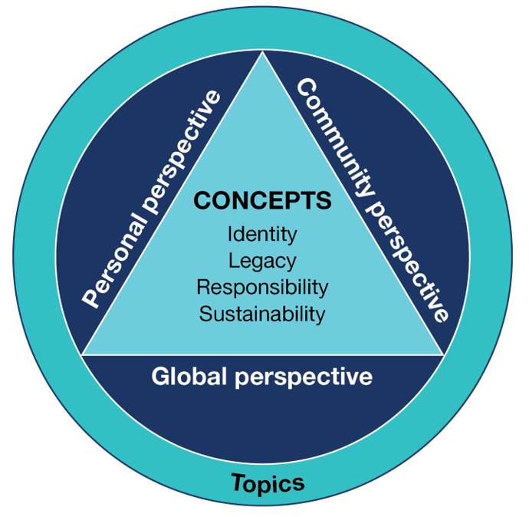
Subtopic – A definition
The subtopic is a specific aspect of one of the prescribed topics. The teacher chooses the subtopic and uses it as a way to teach the topic and its associated concept.
The subtopic will provide the context for teaching, learning and assessment of achievement, and allow students to consider aspects of the topics from personal, community and global perspectives.
Notes:
But first, what is a subtopic?
The subtopic is a specific aspect of one of the prescribed topics. The teacher chooses the subtopic and uses it as a way to teach the topic and its associated concept.
The subtopic will provide the context for teaching, learning and assessment of achievement, and allow students to consider aspects of the topics from a personal, community and global perspective.
This involves students developing the knowledge, skills and understanding to use language through subtopics and this will be evident in the teaching and learning plan.

Slide 5

Subtopic – Concept and topic
The teacher should ensure that students are provided with opportunities to engage with:
  each of the 8 prescribed topics for the language
  personal, community and global perspectives
  content that has an Australian focus.
Notes:
As part of this process, students should have opportunities to engage with
Each of the 8 prescribed topics for the language, with one subtopic covered per outcome or Area of Study
They should also engage with the relevant personal, community and global perspective for the subtopic.
And, where relevant, students will also engage with content that has an Australian focus, as per information provided in the study design.
Teachers are encouraged to regularly consult the study design during the planning and teaching of the 2-year program.

Slide 6
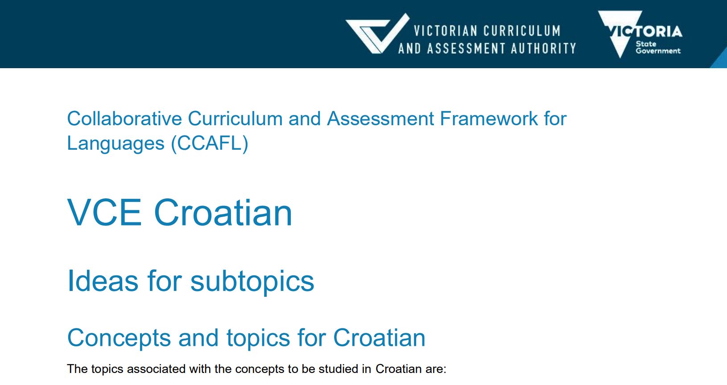
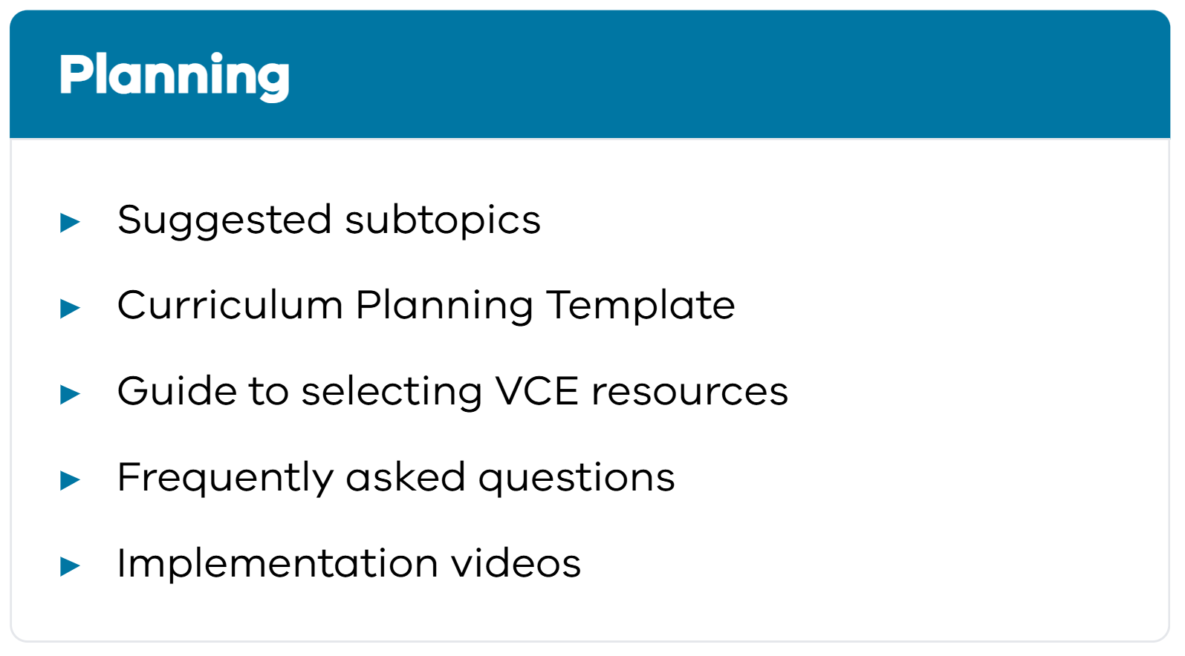
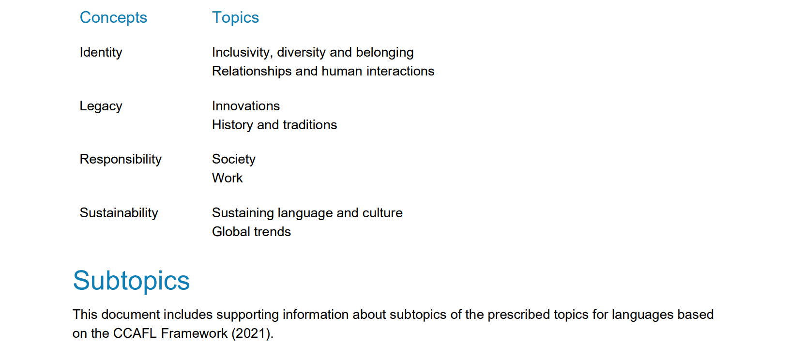
Suggested subtopics resource
Notes:
The VCAA has provided a ‘suggested subtopics’ resource on the CCAFL Language study pages, which is located under ‘Planning’.

Slide 7
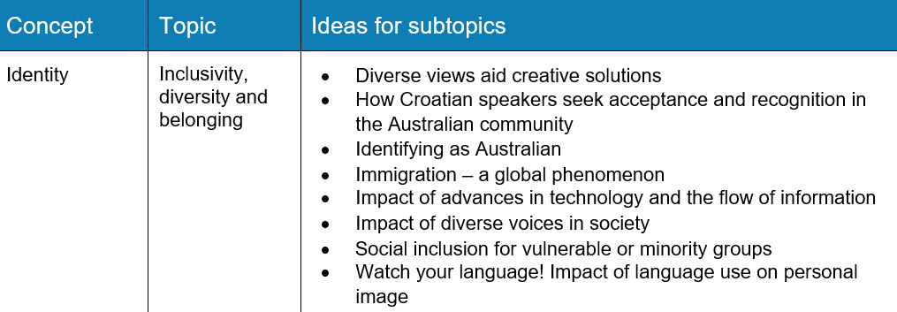
Suggested subtopics resource
INSERT
Notes:
This resource includes a variety of suggested subtopics for each concept and topic. You might like to use some of the suggested subtopics provided on the list or use these as a springboard for ideas of your own. Alternatively, you may already have ideas for unique subtopics that would be suitable for the concepts and prescribed topics provided. It is important to remember, however, that some concepts and topics must be taught in specific units. For more information about each unit, please consult the study design and access the on-demand videos focusing on the individual units.

Slide 8



Subtopics and perspectives
Perspective:
The lens through which teachers teach, and students learn about the subtopic.
global
community
personal
Notes:
You will also notice that each subtopic MUST be studied through one of 3 perspectives.
The ‘perspective’ is the lens through which teachers teach, and students learn about the subtopic being studied.
There are 3 perspectives
Personal
Community and
Global

Slide 9



Subtopics and perspectives
From their own perspective or that of their family or close friends.
personal
From the perspective of their school or local community, or from the perspective of the local target language-speaking community.
community
From the perspective of people in countries around the world.
global
Notes:
So, let’s unpack what each of these perspectives mean.
The personal perspective is when students may study the subtopic from their own perspective, or that of their family or close friends.
The community perspective is when the students may explore the subtopic from a school or local community perspective, or from the perspective of the local target language-speaking community.
When students study the subtopic from the perspective of people in countries around the world, this may be considered the global perspective.

Slide 10
Subtopics and perspectives
Innovations I can’t live without
personal
Concept: Legacy
Topic: Innovation
Meeting the challenges of living in the 21st century through innovation and invention
community
Innovations that changed the world
global
Notes:
So, how could a concept and topic be explored through different subtopics and perspectives?
Let’s look at the concept of legacy and the prescribed topic ‘innovation’.
Through the personal perspective, the subtopic might be ‘innovations I can’t live without’.
Through a community perspective, the teacher might consider the subtopic ‘Meeting the challenges of living in the 21st century through innovation and invention’.
And finally, the topic ‘Innovation through the global perspective’ might be ‘Innovations that changed the world’.
Here you can see how the concepts and topics can be explored through the 3 different perspectives just by changing the subtopic, and therefore the focus. As you can see from this example, the expectation is NOT that the topic and concept are explored through all 3 perspectives.

Slide 11

Balance of subtopics
Balanced exposure to
concepts and topics
subtopics
perspectives
language skills
links between language and culture
Notes:
Balance is very important. Teachers are encouraged to refer to the study design and watch the ‘Planning a 2-year program’ on-demand video. They may assist with the planning phase and help ensure balanced exposure to the concepts, prescribed topics, subtopics, perspectives, a variety of language skills, and opportunities for students to identify and reflect on links between language and culture.

Slide 12
Key Knowledge and Key Skills
Key knowledge
information and ideas related to the subtopic studied
cultural and intercultural considerations relating to the subtopic
vocabulary and grammar suitable for expressing opinions and negotiating
spoken language and behaviours required to effectively initiate, maintain and close a spoken exchange
register appropriate to the audience
Unit 3 Area of Study 1
Notes:
As we mentioned at the start of this video, it’s also important to consider which Area of Study, Key Knowledge and Key Skills students will be focusing on as they learn through the subtopic.
As you can see in this example taken from Unit 3 Area of Study 1, ‘subtopic’ is explicitly referenced in the Key Knowledge and Key Skills.

Slide 13
Subtopic - Considerations
‘Suggested subtopics’ document
Subtopics are chosen by the teacher
Subtopics clearly align with a prescribed topic and concept
Some subtopics may lend themselves more to particular outcomes
Some subtopics may require greater depth of study than others
It is recommended that students study 8 – 12 subtopics over Units 1-4
Subtopics allow flexibility in the way topics are taught and studied.
Notes:
There are a number of other important things to consider when choosing subtopics for your 2-year plan.
For example,
Subtopic choices are a school-based decision and will therefore be selected by the teacher. We would encourage you to access the ‘Suggested subtopics’ document available on your study page for examples of the subtopics you may like to use in your program.
It is also important to remember that subtopics must align with prescribed topics and concepts.
Over the course of the 2 years of study, it is recommended that the students study between 8 and 12 subtopics. As you may find that some subtopics require more dedicated teaching and learning time than others, it’s essential to plan for this in the program.
You will notice that subtopics provide flexibility in the way topics are taught and studied, enabling teachers to cater to student interests, whilst still meeting the requirements of the study design.

Slide 14

Subtopics – Consider the outcomes
Unit 3 Outcome 1
Participate in a spoken role-play in Croatian to negotiate an agreed future action
Three- to four-minute role-play in Croatian focusing on a negotiated future action
Notes:
Considering the outcomes is also essential. As you consider the subtopics, you will notice that some subtopics will lend themselves better to some assessment tasks than others.
For example, a 3-4 minute role-play focusing on negotiating an agreed future action on the subtopic ‘breakthroughs in medicine, science or engineering’ may require more conceptionally and linguistically challenging elements than a focus on ‘volunteering’.
To make the outcomes assessible for all students, you may find it beneficial to map this carefully prior to beginning the program.

Slide 15
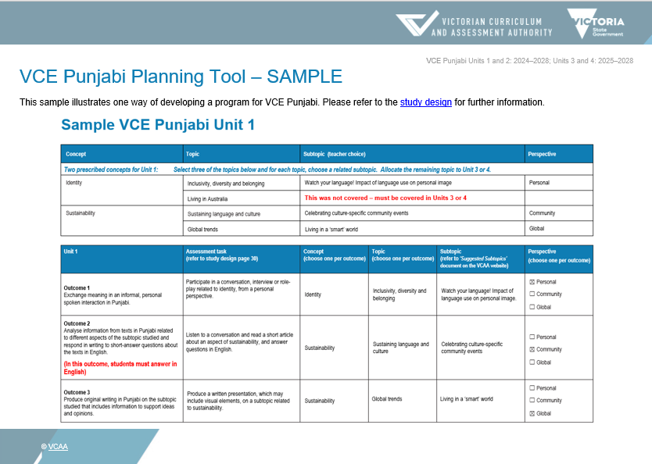
Subtopics – Planning a 2-year program
Curriculum Planning Template for VCE
This document is designed to support
teachers to map out their 2-year VCE
program in accordance with the study design.
It can be downloaded and edited to suit
individual school context. It includes an
example and a checklist.
Notes:
To assist you in mapping your 2-year program, you will find a ‘Curriculum planning template for VCE CCAFL Languages’ on the study page. The templates are language specific and include tips to make planning the concepts, topics, subtopics and perspectives easier. We encourage you to download this document.
As part of this on-demand video series, you will also find the ‘Planning a 2-year program’ video, which provides information about how to use this template.

Slide 16
Contact
Languages Unit
vcaa.languages.curriculum@education.vic.gov.au
© Victorian Curriculum and Assessment Authority (VCAA) 2025. Some elements in this presentation may be owned by third parties. VCAA presentations may be reproduced in accordance with the VCAA Copyright Policy, and as permitted under the Copyright Act 1968. VCE is a registered trademark of the VCAA.
Notes:
Thank you for watching our on-demand video on selecting subtopics. We’d encourage you to access the other videos in this series for more information on a range of topics.
If you have any additional questions, please don’t hesitate to contact our Languages Unit, and don’t forget to subscribe to our newsletters or follow us on social media.

Slide 19


