Slide 1

VCE CCAFL Languages
Viewing – the 5th macro skill
Choosing and using images

Slide 2
Acknowledgement
The Victorian Curriculum and Assessment Authority proudly acknowledges and pays respect to Victoria’s Aboriginal and Torres Strait Islander communities and their rich and enduring cultures.
We acknowledge Aboriginal and Torres Strait Islander people as Australia’s first peoples and as the Traditional Owners and custodians of the lands and waters on which we rely. We pay respect to Elders past and present of the lands where we conduct our work and recognise their ongoing contributions as the first educators on the land now known as Victoria.

Slide 3
Purpose of this video
Define viewing
Choose effective images
Introduce viewing skills
Use images effectively in assessments
Notes:
This video will focus on how to implement and develop the ‘viewing’ skill throughout your units of work and how to use viewed texts effectively in assessments.

Slide 4

What is viewing?
iStock: Metamorworks
Notes:
The macro skill of viewing refers to identifying, examining, interpreting, and creating meaning from visual images. This is an important skill to improving comprehension of print and non-print texts.

Slide 5

Visual texts
communicate information in visual form
are defined as a visual image without text
include a wide range of texts, such as films, cartoons, photographs, posters, artworks
are texts where written text does not convey meaning.
Bosnian Study Design, Visual texts, pp 25-26
Notes:
So, what is a viewed text?
Viewed texts ‘communicate information in visual form’, such as photos.
In the study design, visual texts are defined as images that have no written information.
A list of suggested visual texts is provided for you in the study design.
If written text IS present in the visual, it must be in small quantities and it should not convey meaning.

Slide 6

What is a rich and effective image?
Images from Microsoft 365 Stock Images, used under licence
Notes:
Rich and effective images help to develop the macro skill of viewing and should provide students with ample opportunity to question, interpret and analyse information related to the subtopic, as well as apply their own understanding of the subtopic to the image.
Texts can be used for a range of different purposes. For example, images can be used as part of classroom activities, or for assessment. Visual texts may have different requirements, depending on how the image is to be used.
When using images for assessment, teachers are reminded that any text included in the images should not convey meaning. If the image still conveys the intended meaning when the visuals are removed and the text remains, it is not an appropriate visual text for assessment purposes.
If a visual text does include some writing, ask yourself a few key questions:
“Do students need the written information to understand the visual text or to answer the question?”
“Could the meaning/message be understood if the text were removed?”

Slide 7



What is a rich and effective image?
iStock: Kaikoro
iStock: switchpipipi
iStock: drogatnev
Notes:
Let’s look at some examples …
As you can see in this map, once the text is removed, it is unclear what information students are expected to obtain from the image. We therefore need to consider what the purpose of the text is. A map, with some written text may be useful as part of a classroom activity.
2. As you can see in the infographic, there is quite a bit of text students would need to read to understand the content. In fact, you could probably have a series of classroom activities based on the various parts of this poster, however, this image may not necessarily be an effective visual text for an assessment.
3. Now, consider all the things you could do with the image of the suitcase in a classroom activity or an assessment task.
It could be used to prompt discussions about travel, objects, weather conditions, or modes of travel. It could be used as a prompt for an imaginative story or a personal journal entry. As there is no writing, this could be seen as an effective visual text.

Slide 8

What is a rich and effective image?
iStock: Klyoshev
Notes:
It’s also important to consider how the image will be presented – will it be in colour?

Slide 9

What is a rich and effective image?
iStock: Klyoshev
Notes:
Or will it be in black and white?
What impact does this have on the interpretation of the visual text and students’ ability to obtain relevant information?

Slide 10
How to introduce viewing?
See, think, wonder
Brainstorm what you:
  see in the image?
  think about the image?
  wonder about the image?
Images from Microsoft 365 Stock Images, used under licence
Notes:
The following are examples of teaching and learning activities that could be used to help students develop the macro skill of viewing.
For example, students could complete a see, think, wonder activity.
They would view the image and write down or discuss what they SEE, what they THINK is happening, and what they WONDER about the image, for example, what questions do they have?

Slide 11
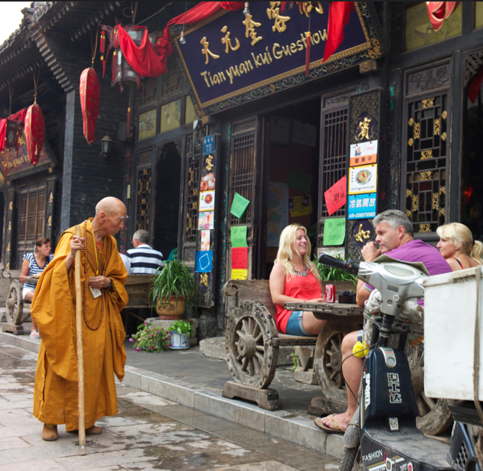
How to introduce viewing?
Word, phrase, sentence
Brainstorm:
  Words required to discuss the image
  Phrases about what you see in the image
  A sentence to describe or discuss the image
Alamy: Stephen Fleming
Notes:
The ‘word, phrase, sentence’ activity allows students to incrementally build their analysis of the image and the language required to discuss the image and subtopic. Students begin with brainstorming words required to discuss the image, then phrases about what they can see, and finally develop full sentences using the words and phrases to describe, discuss or even analyse the image.

Slide 12
How to introduce viewing?
Viewpoints: Lightning writing
Choose a person/animal/object in the image
Brainstorm the outline of a text/story/diary entry you could write from their perspective
Brainstorm the vocabulary you would need to write the text.
Alamy: Stephen Fleming
Notes:
Lightning writing requires students to complete short writing tasks that promote creativity in a low-stakes environment. Students choose to write about something they see in the image and connect it back to the subtopic. It is recommended teachers give students some time to brainstorm vocabulary before they begin writing.

Slide 13
Where can visual texts be used?
Visual texts can be used in classroom activities
Visual texts may be used in
  Unit 1 Outcome 2 (stimulus texts: reading with optional visual text AND listening)
  Unit 3 Outcome 2 (stimulus texts: 2 reading with an optional visual text)
  Unit 4 Outcome 2 (stimulus texts: reading with optional visual text AND listening)
Notes:
Images may also be used in assessment tasks. For example,
Unit 1 Outcome 2, where the stimulus texts include a reading text with an optional image AND a listening text
In Unit 3 Outcome 2, where students access 2 reading stimulus texts that may include an optional visual text
AND
In Unit 4 Outcome 2 , which requires students to access both a reading and a listening text. A visual image without text may also be provided with the reading text.

Slide 14
How to use images in assessment?
Ensure students
can extract information from all texts
can demonstrate the key knowledge and key skills
cannot obtain the same information from more than one text.
viewing
reading
listening
Notes:
When creating an assessment task that uses a visual text it is important that the image used
has information for students to extract from it, and also
requires students to demonstrate the key knowledge and key skills, for example
- ‘use language for analysing’ in Unit 1, and ‘use language for analysing, synthesising and comparing ideas’ in Unit 4
It is also important that students cannot obtain the same information from more than one text, for example both the reading and the visual text.

Slide 15
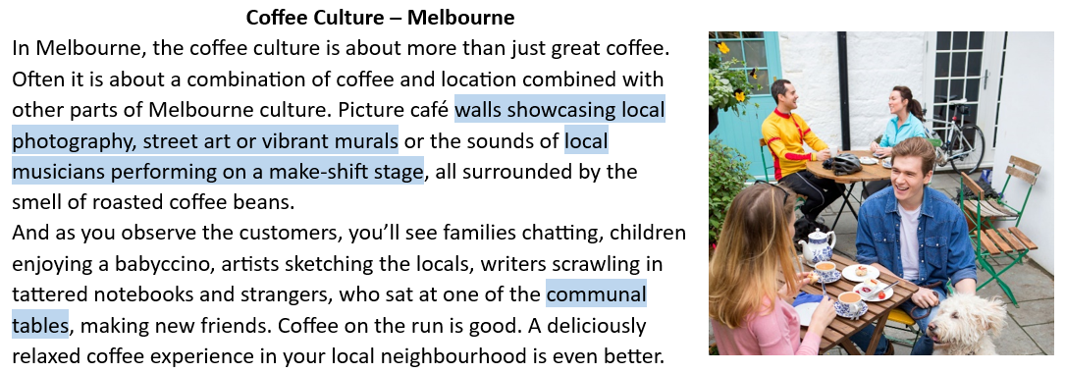
Reading, viewing and responding
iStock: SolStock
Notes:
Here you can see an example of how an image has been provided to support the reading text. The visual text should not just be a nice image – it must also provide information for students to respond to. It’s important that students recognise that they must respond to a visual text when it is presented in an assessment task.

Slide 16
Reading, viewing and responding
The image provides additional information.
iStock: SolStock
Notes:
When reading the text, students will see that the image provides ADDITIONAL information.
For example, when reading the text featured here, it is evident that there is no reference to outdoor seating options, however, in the visual text this is represented.

Slide 17

Reading and viewing text
Information from the image:
  Outdoor seating options
  People bring their dogs
  Accessible by bike
iStock: SolStock
Notes:
In addition to ‘outdoor seating options’, the image also indicates that:
People can bring their dogs
And the café is accessible by bike
These elements could be drawn out through the questioning strategies used in the assessment tasks.

Slide 18
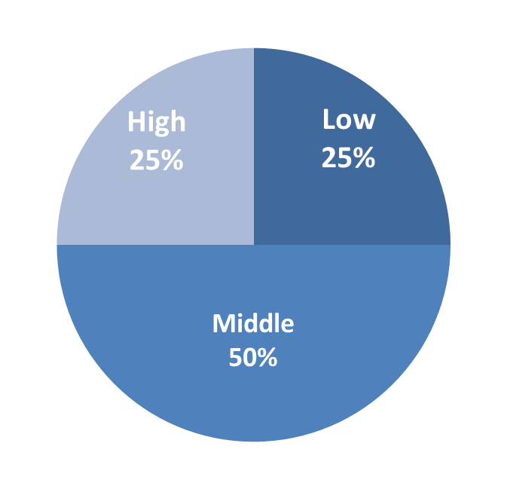

A quick guide to creating questions
25-50-25 rule of thumb
  high
  medium
  low level of difficulty
Multiple entry points
  accessibility
Differentiate
  extend the top band
Notes:
Before we have a look at how to design questions, schools may find it helpful to refer to the 25-50-25 rule, where 25% of questions have a high level of difficulty, 50% a medium level of difficulty, and 25% a low level of difficulty. This allows for multiple entry points and may help to differentiate the task.

Slide 19

Types of questions
Short-answer questions
    students write short answer responses to text(s)
    questions may be ordered from lower to higher order.
Images from Microsoft 365 Stock Images, used under licence.
Notes:
If teachers are creating short answer questions for an assessment task, it is important to include questions of a variety of levels of difficulty, so all students can demonstrate their understanding to the best of their ability. As such, it may be beneficial to reference the VCAA’s glossary of command terms to assist in developing a range of questions.

Slide 20
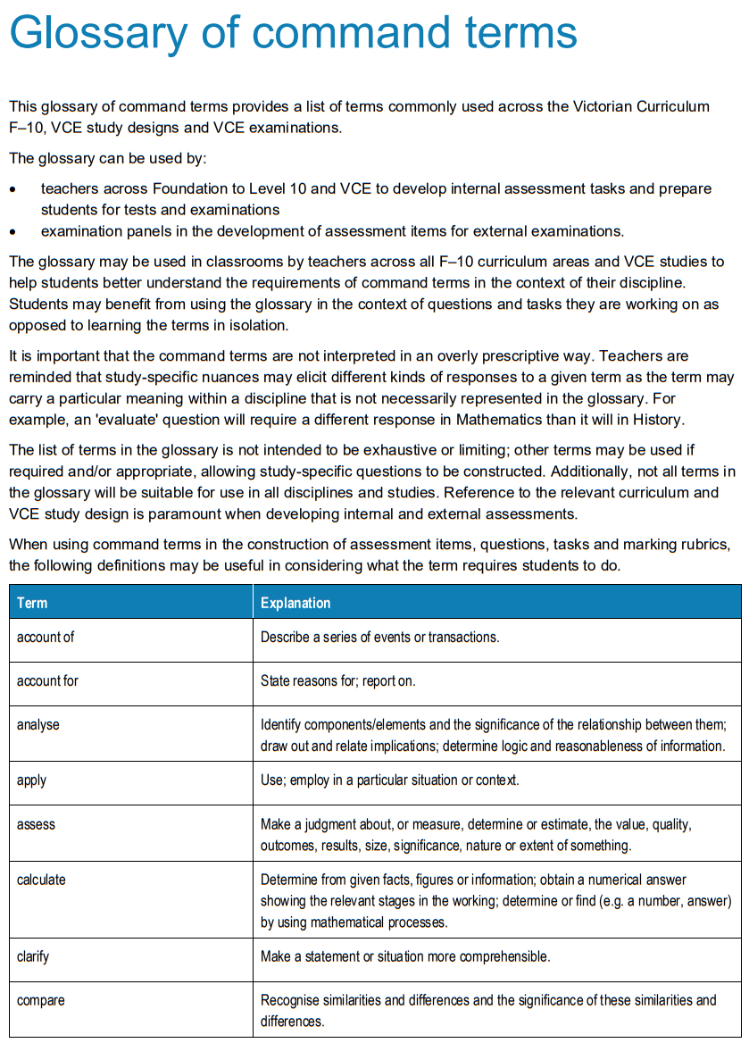
Command terms
Command terms:
indicate what is required
can be used to scaffold questions
Notes:
Command terms:
indicate what is required
can be used to scaffold questions.

Slide 21
Types of questions
Writing prompts
    students draw out relevant information from the prompt or text(s)
    students produce an extended response
Images from Microsoft 365 Stock Images, used under licence.
Notes:
When developing writing prompts for extended response questions, it is important that students can
Draw out relevant information from the prompt and the text(s)
And can produce an extended response incorporating information from all the texts, as required by the assessment task.
Please access the video on the VCAA website focusing on writing effective prompts.

Slide 22
Contact
Languages Unit
vcaa.languages.curriculum@education.vic.gov.au
© Victorian Curriculum and Assessment Authority (VCAA) 2025. Some elements in this presentation may be owned by third parties. VCAA presentations may be reproduced in accordance with the VCAA Copyright Policy, and as permitted under the Copyright Act 1968. VCE is a registered trademark of the VCAA.
Notes:
If you have any additional questions, we would encourage you to contact our Languages Unit.

Slide 24


