Slide 1

VCE Visual Communication Design
Professional learning
On-Demand video
Assessing the School-assessed Task

Slide 2
Acknowledgement
The Victorian Curriculum and Assessment Authority proudly acknowledges and pays respect to Victoria’s Aboriginal and Torres Strait Islander communities and their rich and enduring cultures.
We acknowledge Aboriginal and Torres Strait Islander people as Australia’s first peoples and as the Traditional Owners and custodians of the lands and waters on which we rely. We pay respect to Elders past and present of the lands where we conduct our work and recognise their ongoing contributions as the first educators on the land now known as Victoria.

Slide 3

Purpose
Information provided to students for the School-assessed Task
Information provided to students about the assessment of the School-assessed Task
Updates to assessment information for the School-assessed Task in 2026.
Notes:
In this OnDemand video I will be explaining to you the background of the School-assessed Task, where to find key documents, and how to provide information to your students for the task, how to authenticate and how to assess the task.

Slide 4
SAT Mandatory information for students
Assessment information
Authentication
Task
information
Notes:
In summary there are three key pieces of information to give students for the SAT to meet the requirements of the VCE Assessment Principles.
Information about the task such as the key knowledge and skills, outcome requirements and what they will be assessed on.
How the students are assessed – such as a breakdown of assessment criteria, indicators and descriptors in language the students understand and including visual examples of what standards look like
Information about how you will authenticate the task – what the students can use, timelines for observation and how feedback on the task will be provided to them.

Slide 5
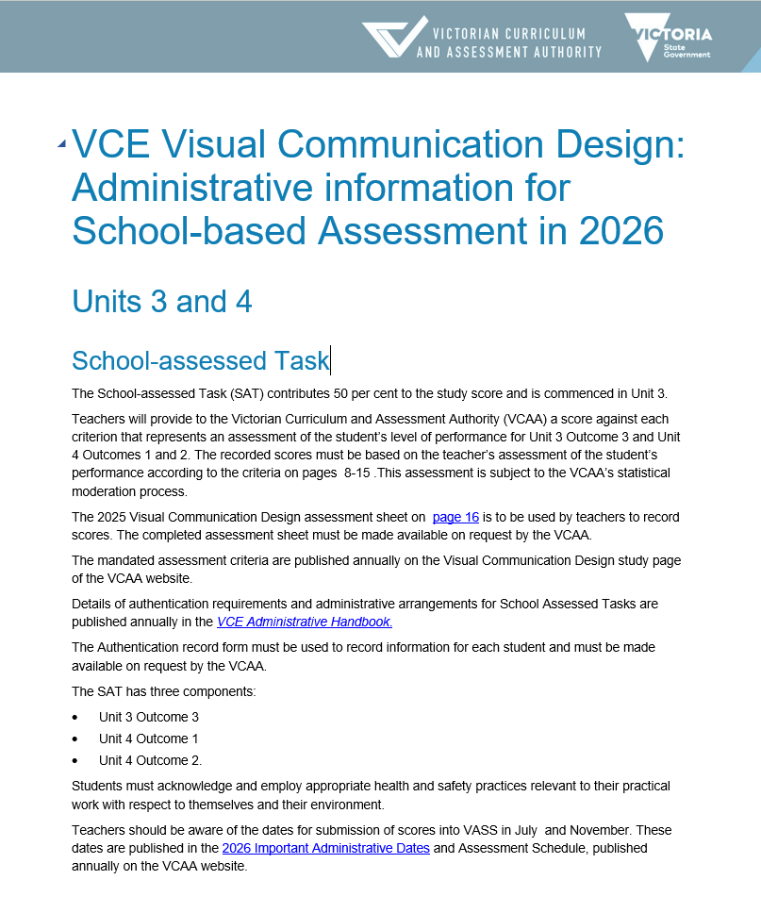
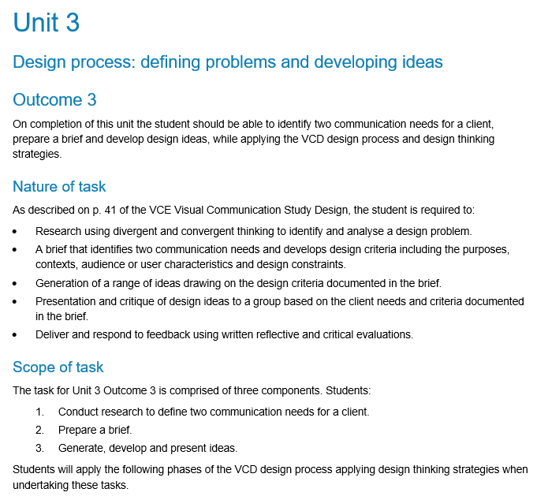
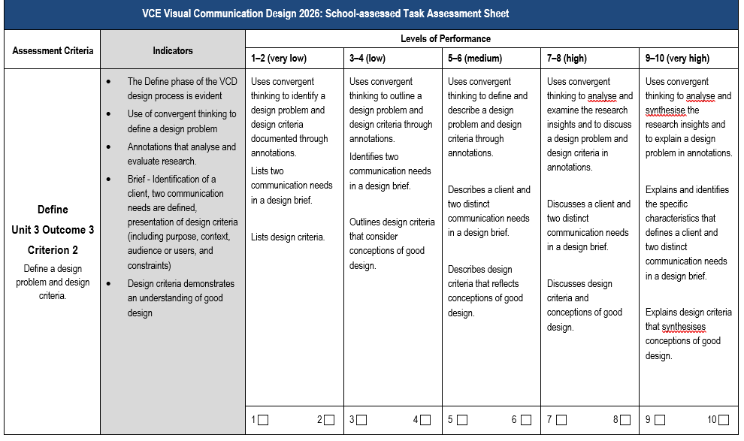
Assessment of the task
Notes:
The VCAA provides the assessment criteria and performance descriptors for the SAT. Unlike School-assessed Coursework, where teachers can develop their own tasks and rubrics, the Scope of the task and the levels of performance are set by the VCAA. When students are given information about the activities in the task, they also must be provided with the information about how it is assessed. Similarly, to the Study Design, the assessment advice is written in language for the teacher, and it must be unpacked for the students.
In Visual Communication Design, there are 8 assessment criteria that are related to the key knowledge and skills for the outcome. The outcome is always listed above the criterion.
The indicators for assessment: the components the teacher is assessing is listed on the left hand side in the grey column.
The teacher then assesses the student work based on the evidence in the indicators.

Slide 6
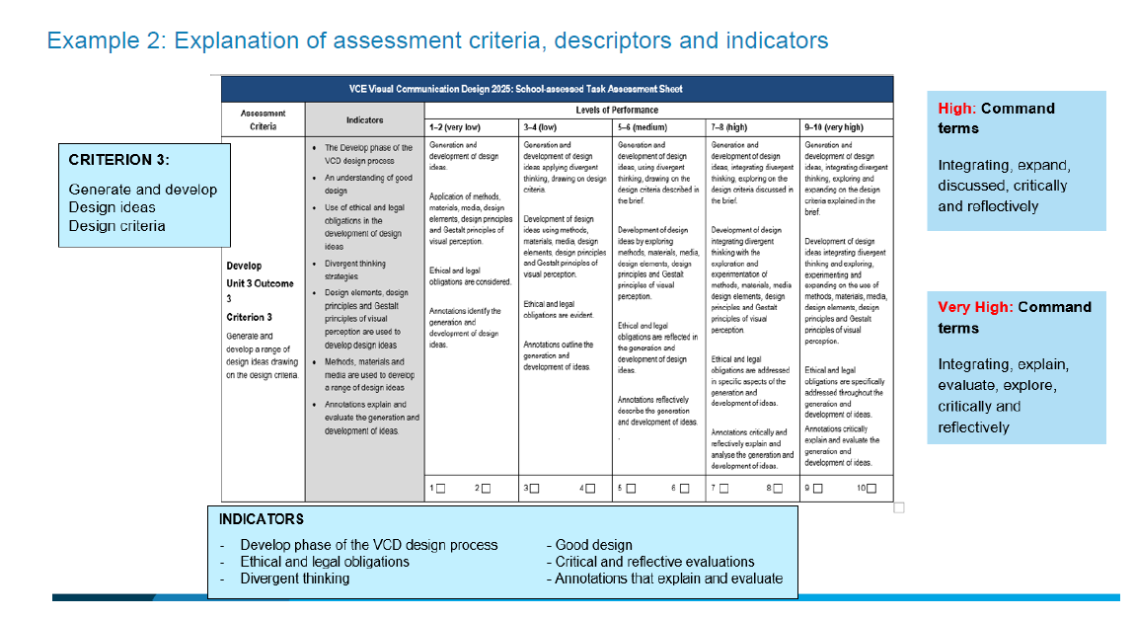
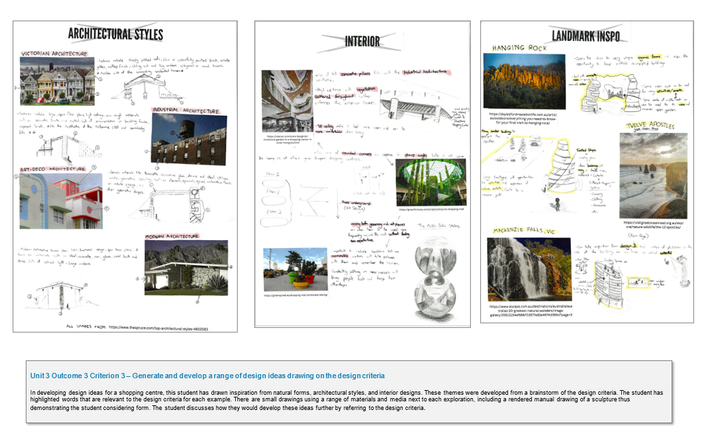
Assessment criteria
Notes:
To ensure that assessment is equitable and valid, teachers need to unpack the criterion, indicators and level of assessment in language the students understand. They might write a description of what the students need to achieve, and provide student work demonstrating a high level of achievement. In this slide, the assessment criteria, descriptors and indicators are summarised, and the students are provided with some examples of achievement from past student folios with annotations. These examples are resources on the VCD study design page that are presented with an annotation of student achievement. A resource document can be developed that is housed on a Learning management system to support the students throughout the year. Please note, that as the criterion, indicators and descriptors are updated each year, the material needs to be updated annually.

Slide 7
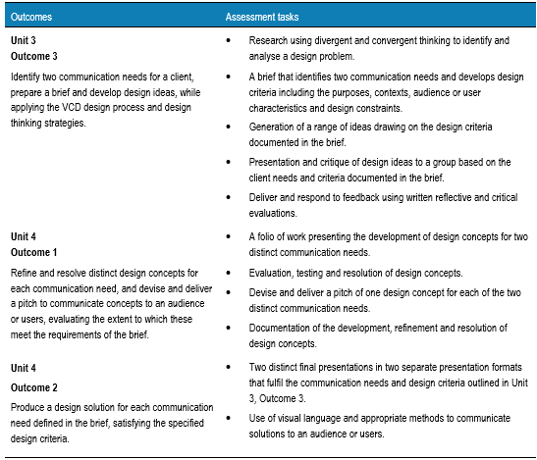
School-assessed Task
VCE Visual Communication Design study design, Page 41

Slide 8
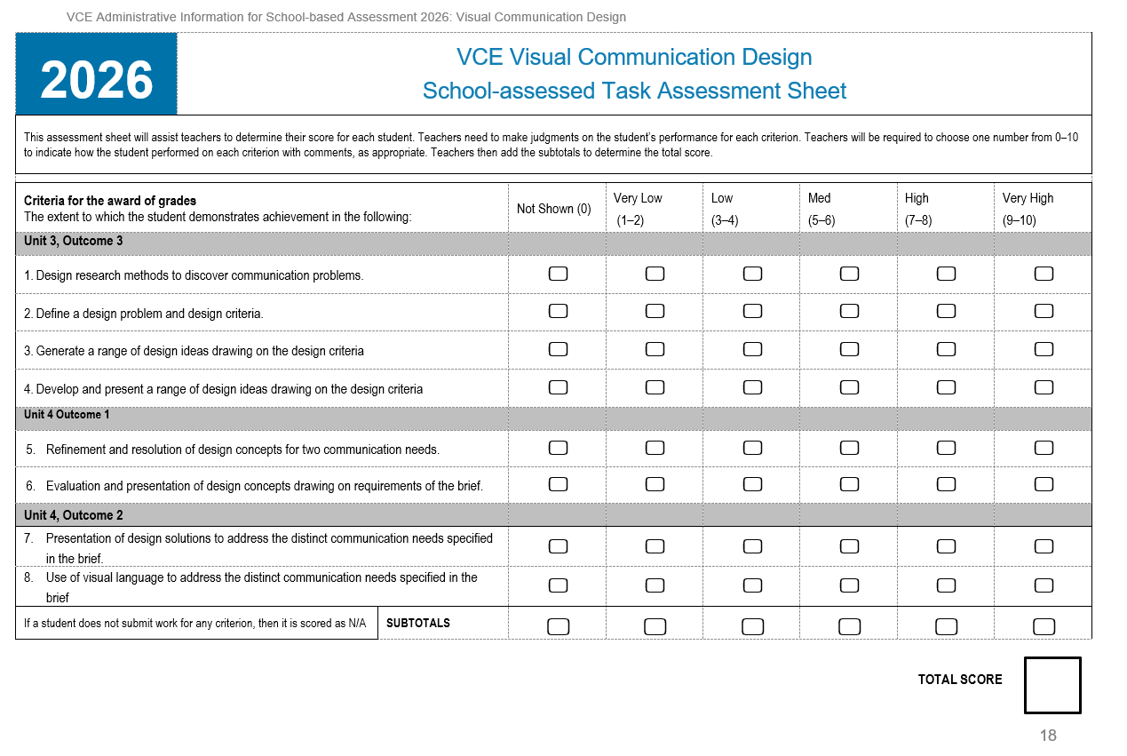
Notes:
This is the assessment sheet where you can record the final school scores for students. However, in addressing the VCE assessment principles, students should receive feedback on their performance in each Criterion. This feedback can be placed on the authentication record form. If the feedback is given in another form, such as a School-assessment system, this feedback should be copied and pasted into the Authentication Record Form.

Slide 9
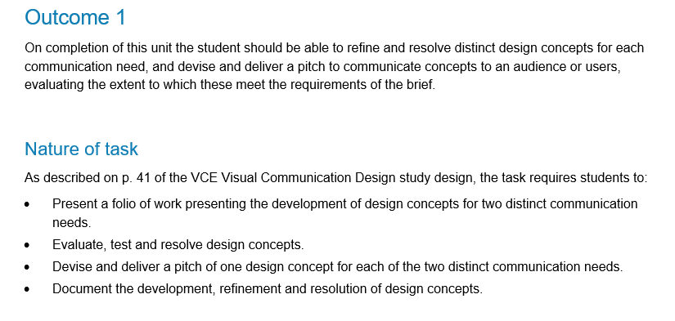
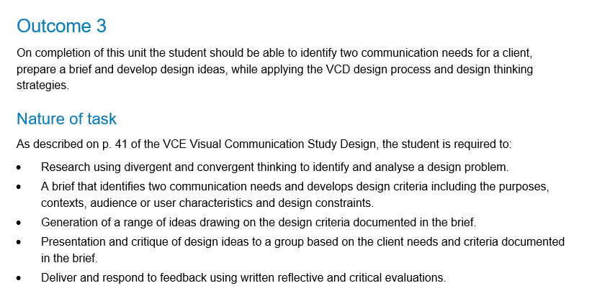
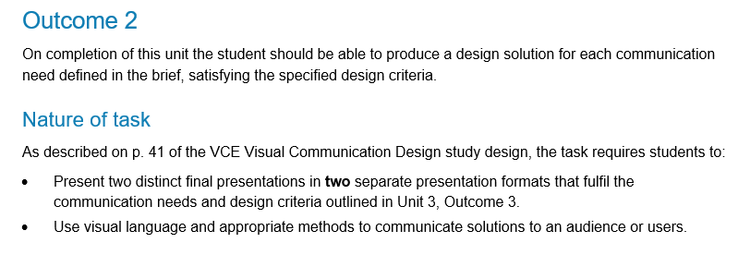
Nature of task
Unit 4
Unit 3
Notes:
The nature of the task is mandatory and is outlined in the study design.

Slide 10
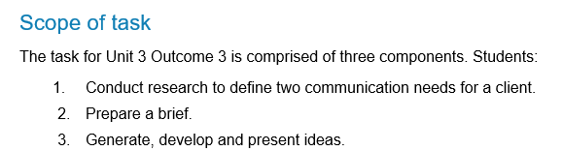
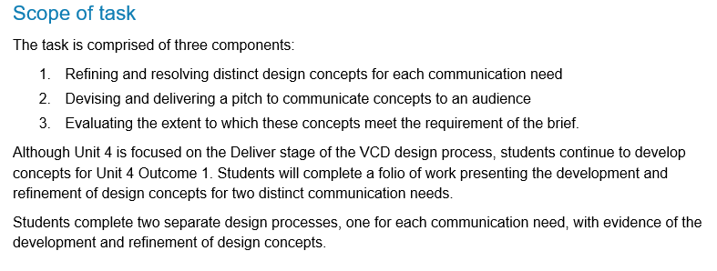
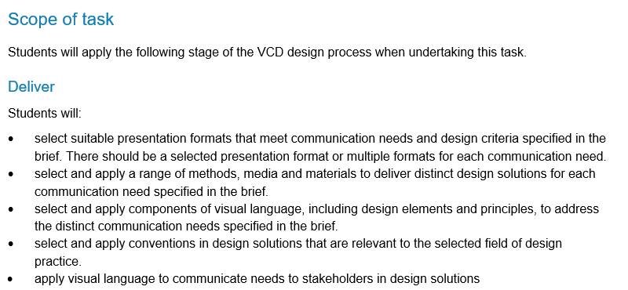
Scope of task
Unit 3
Unit 4
Unit 4
Notes:
The scope of the task describes what can be assessed. This is developed alongside the Key Knowledge and Skills of each outcome associated with the SAT in the study design.

Slide 11
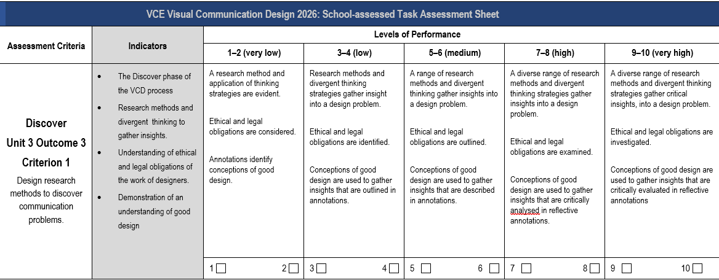
Criterion 1
Updates
Criterion change to ‘discover’
Conceptions of good design evaluated in reflective annotations.
Notes:
The changes to the descriptors are highlighted by a blue box, and any changes to the Criterion in red.
A change to criterion 1 is now linked to the Discover phase of the Visual Communication Design process. Research is focused on discovering a communication problem and the Define phase shifted to Criterion 2.
There is more inclusion of conceptions of good design in the research achieved through annotations.

Slide 12
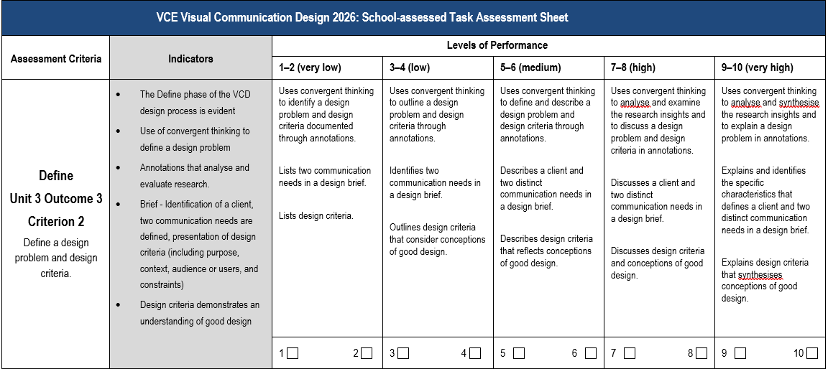
Criterion 2
Updates
Criterion change to ‘define a design problem and design criteria’
Evidence of annotations that evaluate the research to define the design problem
Design criteria linked to good design.
Notes:
To align with the Define phase of the VCD design process Criterion 2 has been adjusted to refer to defining the design problem and design criteria so there is additional evidence to be assessed alongside the design brief.
Additional descriptors have been written referring to research insights and design criteria through annotations. The design criteria must also address conceptions of good design.

Slide 13
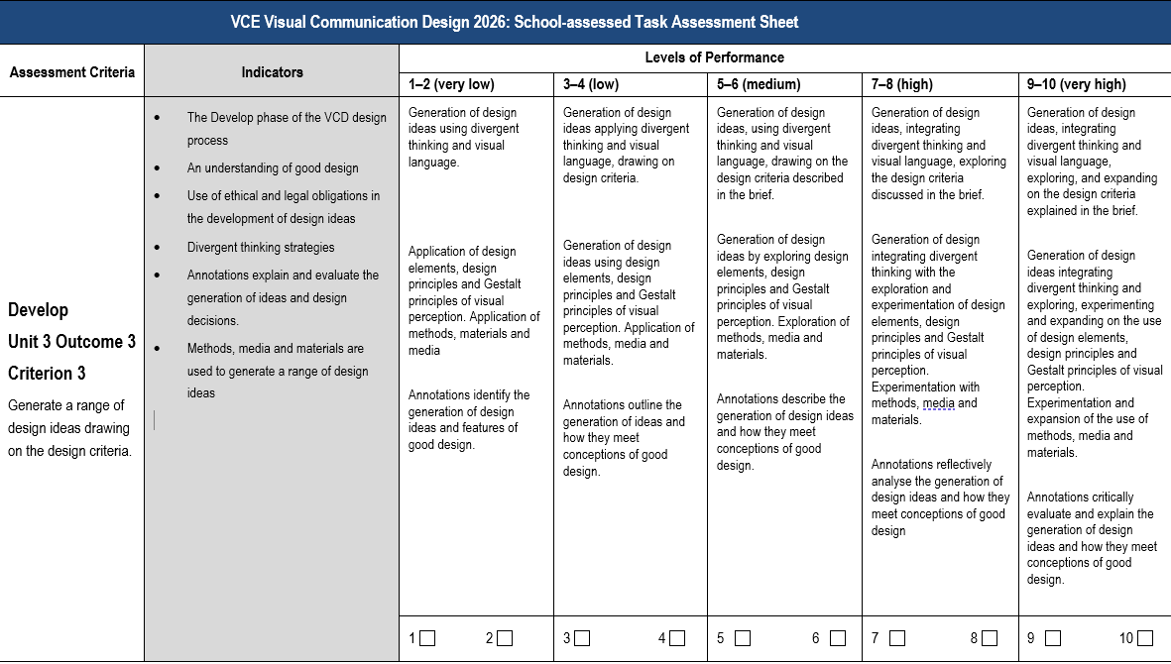
Criterion 3
Updates
Criterion change to ‘generate design ideas’
Methods, media and materials added to indicator
Addition of descriptor linking ideas and good design.
Notes:
There are some changes to Criterion 3 and Criterion 4 to align with the develop phase of the VCD process in unit 3 and to differentiate between the generation and development of ideas. In Criterion 3 students generate design ideas. Students must apply methods, media and materials. The design ideas must be evaluated referring to conceptions of good design with the evidence demonstrated in annotations.

Slide 14
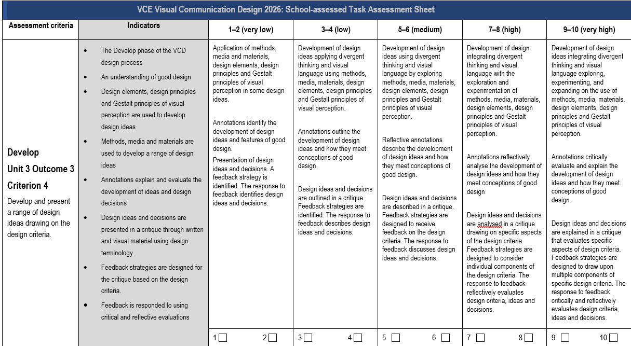
Criterion 4
Updates
Criterion change to ‘develop and present design ideas’
Change to all descriptors referring to design ideas and divergent thinking
Annotations demonstrate the links between the development of design ideas and conceptions of good design.
Notes:
In Criterion 4, design ideas are developed and presented. Methods, media, design elements, design principles and Gestalt principles of good design are experimented with. Annotations demonstrate the links between design ideas and conceptions of good design.

Slide 15
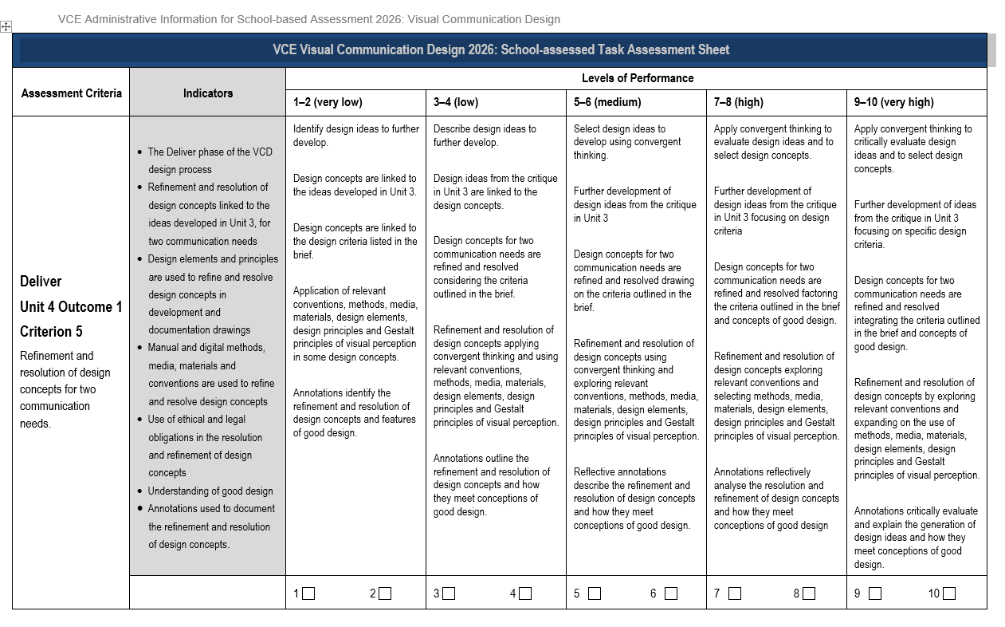
Criterion 5
Updates
Addition of design concepts related to ideas developed in Unit 3
Descriptors referring to concepts
Annotations refer to design concepts and conceptions of good design.
Notes:
As Criterion 5 assesses the start of Unit 4, the design concepts must relate to the ideas developed in Unit 3. This has been listed in the indicator for assessment. By adjusting Criterion 3 – 5, the inclusion of methods, materials, media, design elements, design principles and Gestalt principles of visual perception have been added. Annotations must analyse how the design concepts meet conceptions of good design. The design concepts must be for TWO communication needs.

Slide 16
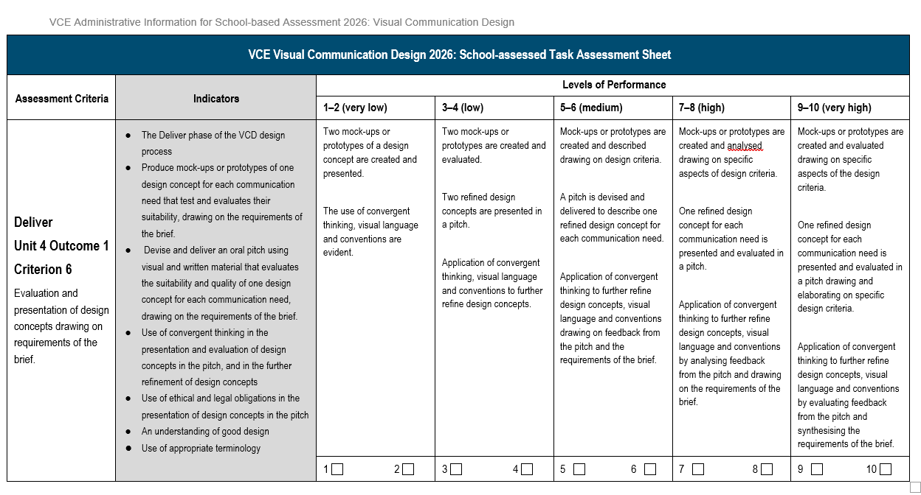
Criterion 6
Updates
Two mock-ups are required to score 1-4.
Inclusion of visual language and conventions in all descriptors.
Notes:
To meet requirements of the outcome, students must present two mock-ups or prototypes for feedback. In the presentation of the two mock-ups visual language and conventions must be considered and convergent thinking is used to further refine the concepts.

Slide 17
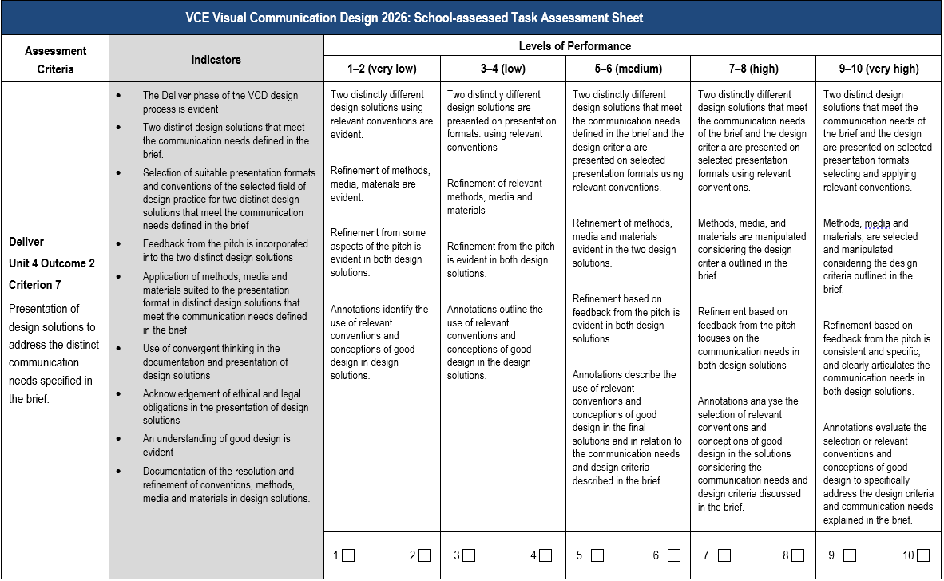
Criterion 7
Updates
Change to criterion to ‘distinct’ communication needs
Refinement from the pitch is evident
Presentation formats must use the conventions relevant to the field
Annotations evaluate good design and address the design criteria.
Notes:
Criterion 7 and 8 relate to the final design solutions. These solutions must refer to each ‘distinct’ communication need.
Presentation formats must use conventions relevant to the field of design practice. Information regarding conventions of the fields of design practice are included in the FAQ document published on the VCE Visual Communication Design study design page under Support: Planning.
There should be evidence of the refinement of methods, media and materials from the pitch.
Annotations evaluate the links to conceptions of good design.

Slide 18
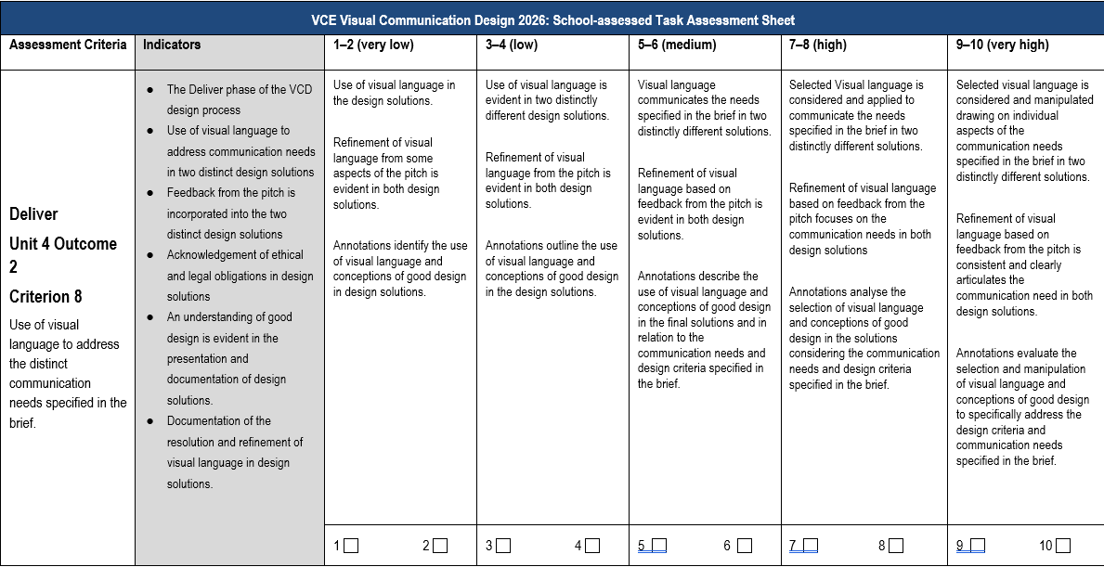
Criterion 8
Updates
Visual language is considered and applied in the final solutions
Refinement of visual language based on feedback from the pitch
Evaluation of conceptions of good design in annotations.
Notes:
All design solutions must demonstrate an understanding of good design and this should be evaluated in the annotations. Annotations, therefore must evaluate the conceptions of good design that have been addressed the design criteria in the brief.

Slide 19
Contact us:
vcaa@education.vic.gov.au or +61 3 9032 1629
© Victorian Curriculum and Assessment Authority 2025
The copyright in this PowerPoint presentation is owned by the Victorian Curriculum and Assessment Authority or in the case of some materials, by third parties. No part may be reproduced by any process except in accordance with the provisions of the Copyright Act 1968 or with permission from the Copyright Officer at the Victorian Curriculum and Assessment Authority.
Notes:
Please send any enquires related to the VCAA to the general email and it will be forwarded to the relevant contact person. This ensures your enquiry is promptly replied to by the appropriate person and bookmark our website.
“”Please note, it is encouraged that CM’s direct messages to the VCAA contacts**

