Slide 1
VCAA Manual Handling Awareness Training

Slide 2
Acknowledgement of Country
The Victorian Curriculum and Assessment Authority proudly acknowledges and pays respect to Victoria’s Aboriginal and Torres Strait Islander communities and their rich and enduring cultures.
We acknowledge Aboriginal and Torres Strait Islander people as Australia’s first peoples and as the Traditional Owners and custodians of the lands and waters on which we rely. We pay respect to Elders past and present of the lands where we conduct our work and recognise their ongoing contributions as the first educators on the land now known as Victoria.

Slide 3
Outline
What is manual handling? What are the risks of manual handling? What makes manual handling hazardous? How can the risks be managed? > S.M.A.R.T lifting > Team lifting > Pushing and pulling > Manual handling of people > Safe storage Available supports and resources

Slide 4
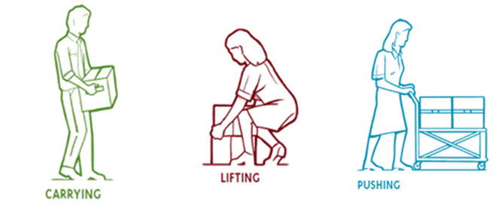
What is Manual Handling?
Manual handling is any activity requiring the use of force, exerted by a person to lift, lower, push, pull or carry or otherwise move, hold or restrain an object, person or animal.

Slide 5



Example Manual Handling Tasks
Carrying large number of books
Lifting and moving equipment
Storing and retrieving boxes above or below shoulder height
Moving furniture
Typing at an incorrectly set-up
workstation
Hanging posters

Slide 6
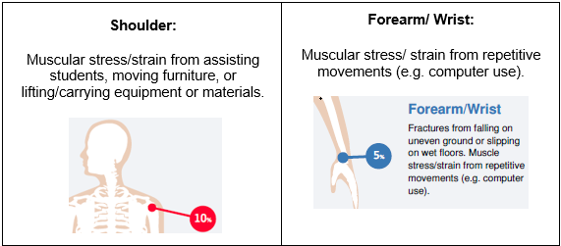
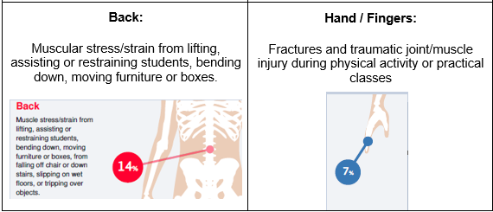
What are the risks?
Manual handling injuries make up approximately 10% of total injuries occurring in VCAA workplaces.
According to WorkSafe Victoria the most common injuries associated with manual handling for the education sector are:

Slide 7
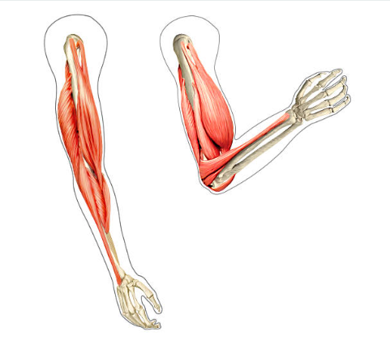
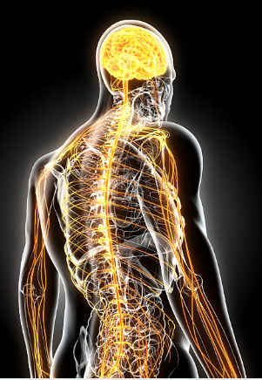
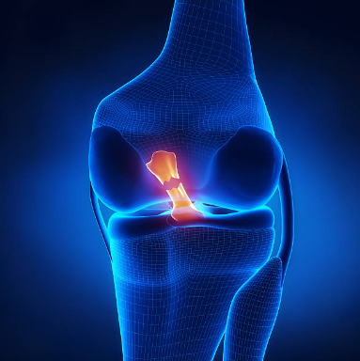
What are the risks?
Work-related musculoskeletal disorders can occur as a result of:
repeated damage or strain
a single case of overburdening
Work-related musculoskeletal disorders may include injuries to:
Muscles
Ligaments
Intervertebral disc
Nerves
Tendons in the wrist, arms, shoulders, neck or legs
Bones and muscle while flexing
Nervous System
Torn Anterior Cruciate Ligament

Slide 8
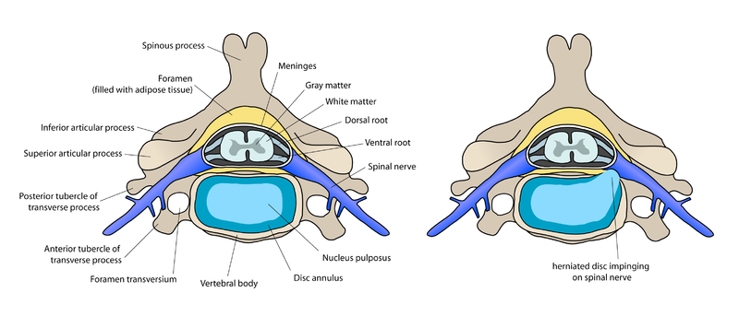
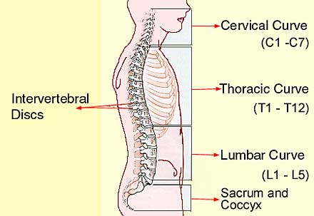
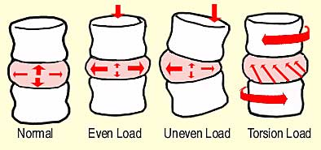
What are the risks?
The spine in its normal S-curve shape is very flexible but is easily affected by movements which are: forceful, awkward, asymmetrical and or jerky, especially if the back is bent or twisted while moving.
Carrying a large or heavy load while the back is not in its normal S-curve shape puts much more strain on the discs between the vertebrae.
Normal Disk
Bulging Disk

Slide 9
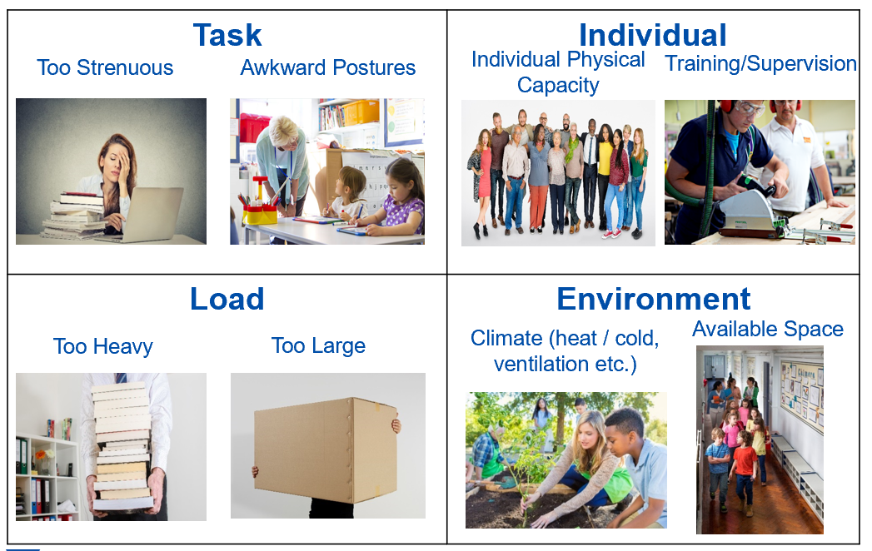
When does it become hazardous?

Slide 10
Example Risk Controls
Clear the walkway
Don’t undertake the task
Change the environment

Slide 11
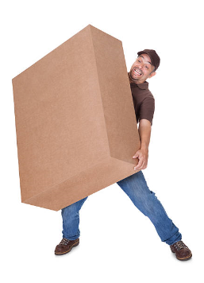
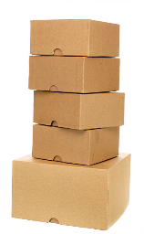


Example Risk Controls
4. Change the object
3. Change the nature of the work
5. Use mechanical aids

Slide 12
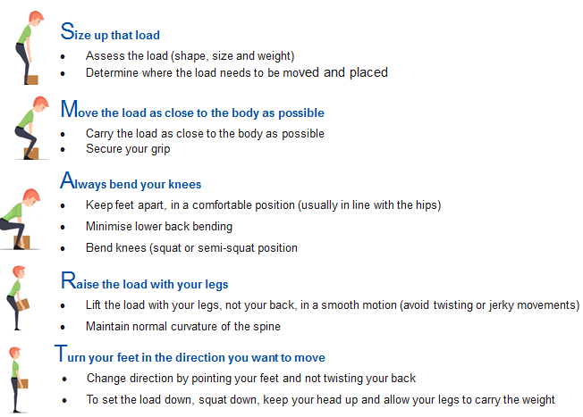
S.M.A.R.T Lifting

Slide 13
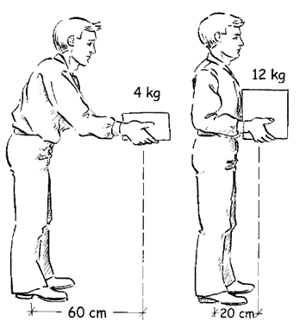
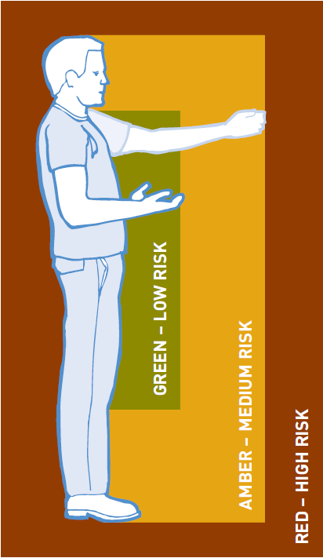
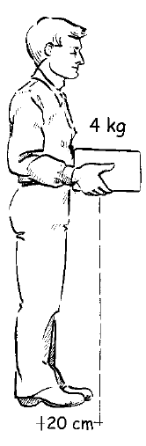
S.M.A.R.T Lifting
Lifting a 4kg load held 6cm in front of the body requires about the same effort as lifting a 12kg load held 20cm in front of the body.

Slide 14
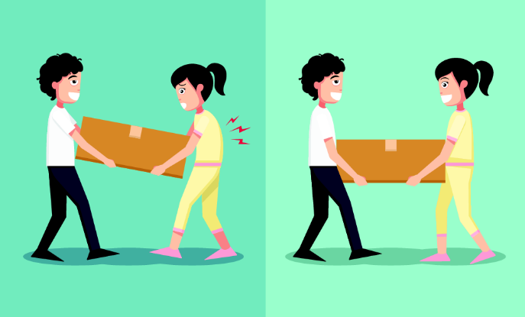
Team Lifting
Consider:
Are there enough people?
Are all persons of the same size with similar strength?
Are there any known pre-existing injuries?
Who is coordinating the lift?
Is there a plan, and has been communicated to those involved?

Slide 15
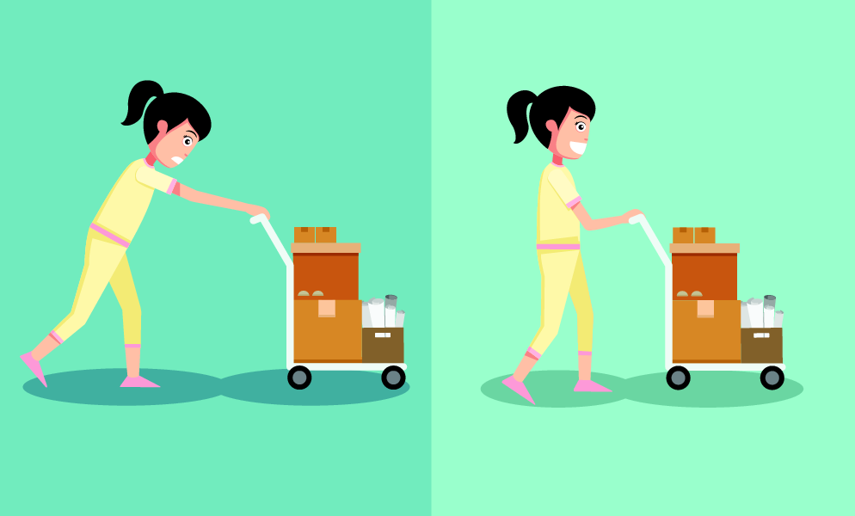
Pushing and Pulling
Consider:
When pushing, lean forward
Stand close to the trolley
When pulling, lean backwards (pushing is preferable as it involves less work by the lower back muscles and allows for maximum use of body weight). It allows employees to adopt a forward-facing posture, providing clearer vision in the direction of travel
Ensuring you have a good grip
Avoiding twisting and turning
Checking that the handle height is between shoulder and waist height

Slide 16

Manual Handling of People
No lift policy is best, use equipment and the student’s own ability to avoid unnecessary manual handling.
Always follow Behaviour Support Plans for individuals who cannot assist with their own movement.

Slide 17
Safe Storage
Consider:
Storing frequently and heavy items between waist and shoulder height
Storing smaller, lightweight or infrequently used items in lower or higher areas
Knowing shelving weight limits
Having access to a step-ladder
Testing the weight of the object before picking it up
Conducting quarterly workplace inspections

Slide 18
Supports
Immediate Manager or Unit Manager
Health and Safety Representative
VCAA HR at vcaa.hr@education.vic.gov.au or call 1800 718 320 (option 2).
Manual Handling OHS documentation

Slide 19
Thank you

