Slide 1
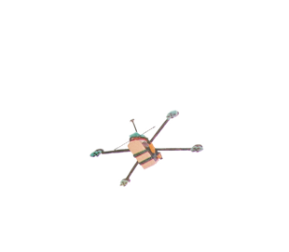
Your world. Your VCE.
Presentation slides for school use

Slide 2
Background for schools
Using or adapting these slides
You play an important role in helping students choose and pursue their goals.
These slides will help you explain students’ options, including the VCE Vocational Major and Victorian Pathways Certificate.
More Victorian parents are familiar with university pathways than VET options, including TAFE, apprenticeships and traineeships. You may wish to discuss the many different routes to a rewarding career.
You’re welcome to skip, amend or copy slides to suit your school’s programs.

Slide 3
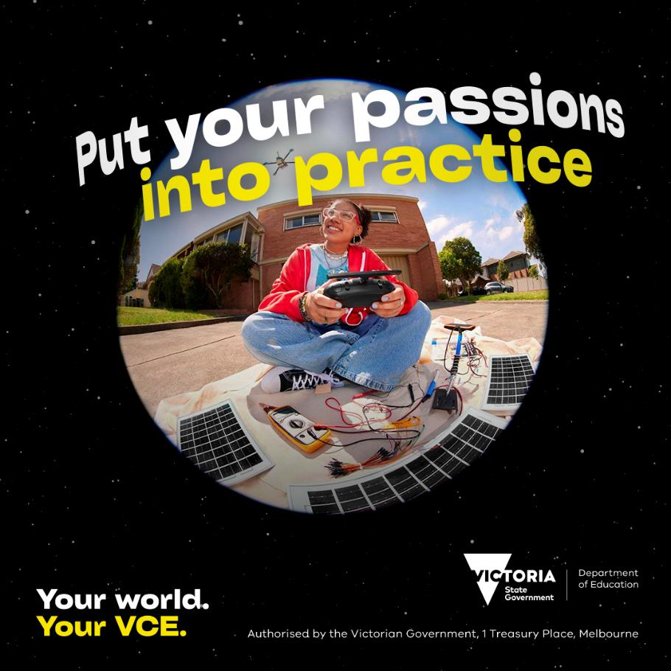
Background for schools
Your world. Your VCE.
The Your world. Your VCE. public awareness campaign motivates students to discover a VCE that suits their world, so they can pursue their talents and passions.
The campaign builds awareness of options in the VCE, including the new VCE Vocational Major.
It replaces the Many talents. One VCE. campaign, expanding on the same idea and making it personal.
Include campaign videos and images in your presentation to inspire students and parents to explore the many options in the VCE.
For more resources, visit: www.vic.gov.au/vce-resources

Slide 4
Background for schools
Acknowledgement of Country
The Victorian Aboriginal Education Association Inc. (VAEAI) is the peak Koorie community organisation for education and training in Victoria.
VAEAI recommends that an acknowledgement of country (alternatively called an acknowledgement of traditional owners) is made at the commencement of school events, such as a career and pathway information evening.
For guidance on developing an acknowledgement, visit : Acknowledgement of Traditional Owners (First Peoples-State Relations, Victoria).
“Aboriginal & Torres Strait Islander people have experienced significant exclusion from Australian society for many years…. Acknowledging Aboriginal & Torres Strait Islander people in events is one part of ending this exclusion.”
(VAEAI, Ways to include and encourage Aboriginal culture, 2019)

Slide 5
Your world. Your VCE.
Study options for Years 11 and 12 in 2025

Slide 6
Your world. Your VCE.
Click to play

Slide 7
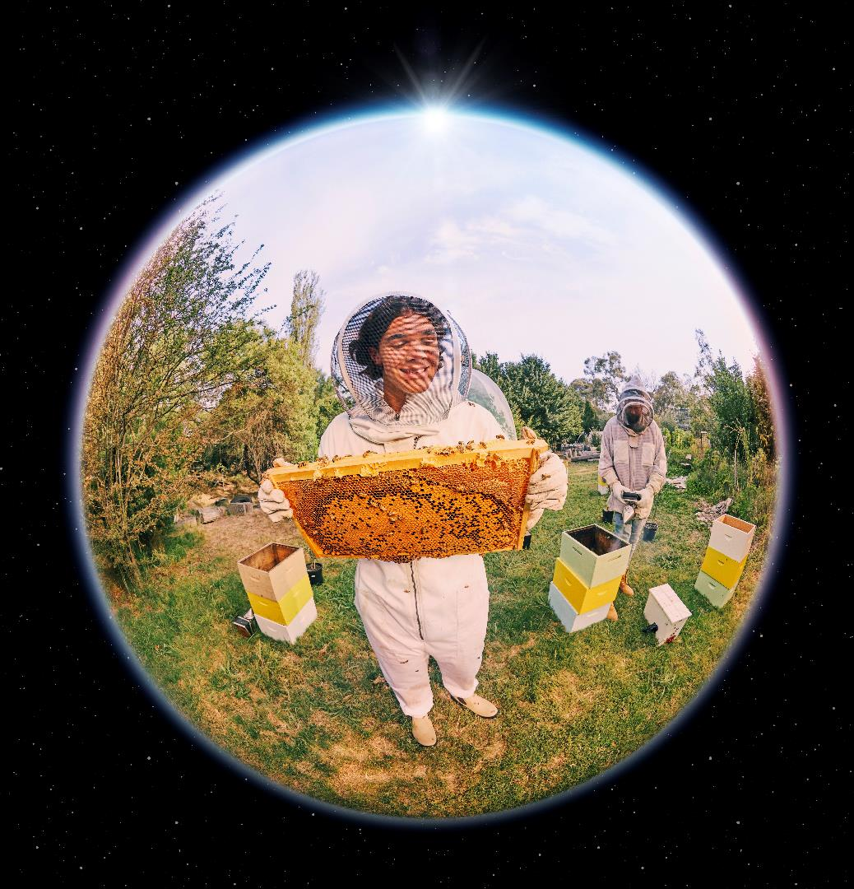
More possibilities in Year 11 and 12
Senior secondary education in Victoria has changed.
Students have more options, including:
The VCE, as we have known it
The new VCE Vocational Major program
New subjects: VCE VM Work Related Skills and VCE VM Personal Development Skills
More vocational education and training (VET) options
Victorian Pathways Certificate.
Every student can choose a Year 11 and 12 pathway that supports their goals.

Slide 8
Your pathway options
Click to play

Slide 9
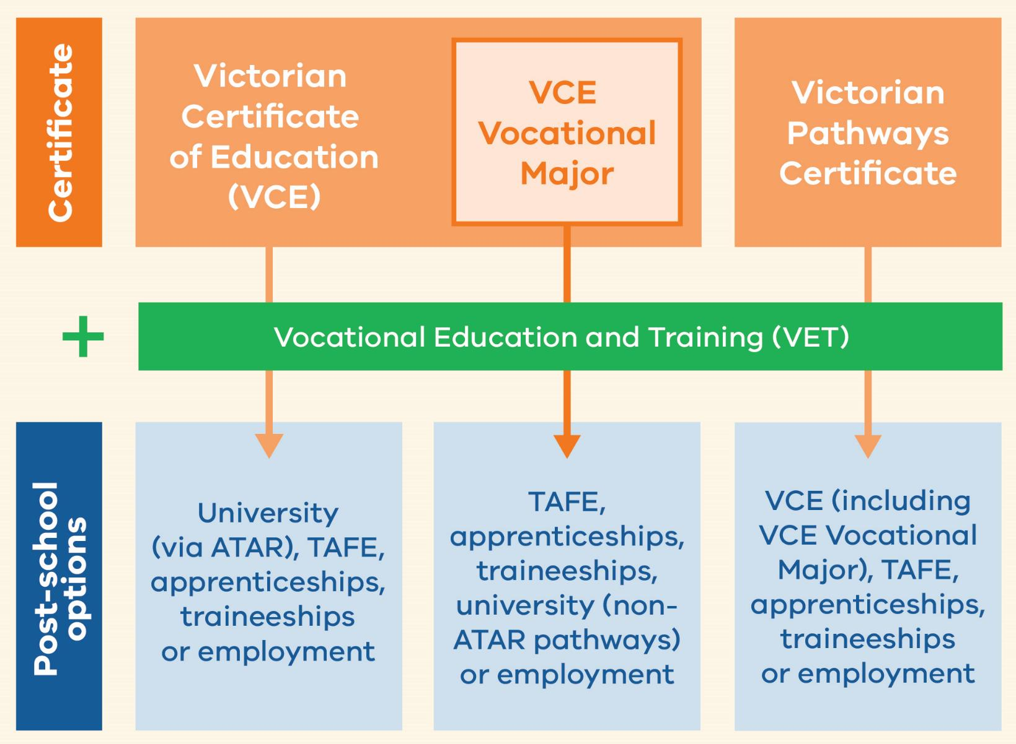
Your options
Two certificates available: VCE and VPC
VCE Vocational Major is a program within the VCE
Any student can include VET
Think about your interests and goals to make your choice

Slide 10
Quick comparison
Victorian Certificate of Education (VCE) |  | Victorian Pathways Certificate By school recommendation only.
VCE | VCE Vocational Major
A great choice if you ... | A great choice if you... | A great choice if you...
prefer to learn in the classroom | prefer to learn in the real world and classroom | prefer to learn in the real world and classroom
need an ATAR for your goals | don't need an ATAR for your goals | don't need an ATAR for your goals
want to develop confidence in academic learning | want to develop confidence in the workplace | want to develop confidence in practical skills
want to pursue university immediately after Year 12, or pursue TAFE, an apprenticeship, a traineeship, or full-time work | want to pursue TAFE, an apprenticeship, a traineeship, or full-time work immediately after Year 12, or pursue university after time in training or work | want to complete the VCE, entry-level VET or start full-time work after Year 12
are ready to do the VCE. | are ready to do the VCE. | need flexibility to complete Year 11 and 12.

Slide 11
Victorian Certificate of Education (VCE)
Depending on availability, students can choose from more than 90 subjects (called studies) to suit their interests, talents and goals
Can also include Vocational Education and Training (VET) in the VCE
Each study has 4 units: Units 1 & 2 (Year 11) and Units 3 & 4 (Year 12). One unit = one semester
Students study between 16 and 24 units over 2 years
Assessment in school and final exams lead to a study score for each study
Study scores lead to an ATAR for direct university entry

Slide 12
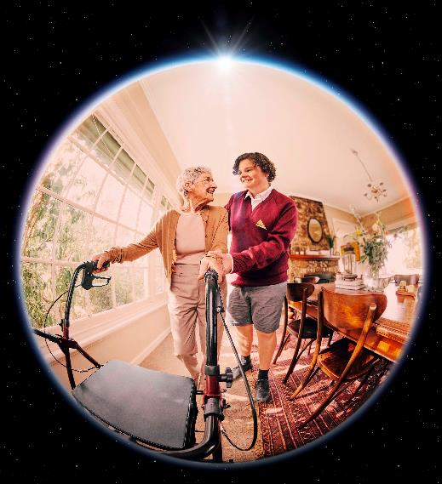
VCE Vocational Major (VCE VM)
Program within the VCE
Students study 16 to 20 units over 2 years
Four core study areas:
VCE VM Literacy
VCE VM Numeracy
VCE VM Personal Development Skills
VCE VM Work Related Skills
Can include other VCE studies
Must include Vocational Education and Training (VET) in the program
Assessment in school for each study (not exams)
No study scores or ATAR from VCE VM studies

Slide 13
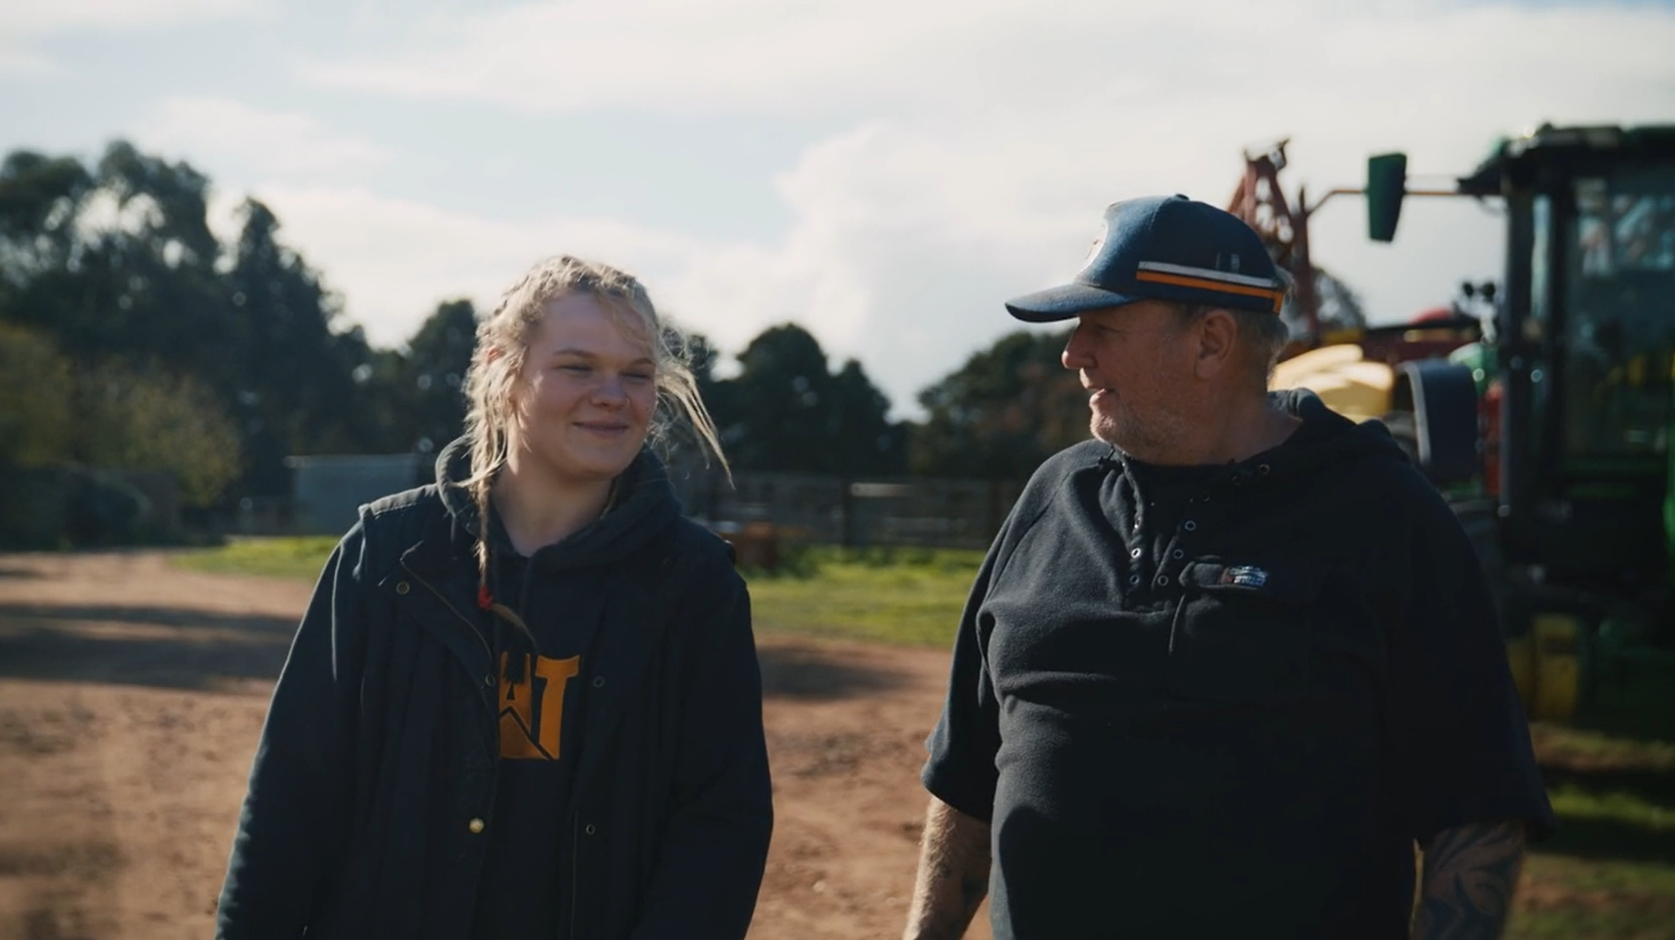
VCE Vocational Major: Supporting student goals
Click to play

Slide 14
New studies available to all VCE students from 2025
VCE VM Work Related Skills
VCE VM Personal Development Skills
Build communication and teamwork skills and learn how to negotiate important workplace relationships.
Explore different career options, develop a career action plan, and build job-seeking skills.
Learn about healthy and safe workplaces, your rights at work, and how to support the people you work with.
Learn about and build your emotional intelligence, social awareness, and leadership qualities.
Plan and deliver a project to help your community, in a group with other students.
Explore how communities work together on a local, national, and global scale.
These studies prepare students with valuable skills for work and life. They do not contribute to an ATAR.

Slide 15
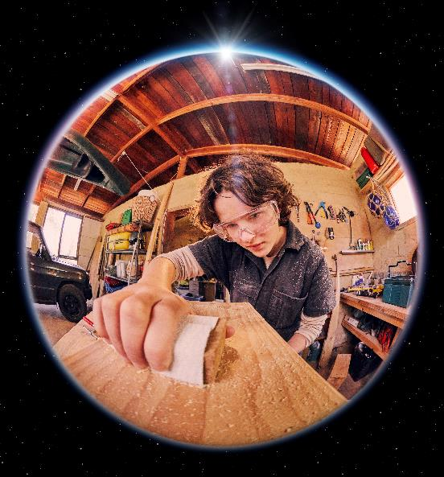
Victorian Pathways Certificate (VPC)
Stand-alone certificate for students in Year 11 and 12
Designed for students who would benefit from a more individualised program at a more accessible level than the VCE
Provides opportunities in developing employability skills and preparing students for further study or the workforce
Program can include VCE studies (including VCE VM studies) or VET
Acceptance into this course is a shared decision between the school, the student, and parents or carers

Slide 16
Is the VPC right for you?
The Victorian Pathways Certificate (VPC) may be appropriate if a student:
is re-engaging in school or had a highly modified program during their schooling from F–10.
has additional or complex social and wellbeing needs.
has a disability, a Disability Inclusion Profile, or an Individual Education Plan during their schooling from F–10.

Slide 17
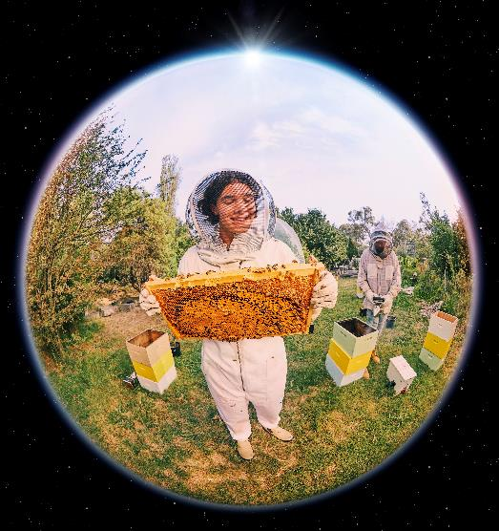
Vocational Education and Training (VET)
Can be included in the VCE or VPC
Nationally recognised qualifications
Industry specific knowledge, practical skills and experience
More than 40 certificate qualifications across 28 VCE VET programs
Options include courses in health, engineering, digital media, building and construction, early childhood education, and many more
Undertaken at a TAFE or other Registered Training Organisation (RTO), or in-school

Slide 18
Defining the language
Vocational learning – focuses on the learning activities that take place in a real or simulated workplace
Applied learning – students take the things they have been learning about in theory and put them into practice. Then they reflect on the outcome and improve on it the next time
Structured Workplace Learning (SWL) – learning in the workplace with specific goals, either during the school week or in a block during holidays

Slide 19
Post-school pathways

Slide 20
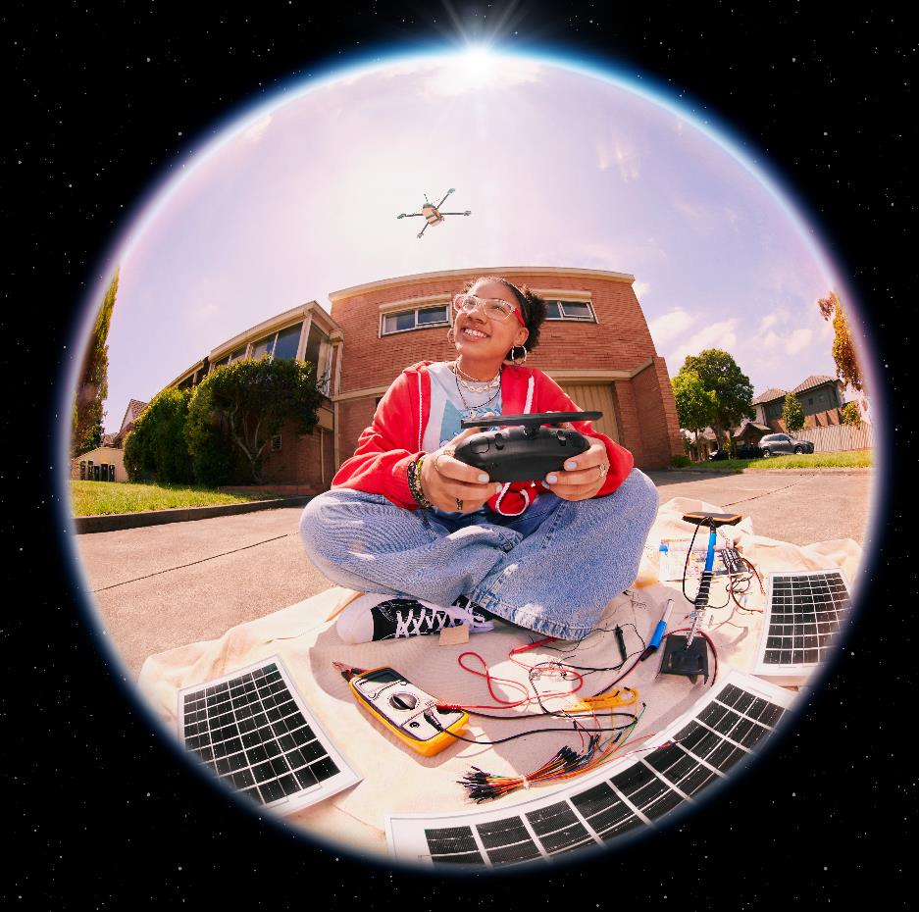
Education for future success
Nearly 80% of students leaving Year 12 do further study at TAFE or university immediately after school
More will study in subsequent years
More than 90% of new jobs in Victoria will require post-school qualifications (university or TAFE)

Slide 21
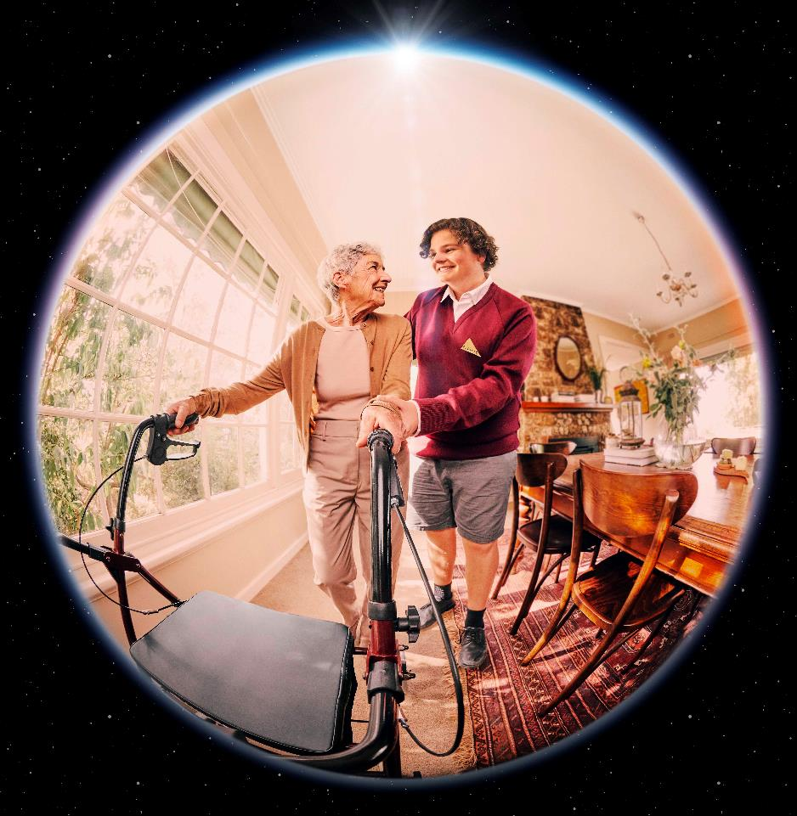
Why finish school?
Completing Year 12 sets up you up for life-long learning
It means you will be ready to keep learning as you navigate your career and the opportunities of career changes throughout your life
Continued education and training after school leads to higher paying jobs and better health over a lifetime

Slide 22
What is TAFE?
TAFE institutes deliver nationally-recognised vocational education and training (VET) courses
Provides practical skills used in a job/industry (e.g. engineering, community services, clean energy, health)
Provides qualifications (Certificate, Diploma, Advanced Diploma, Graduate Diploma) required for many jobs
Many people go to TAFE first, and then university
16 TAFE institutes in Victoria, including some universities
TAFEs can deliver VET to school students
More than 80 post-school VET courses at TAFE are free
More information: vic.gov.au/free-tafe

Slide 23
Getting into university or TAFE
Direct entry ​with an Australian Tertiary Admission Rank (ATAR)
An alternate entry​ for courses with non-ATAR entry requirements using: folios, work experience or relevant pre-requisites for the alternative pathways to further study​
TAFE entry​ contact the preferred TAFE for their entry requirements​

Slide 24
Choosing the right pathway
What do you want to do after finishing secondary school?
Further study/work?​
Don’t know yet? That’s ok.
Think about your interests and strengths.
Read the information provided
Talk to careers staff teachers/parents​.

