Slide 1
Senior Secondary Certificate Reform Curriculum consultation Vocational specialisation

Slide 2
Certificates in Victoria
Foundation Pathways Certificate
AQF level 1
Standards based
Vocational Specialisation in the VCE
AQF Level 2-3
Standards based
VCE
AQF Level 2-4
Standards and examinations
Highly flexible
Flexible
Structured
Students, parents and schools choose in partnership most appropriate course – student need, aspiration and capability
Standards based courses – teachers assess whether a student meets the standards in the curriculum documents. Students receive an ‘S’ or ‘N’ result.
Enhanced statement of results – what they know and can do, have achieved.

Slide 3
Our hopes for this curriculum
Students engaging in the learning
Importance / relevance
about them and their futures
Self efficacy /achievable
teach at different levels for success /flexible
Emotional response
feel intrigued / curious/ excited / control /anxious
Marzano the Self System Effect size .74 / 27pp

Slide 4
New curriculum ready for feedback
Based on the VCAL strands
Developed by teams of teachers lead by our curriculum team
Tested already with a range of targeted consultation, both within and outside VCAA
Best of the old – supplemented by new material
Four curriculum documents:
Literacy 1–4
Numeracy 1–4
Personal Development Skills 1–4
Work Related Skills 1–4.

Slide 5
Draft Vocational specialisation* structure
Students will undertake 16–22 units. This can include credit at Units 1 & 2 for Structured Workplace learning recognition
Minimum requirement for satisfactory completion: 16 units, which must include:
3 units of Literacy or VCE English, including a 3–4 sequence
2 units of Numeracy or VCE Mathematics
2 units of Work Related Skills
2 units of Personal Development Skills
2 credits of VET at Certificate II level or above.
Students will be required to complete a total of 8 units at Units 3–4 level.
*to be renamed

Slide 6
Consultation timeline
Consultation closes midnight Sunday 12 September.
Accessed via VCAA website: www.vcaa.vic.edu.au/victorianseniorsecondarycertificatereform/Pages/Index.aspx
Final curriculum published early 2022
Implementation from 2023.

Slide 7
Vocational specialisation study designs
VCE study design format (as they will be a program within VCE)
Format familiar to those who have worked with VCE:
Introduction, scope of study, rationale and aims
Units, areas of study, outcomes, key knowledge and key skills
(new) Evidence for Assessment
Four-unit structure
Minimum of 50 hours of scheduled class time per unit
Units 1 and 2 provide a progression to Units 3 and 4.

Slide 8
Implementation support and resources
Advice for Teachers will be published
Will include case studies and examples, particularly of ways to integrate units
Professional learning program in 2022
Regional and metropolitan areas/cross sectoral
Enhanced quality assurance/audit program.

Slide 9
Study designs

Slide 10
Numeracy – Aims
Students will:
develop and enhance numeracy practices to help make sense of personal, public and vocational lives
develop mathematical skills with consideration of local, national and global environments and contexts, and an awareness and use of appropriate technologies

Slide 11
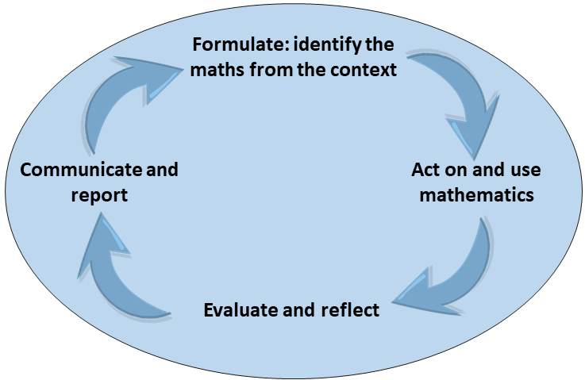
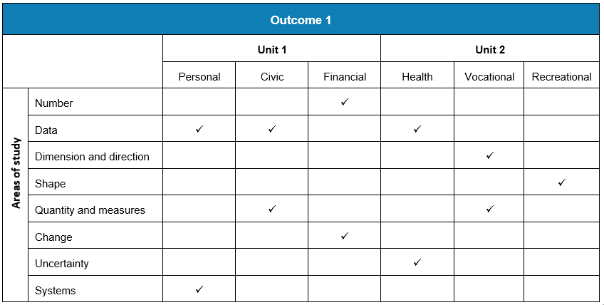
Numeracy each unit has 3 Outcomes
Outcome 2 Problem Solving
Outcome 1
Outcome 3
Tool kit

Slide 12
Eight areas of study name and describe a range of different mathematical knowledge and skills that are expected to be used and applied across the three outcomes
Outcome 1 is framed around six different numeracies:
Personal numeracy
Civic numeracy
Financial numeracy
Health numeracy
Vocational numeracy
Recreational numeracy.

Slide 13
Literacy – Aims
Students will:
develop the knowledge and skills required in order to be confident users of written and oral communication
understand that different audiences require different types of language
develop the knowledge and skills required to be able to produce a range of workplace documentation
have the confidence to present ideas in a thoughtful and reasoned manner

Slide 14
Literacy: Units 1–4
Unit 1 | Unit 2
Literacy for personal use Understanding and creating digital texts | Understanding the language of public debate Responding to opinions
Unit 3 | Unit 4
Accessing and understanding specialised texts Creating and responding to specialised texts | Understanding and engaging with literacy for persuasion and promotion Speaking to advise or advocate: Option 1: Literacy for civic participation Option 2: Literacy for everyday personal contexts

Slide 15
Personal Development Skills – Aims
Students will:
develop a sense of identity and self-worth
access, critique, synthesise and communicate reliable information
practise the rights and responsibilities of belonging to a community
recognise and describe the attributes of effective leaders
work independently and as part of a team to understand and respond to community issues
develop capacities to participate in society as active, engaged and informed citizens.

Slide 16
Personal Development Skills: Units 1–4
Unit 1 | Unit 2
Healthy individual Identity and Self-care Health in action Social media and communication | Connecting with community What is community Community cohesion Community support
Unit 3 | Unit 4
Leadership and goal achievement Self-management for goal achievement Effective leadership Leadership and collaboration | Researching a community issue Plan and initiate a response to community issue Communicate and evaluate the project

Slide 17
Work Related Skills – Aims
Students will:
understand and apply concepts and terminology related to the workplace
understand the complex and the rapidly changing world of work and workplace environments
understand the relationship between skills, knowledge, capabilities and attributes, and the achievement of pathway goals
develop effective communication skills to enable self-reflection and self-promotion
practically apply skills and knowledge.

Slide 18
Work Related Skills: Units 1–4
Unit 1 | Unit 2
Careers and Learning for the Future Future careers Presentation of career and education goals | Workplace Skills and Capabilities Skills and capabilities for employment and further education Transferable skills and capabilities
Unit 3 | Unit 4
Industrial Relations, Workplace Environment and Practice Workplace wellbeing and personal accountability Workplace responsibilities and rights | Portfolio Preparation and Presentation Portfolio development Portfolio presentation

Slide 19
Q & A session

