Slide 1
VCE Geography
Implementation of VCE Study Design for 2022 - 2026
Question and Answer Session
Wednesday 12 May

Slide 2
The copyright in this PowerPoint presentation is owned by the Victorian Curriculum and Assessment Authority or in the case of some materials, by third parties. No part may be reproduced by any process except in accordance with the provisions of the Copyright Act 1968 or with permission from the Copyright Officer at the Victorian Curriculum and Assessment Authority.

Slide 3

Acknowledgment of Country
I would like to acknowledge the traditional custodians of the many lands across Victoria on which each of you are living, learning and working from today.
For those of you in the Melbourne metropolitan area, we acknowledge the traditional custodians of the Kulin Nations. For myself, I acknowledge the Wadawurrung people of the Lake Burrumbeet region, near Ballarat, from where I am working today.
When acknowledging country, we recognise Aboriginal and Torres Strait Islander peoples’ spiritual and cultural connection to country and acknowledge their continued care of the lands and waterways over generations, while celebrating the continuation of a living culture that has a unique role in this region.
I would like to pay my respects to Elders past, present and emerging, for they hold the memories, traditions, culture and hopes of all Aboriginal and Torres Strait Islander peoples across the nation, and hope they will walk with us on our journey. I particularly welcome any first nations people who are joining us today.

Slide 4
Purpose
Support VCE teachers in implementing and delivering the newly accredited Geography Study Design 2022-2026
Answer questions related to the adjusted study design content and school-based assessment in a live Q and A
(both pre–sent questions and live)

Slide 5
Advice for teachers
The Geography Advice for teachers has been published online and can be accessed from the Geography study web page
https://www.vcaa.vic.edu.au/curriculum/vce/vce-study-designs/geography/Pages/Index.aspx
Please note – Performance Descriptors to be developed

Slide 6
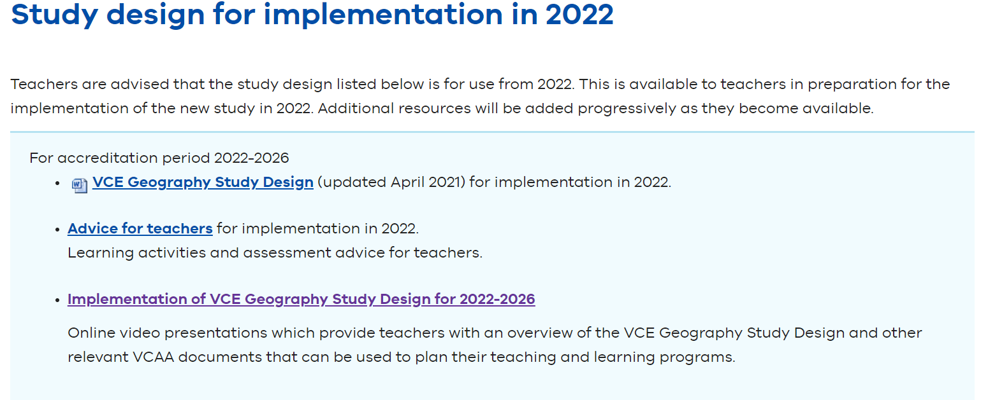

Slide 7
Characteristics of the study
Key geographical concepts
Geographic skills
Geospatial technologies
Fieldwork Report

Slide 8
Unit 1 : Hazards and disasters

Slide 9
Terminology – factors AoS 1
  economic
  social
  political
  environmental
  cultural

Slide 10
Terminology Area of Study 2
trend or pattern - broad problem
issue
challenge

Slide 11
Advice for teachers
One of the key aims of the study of VCE Geography is to enable students to analyse issues and challenges to human welfare and the environment, at a range of scales.
An issue can be understood as a broad problem which needs to be addressed and a challenge is a specific difficulty in addressing the issue. Issues often arise as the result of geographical change such as a hazard event, the development of tourism, a change in land cover or population dynamics.

Slide 12
Unit 2 : Tourism : issues and challenges

Slide 13
Unit 1 and 2 Assessment

Slide 14
VCAA Principles of Assessment
should be
valid and reasonable
equitable
balanced
efficient

Slide 15
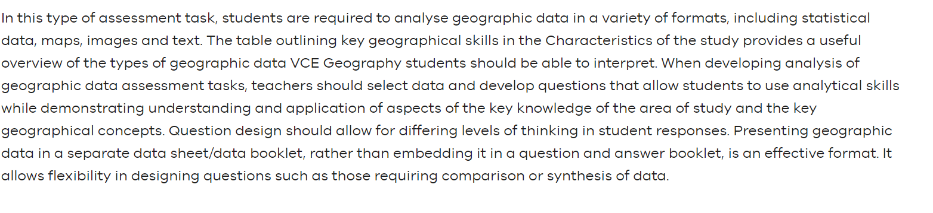
Analysis of geographic data

Slide 16
Case study

Slide 17
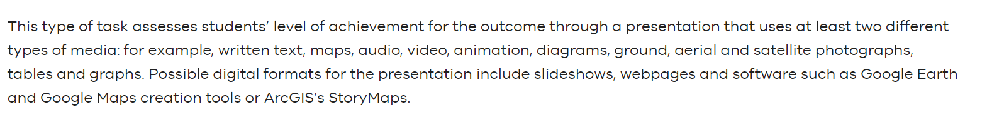
Multi-media presentation

Slide 18
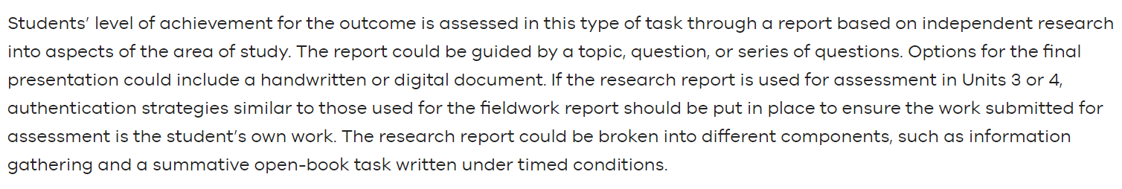
Research report

Slide 19
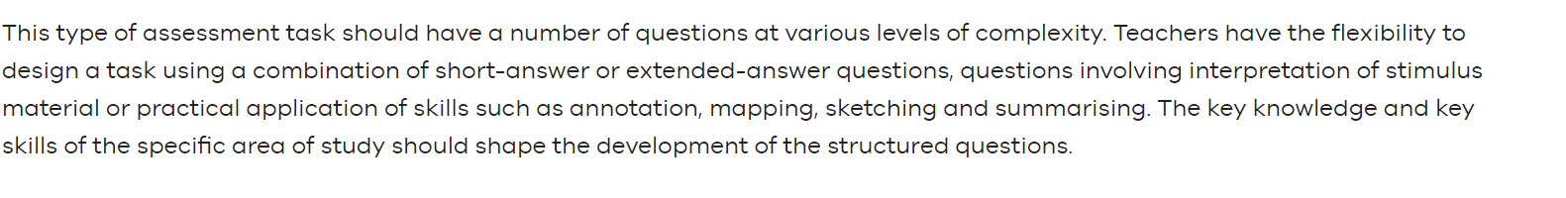
Structured questions

Slide 20
Unit 3 Changing the land

Slide 21
Unit 4 : Human population trends and issues

Slide 22
Area of Study 2 Outcome 2
Key skill
analyse the causes and impacts of issues and challenges that arise in responding to these issues

Slide 23
Unit 3 and 4 Assessment

Slide 24
Resources
For more information visit the VCAA website for:
VCE Geography Study Design
VCE Geography Advice for Teachers 2022 - 2026
Examination Specifications (not available as yet)

Slide 25
Contact
Leonie Brown
VCAA Humanities Curriculum Manager
Leonie.Brown4@education.vic.gov.au
Phone 03 9059 5143
Mobile 0407 279 470
Thank you

