Slide 1
Introducing English

Slide 2
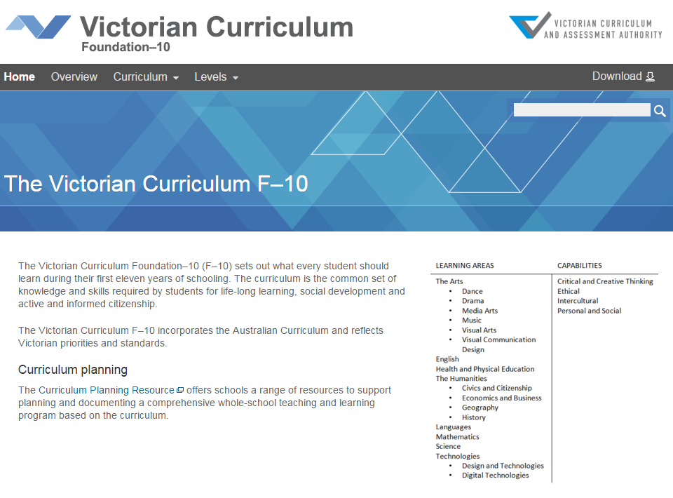
Victorian Curriculum F–10
Released in September 2015 as a central component of the Education State
Provides a stable foundation for the development and implementation of whole-school teaching and learning programs
The Victorian Curriculum F–10 incorporates the Australian Curriculum and reflects Victorian priorities and standards
http://victoriancurriculum.vcaa.vic.edu.au/

Slide 3
Aims
The English curriculum aims to ensure that students:
learn to listen to, read, view, speak, write, create and reflect on increasingly complex and sophisticated spoken, written and multimodal texts across a growing range of contexts with accuracy, fluency and purpose
appreciate, enjoy and use the English language in all its variations and develop a sense of its richness and power to evoke feelings, convey information, form ideas, facilitate interaction with others, entertain, persuade and argue
understand how Standard Australian English works in its spoken and written forms and in combination with non-linguistic forms of communication to create meaning
develop interest and skills in inquiring into the aesthetic aspects of texts, and develop an informed appreciation of literature.

Slide 4
Structure
The English curriculum is organised by three language modes and then strands
Language mode | Reading and Viewing | Writing | Speaking and Listening
Achievement standards
The achievement standards are structured by language mode.
The first achievement standard at Foundation and then at Levels 1, 2, 3, 4, 5, 6, 7, 8, 9 and 10
A curriculum for students with disabilities is provided in this learning area

Slide 5
Structure Within each language mode, the content descriptions are grouped into strands and sub-strands
Strand | Sub-strands
Language | Language variation and change
 | Language for interaction
 | Text structure and organisation
 | Expressing and developing ideas
 | Phonics and word knowledge
Strand | Sub-strands
Literature | Literature and context
 | Responding to literature
 | Examining literature
 | Creating literature
Strand | Sub-strands
Literacy | Texts in context
 | Interacting with others
 | Interpreting, analysing, evaluating
 | Creating texts

Slide 6
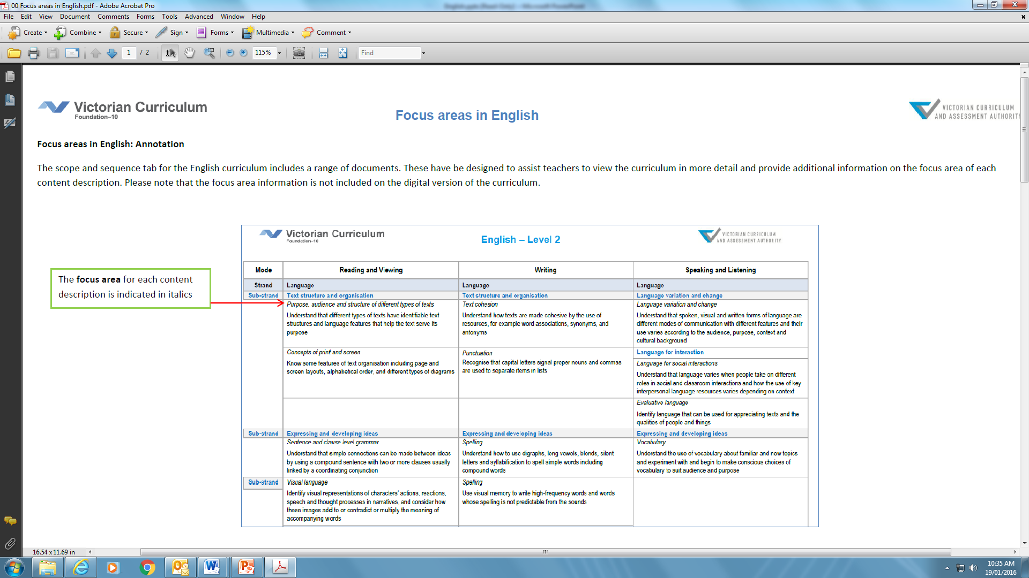
Focus areas
Focus area information is not included on the digital version of the curriculum.
This information is located on the Scope and Sequence charts.
http://victoriancurriculum.vcaa.vic.edu.au/english/introduction/scope-and-sequence
Notes:
The English curriculum is organised by language modes and strands.
The language modes are interrelated and the learning in one often supports and extends learning of the others. Each content description has been placed in the mode which is the major focus of its learning.
Classroom contexts that address particular content descriptions will necessarily draw on more than one of these modes in order to support students’ effective learning. For example, students will learn new vocabulary through listening and reading and apply their knowledge and understanding in their speaking and writing as well as in their comprehension of both spoken and written texts.
Within each language mode, the content descriptions are grouped into strands and sub-strands.
An annotated example of the English curriculum, shown here, is available and is designed to assist teachers to understand the structural elements when viewing the curriculum.

Slide 7
Key messages
English in the Victorian Curriculum is substantially similar to AusVELS English, with the majority of the curriculum unchanged.
However, there have been some changes to strengthen particular areas and clarify others:
Phonics and word knowledge strengthened
Handwriting revised to make connection between phonics and handwriting more explicit
Content descriptions added to improve developmental continuum
Removal of duplicate content
Consolidation of similar content
Reporting progress in English
These changes do not cause a break in reporting data and student progress can be shown from AusVELS English to the Victorian Curriculum F–10 English

Slide 8
Key messages – EAL Update
Work is being undertaken to update the EAL Companion to the Victorian Curriculum F-10
Schools should continue to use the current version during 2016

Slide 9
Key messages - Literacy across the curriculum
Literacy is foundational to all learning areas and capabilities in the Victorian Curriculum.
It is not one of the four capabilities which have separately articulated content descriptions and achievement standards.
Students develop knowledge and skills across the Language and Literacy strands of the English curriculum.
Much of the explicit teaching of literacy occurs in the English learning area, however, it is strengthened, made specific and extended in other learning areas as students engage in a range of learning and assessment with significant literacy demands.
Resources will be prepared to support teachers to understand the language demands of different learning areas, and demonstrate how English content descriptions apply to particular texts.
Notes:
You have to ‘literacy’ about something.

