Slide 1
Introducing Geography

Slide 2
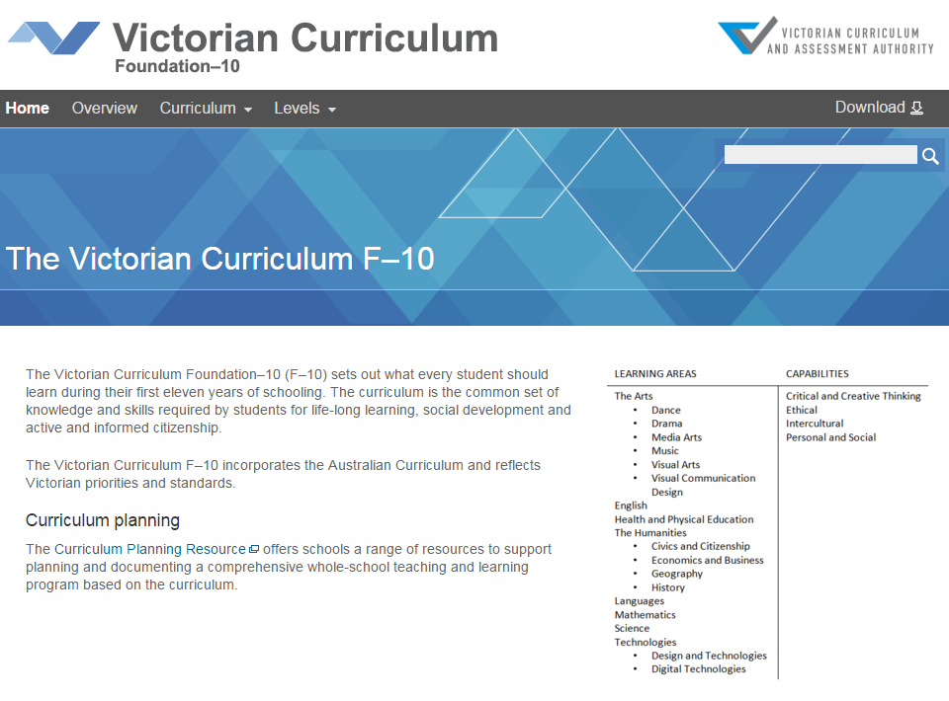
Victorian Curriculum F–10
Released in September 2015 as a central component of the Education State
Provides a stable foundation for the development and implementation of whole-school teaching and learning programs
The Victorian Curriculum F–10 incorporates the Australian Curriculum and reflects Victorian priorities and standards
http://victoriancurriculum.vcaa.vic.edu.au/

Slide 3
Aims
The Geography curriculum aims to ensure that students develop:
a sense of wonder, curiosity and respect for places, people, cultures and environments throughout the world
a deep geographical knowledge of their own locality, Australia, the Asia region and the world
the ability to think geographically, using geographical concepts
the capacity to be competent, critical and creative users of geographical methods and skills
the capacity to be informed, responsible and active citizens who can contribute to the development of a world that is environmentally and economically sustainable, and socially just.

Slide 4
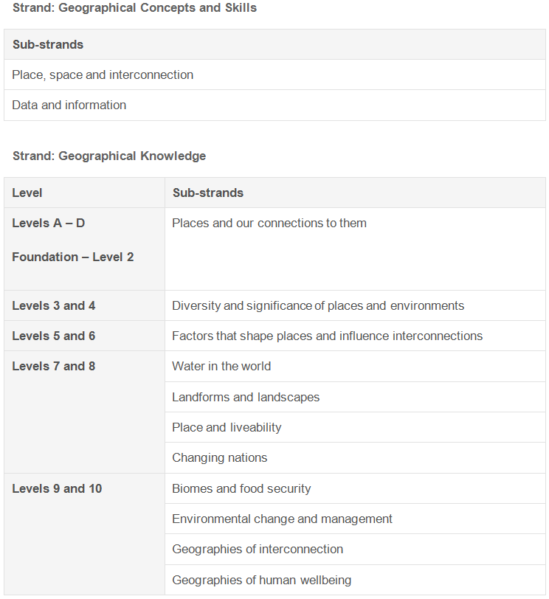
Structure
Structure: Strands and sub-strands
Achievement standards
The first achievement standard at Foundation – Level 2 and then at Levels 4, 6, 8 and 10.
A curriculum for students with disabilities is provided in this learning area.

Slide 5
Key messages
No longer general Humanities from F–4
Specific Geography curriculum from F–10
Revised structure
Development of conceptual thinking strengthened
Significant revisions to knowledge and skills
Revisions to achievement standards

Slide 6
Key messages
Geographical concepts and skills
Strengthens the progression of geographical skills essential to working with data and information
Seven concepts underpin the whole curriculum:
Place
Space
Interconnection
Environment
Sustainability
Scale
Change

