Slide 1
Introducing Media Arts

Slide 2
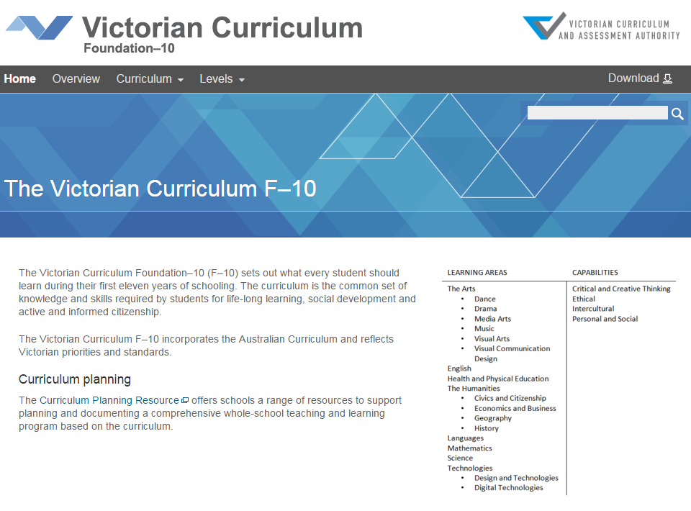
Victorian Curriculum F–10
Released in September 2015 as a central component of the Education State
Provides a stable foundation for the development and implementation of whole-school teaching and learning programs
The Victorian Curriculum F–10 incorporates the Australian Curriculum and reflects Victorian priorities and standards
http://victoriancurriculum.vcaa.vic.edu.au/

Slide 3
Aims
The Media Arts curriculum aims to develop students’:
conceptual and perceptual ideas and representations through design and inquiry processes
understanding of the use of the techniques, materials, processes and technologies
critical and creative thinking skills, Media Arts languages, knowledge of Media Arts theories and practices
respect for and acknowledgement of the diverse roles, innovations, traditions, histories and cultures of artists, designers, commentators and critics
understanding of Media Arts social, cultural and industry practices
confidence, curiosity, imagination, enjoyment and a personal aesthetic.

Slide 4
Structure
Strands
Explore and Represent Ideas | Media Arts Practices | Present and Perform | Respond and Interpret
Achievement standards
The first achievement standard at Foundation and then at Levels 2, 4, 6, 8 and 10.
A curriculum for students with disabilities is provided in this learning area.

Slide 5
Key messages
Each Arts discipline is based on two overarching principles:
students learn as artist and as audience
students learn through making and responding
The addition of an achievement standard in Foundation reflects the advice in Victorian Curriculum F–10: Revised curriculum planning and reporting guidelines about the importance of the Arts in the early years of schooling
The five interrelated key areas of media languages, media technologies, institutions that produce media artworks, audiences and constructed representations of the world, provide a framework within which students operate to create and analyse media artworks. They develop understanding of how representations, including constructed realities of the world, are communicated through languages and technology, for an audience in communities and institutional contexts.

