Slide 1
Introducing Visual Communication Design

Slide 2
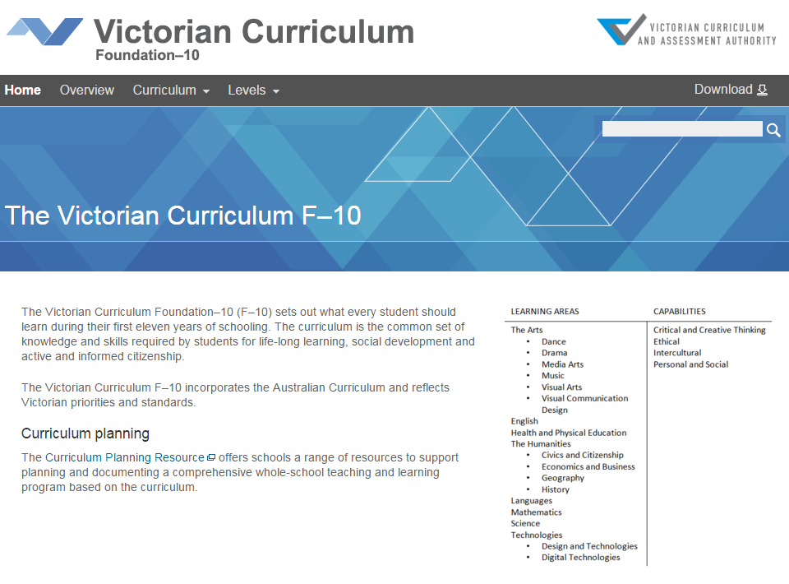
Victorian Curriculum F–10
Released in September 2015 as a central component of the Education State
Provides a stable foundation for the development and implementation of whole-school teaching and learning programs
The Victorian Curriculum F–10 incorporates the Australian Curriculum and reflects Victorian priorities and standards
http://victoriancurriculum.vcaa.vic.edu.au/

Slide 3
Aims
The Visual Communication Design curriculum aims to develop students’:
confidence, curiosity, imagination and enjoyment through an engagement with visual communication design practices
creative and innovative ways to communicate ideas and information
aesthetic knowledge, including the application of design elements and principles, as they explore visual communications
visual communication design practices, processes and technologies
creative, critical and reflective thinking, using visual design thinking skills
respect for and acknowledgement of the diverse roles and practices of designers, and the cultural context of visual communication design.

Slide 4
Structure
Strands
Explore and Represent Ideas | Visual Communication Design Practices | Present and Perform | Respond and Interpret
Achievement standards
The first achievement standard at Level 8 and then at Level 10.

Slide 5
Key messages
Each Arts discipline is based on two overarching principles:
students learn as artist and as audience
students learn through making and responding
Visual Communication Design curriculum involves the
communication of ideas and information through the use of:
drawing conventions
design elements and principles
skills, techniques and processes.
Students learn about and explore traditional and contemporary conventions involved in the making of visual communication designs. These include the use of design elements such as point, line, shape, colour, tone, texture, form and type, and principles such as balance, contrast, scale hierarchy, cropping, proportion, figure ground and pattern.

